Slide 1


STUDENT HANDBOOK
FORMULA SAE MICHIGAN
BROOKLYN, MICHIGAN
MAY 9-12 2018
Revision date of January 8th 2018

Slide 2
TABLE OF CONTENTS
EVENT SITE OPERATIONS
On-Site Contact Information & First Aid 4
Event Site Review 5-6
Photography Rule 7
Honda Paddock Rules 8
Restricted Area & Access 9-10
Hospitality 11
SCHEDULE
Daily Schedule 12
Detailed Schedule 13-15
Schedule Notes 16
Support Services 17
Sponsor Skillshop Schedule 18
Static Schedules 19-22
Cost Event Schedule 23
Presentation Event Schedule 24
Design Event Schedule 25
REGISTERED TEAM LISTS
Numerically 26-28
AWARDS
List 29
Ceremonies - Sponsored by General Motors 30
TECHNICAL INSPECTION – SPONSORED BY CUMMINS
Event Description 31-33
Scales
Event Description 34
STATIC EVENTS
COST EVENT
Event Description 35-36
Real Case Cost Scenario 37
DESIGN EVENT – SPONSORED BY BOSCH
Event Description 38-39
SALES PRESENTATION EVENT
Event Description 40-41

Slide 3
TABLE OF CONTENTS
DYNAMIC EVENTS
FUEL & TILT TABLE EVENT
Event Description 42-43
BRAKE & NOISE TEST EVENT – SPONSORED BY AKEBONO
Event Description 44-46
PRACTICE TRACK – SPONSORED BY MAHLE
Event Description 47-48
ACCELERATION EVENT – SPONSORED BY ROUSH
Event Description 49
SKID PAD
Event Description 50
AUTOCROSS – SPONSORED BY MAGNA
Event Description 51-52
FORD ENDURANCE & FORD FUEL EFFICIENCY EVENT
Event Description 53-57
MAPS
MIS Site Map 58
Garage Layout 59
Paddock Layout 60
Cost Event Map 61
Fuel/Tilt/Noise Layout 62
Fuel Station Layout 63
Brake Layout 64
Practice Track Layout 65-66
Acceleration Layout 67
Skid Pad Layout 68
Autocross Layout 69
Endurance Map 70
LOCAL MERCHANTS
Places To Eat 71-73
Motorcycle Shops & Fire Extinguisher Suppliers 74
Racing Supplies 75-76
Local Business Guide 77
Student Survival List 78
TIMING AND SCORING TECHNOLOGY 79
DESIGN JUDGES BIOGRAPHIES 80-101
SPONSORS 102

Slide 4
ONSITE CONTACT INFORMATION
G1 will be staffed with volunteers and the Official Announcer will be in the Main Tent at all times that the competition is in progress.
For all other communication, stewards and event crew should find the nearest event official or Paddock Patrol/Spectator Marshal volunteer with a mobile radio.
STUDENTS MAY CONTACT:(After Hours)
Kaley Zundel 412-719-2865
Ryan Good 724-859-5402
FIRST AID INFORMATION
There will NOT be a First Aid Station on site. All incidences will be covered by EMS or one of the two supporting fire trucks.
To expedite matters in case of accident or injury after-hours, simply call 911.
STORM SHELTER:
In the event of severe weather, we have been instructed by MIS management to gather inside the Pedestrian Tunnels.
Local Emergency Contact Information for MIS Area
MedPlus – After Hours Clinic
212 South Main Street
Brooklyn, MI 49230
(517) 592-6047
Mon.-Fri.: 5 p.m. – 10 p.m. Sat.-Sun. 10 a.m. – 6 p.m.

Slide 5
EVENT SITE REVIEW
ASK QUESTIONS: If you have a question – ask! If you have any questions about any part of the competition, the schedule, the procedures, the rules or anything else, just ask one of the officials. The first place to bring questions is to the staff in the registration area. Rules questions may be presented to the technical inspectors.
ANNOUNCEMENTS: Announcements requesting parts, tools or assistance can be made by the announcer in the Main Tent. In addition, the sound system will be FM Broadcasted. We will announce at the Welcome Ceremony and remind teams at Drivers' meetings of what the frequency is. Event Announcements will also be available on Live Mobile Scoring Website.
ARRIVAL: In order to prevent traffic backlogs onto U.S. 12, please plan to arrive at MIS no earlier than 7:30 a.m. Wednesday, May 9.
BE ON TIME: The schedule is included in the Student Handbook and posted online. It is your responsibility to be on time.
BRING YOUR DOCUMENTATION: When you come to tech inspection bring all the documentation and correspondence connected to your (1) SEF submission, (2) Impact Attenuator Data Report and (3) any Rules Questions you submitted. The inspectors do not have immediate access to this material and you may need it to answer questions about your vehicles design and construction. The inspectors want you to pass tech and pass it easily, but they need your help to make that happen.
DO NOT RUN: Running tells people there’s an emergency. Do not run unless life or limb is in danger.
DRIVER MEETINGS: Attending ALL drivers’ meetings is mandatory if you are planning to drive. Attendance may be taken.
DYNAMIC/TECH AREA PASSES: Each team is issued 4 dynamic area passes. You must have a pass to gain access to the dynamic events areas. This pass is also used for tech inspection as we limit the number of team members with the car in tech to 4.
ENTERING AND EXITING THE SITE: Trucks cannot fit in through the General Entrance (Gate 21) tunnel off Brooklyn Highway. All team member cars are to park outside oval in MIS Fan Zone located near Gate 21. The formula car transportation trucks must enter in and out through the US 12 (Gate 12) entrance. You will be driving across the track, so on Friday and Saturday the truck entrance will be closed when dynamic events are running; teams will need to arrange for escorts in G1.
EVENT CLOSING TIMES: Friday dynamic event times will be expanded and consist of a staggered opening. All events will close at 5 p.m. Your car must have crossed the starting line by that time or you can’t run.

Slide 6
EVENT SITE REVIEW CONT.
PARKING: All students will need to park outside of track in MIS Fan Zone. Paddocks can only contain FSAE Vehicle transporter. and 1 commuter vehicle if it fits in your paddock.
PHOTOGRAPHY: For 2018, there will be no controlled area for photographers to have an unblocked view of the Autocross and Endurance due to expansion of Endurance. Acceleration can be photographed from the top of the suite area. There will be no photography areas available for Skid Pad. Official press will be escorted onto track; credentials required. Event photographs captured by SAE photographer will be made public.
PUSH BAR: You can only move your car if you use the push bar. Please Note: Push Bar Competition will NOT be operating this year.
REMOVING CARS OVERNIGHT: Removing your car from MIS overnight is entirely your decision. If you want to take your car off site you must take it to tech inspection and have an inspector remove part one of the tech sticker. When you return you’ll need to have the items you’ve worked on re-inspected.
RESTRICTED AREAS: At MIS, we are only authorized to use the infield, back straight, Pit Lane, garages and certain surrounding facilities. We are not permitted on the other parts of the main oval or the buildings immediately adjacent to the main oval. Please respect these restrictions.
SECURITY: Keep your equipment locked up. This is a large site and security can’t be everywhere. Don’t leave your tools, computers and other equipment lying around where they could be stolen.
SOCIAL MEDIA: #FSAEMICHIGAN
https://www.facebook.com/FormulaSAE
https://twitter.com/formulasae
SPECTATORS: Spectators are welcome to attend FSAE. If you have friends or family who want to see the competition, tell them to park in MIS Fan Zone near gate 21 on Brooklyn Highway and walk through pedestrian tunnels. Spectators must go to Registration in Garage 1 to sign the SAE waiver and receive their wristband. Please note to all spectators closed toed shoes are preferred. No pets allowed; except guide dogs.
TRANSLATORS: If you have a driver who isn’t fluent in English, you must have a translator. Translators must be in the dynamic events area and available to the officials when that driver is on the course. Translators will be issued an additional dynamic area pass. If you need a dynamic area pass for your translator - ask at the registration area.
WEATHER: In May, the local weather can be unpredictable. We encourage you to be prepared for all weather types from sun to rain. Pack long and short sleeve apparel, sun block, coats and comfortable; closed-toe shoes.

Slide 7
PHOTOGRAPHER RULES
RULES FOR ALL PHOTOGRAPHERS ON TRACK
DYNAMIC EVENTS AREA: For 2018, Students will not have a separate controlled area on the track due to Endurance course expansion. Acceleration can be photographed from the top of the suite area. There will be no photography area available for Skid Pad.
AUTHORIZATION: SAE staff is solely responsible for authorizing professional photographers/spotters, such as media, to enter the dynamic event area. Photographers/spotters must (1) be registered for the competition, (2) sign all required waivers, (3) read any required material, (4) agree that they understand and have no questions regarding the policies and procedures for photographers, and (5) agree to abide by these policies and procedures at the risk of being escorted from the dynamic area.
Videographers are classified as photographers.
Photographers must have photographic equipment – cell phones are not cameras.
ACCESS POLICY: Properly credentialed photographers/spotters may only access the dynamic events area with escort of SAE staff or designated volunteer.
SPOTTERS: Photographers in the dynamic events area must be accompanied by a spotter at all times. Photographers are responsible for providing their own spotters. Spotters may not have cameras or take pictures - they are there to spot only.
ACCESS PERIOD: Photographers/spotters will be based on the availability of staff escort; conscious effort will be made to provide enough time on track.
AREA CONTROL: At all times photographers/spotters are under the control of the Photographer Access Captain and the Director of Operations. Instructions and commands from Captain, Director or nearest Course Marshal must be followed immediately and without question.
CHECK-IN: Photographers/spotters must check-in and check-out with controlled area gate control.
REMINDER: You are responsible for your own safety at all times!

Slide 8
PADDOCKS RULES
PADDOCKS SPONSORED BY: Honda
ENGINE RUNNING IN THE PADDOCK: Engines may be run in the paddock provided the car has passed parts 1 and 2 of technical inspection and the following conditions are satisfied (Rule S2.7): (A) The car is on an adequate stand, and (B) The drive wheels are at least 10.2 cm (4 in) off the ground, or the driver wheels have been removed. Note – People may not be underneath the vehicles while engines are running.
DRIVER’S EQUIPMENT: Anytime the driver is in the cockpit with the engine running, the following approved safety equipment must be worn: helmet, driver’s suit, racing gloves, goggles/face shields, racing shoes, and hair covering, if necessary (Rule T14.1 “Driver’s Equipment”).
VEHICLE MOVEMENT: Vehicles may not move under their own power anywhere but on the practice or competition tracks. Off track vehicles must be pushed at a normal walking pace by means of a “Push Bar” (D12.2), with all four (4) wheels on the ground, a team member sitting in the cockpit to steer and brake and with another team member walking beside the car (Rule D12.1.3).
JACKING: When supporting cars off the ground, use strong, sturdy stands which support the vehicle in a stable and secure way. Do not use milk crates, piles of wood, four of the strongest team members, etc.
FIRES: No open fires in the paddock including BBQ grills, oxy-acetylene torches, heaters, cigarettes, etc. Electric hot plates and MIG or TIG welding (with gas bottles safely secured) are allowed in your stall. Propane BBQ grills ONLY may be used only in the designated area, which is also the smoking area located in the grass outside paddocks.
FUEL AND OIL: No open fuel containers. All fuel containers must be DOT approved. Waste oil, etc., is to be taken to the fuel station for disposal. Once at the race site, the FSAE race cars cannot be fueled except by the Formula SAE provided fuel at the fuel station. Note: waste fuel/oil may be disposed of at the fuel station.
FIRE EXTINGUISHERS: Fire extinguishers should be close by the vehicle and readily accessible and all team members must be knowledgeable in their use. A fire extinguisher must accompany the car wherever it is in the paddock or moved to any part of the site. A team member must hold a fire extinguisher ready whenever the car is running in your stall.
VEHICLE MODIFICATIONS: No unapproved modification to the vehicle after it has been through tech inspection. (Rule T1.2)
BEHAVIOR: Alcohol, illegal drugs, weapons or other illegal material are prohibited on the event site during the competition. Use of motorcycles, quads, bicycles, skateboards, rollerblades, scooters, or similar person-carrying devices in any part of the competition area (including the paddocks) are prohibited, as are self-propelled pit carts, tool boxes, tire carriers, etc.. (Rules D10.5, D11.6, D11.7)
DRIVING PRACTICE: Practice is only to take place in the designated areas during designated hours.
TOOL USE: Tools are expected to be used safely. Wear safety glasses when cutting, grinding, etc. Wear appropriate eye protection while welding.
TRASH: It is the team’s responsibility to keep their Paddocks clean throughout the event. There are trash compactors in the paddock and near the suites. No trash (including broken parts, old furniture, worn out tires or other materials) may be left behind at the end of the event. (Rule D10.7)
2018 FSAE RESTRICTED AREAS: Please reference the Restricted Areas document.
UNDER NO CIRCUMSTANCES ARE PASSENGER VEHICLES TO BE DRIVEN ON THE TRACK.
Exception – crossing the track upon arrival to and departure from MIS is permitted under supervision.
A special note for drivers: All drivers should perform a check of critical fasteners and components on their vehicles to assure complete control during the driving events. Fasteners do come loose, parts do fatigue, and occasionally someone forgets to torque a nut – you will be intimately involved if this happens. It is OK to use the kill switch in the event of engine or brake malfunction.

Slide 9
RESTRICTED AREAS & ACCESS
ALUMNI ACTIVITIES– Some teams invite alumni, parents and sponsors to the competition. These visitors are welcome but must comply with the rules that apply to all spectators and sign the liability waivers and be wrist banded. Any formally organized alumni activities, e.g. meetings, rallies, cook outs, must take place within the relevant team’s paddock and under the same rules that apply to the team.
DYNAMIC AREA & DYNAMIC AREA ACCESS: At Formula SAE the “dynamic area” is one of the “restricted areas” and is defined as any part of the competition site where cars are running under power. The “dynamic area” includes the following parts of the site:
  Brake test area
  Courses
  Event queues and surrounding areas
  Noise test area
  Practice track
The dynamic area is considered highly restricted and may only be accessed by individuals with the proper credentials: (1) dynamic area pass and (2) a wristband as follows:
  COMPETITOR: Access limited to times the dynamic area gate is open – Must have a dynamic area pass
  EVENT CREW WITH DYNAMIC AREA PASS: Access limited to times the dynamic area gate is open -- Must have a dynamic area pass AND be assigned to work the dynamic area.
  Note: Scorekeeping crew may access the dynamic event site at any time to install timing/scoring equipment.
  FACULTY: Access limited to times the dynamic area gate is open – Must have a dynamic area pass. Faculty must use one of their team’s passes.
  JUDGES: Judges have very limited access to the dynamic area. Only 6 judges allowed at a time.
  MEDIA: Access limited to times the dynamic area gate is open. Notes (1) Photographers and video crews must have a spotter. (2) Media, photographers, video crews and spotters must have dynamic area passes. (SAE staff are responsible for all media access.)
  OFFICIAL/ORGANIZER: All area access at all times
  VIP/SPONSORS: VIPS/Sponsors are not permitted in the dynamic area unless escorted by SAE staff and will not be issued dynamic passes.
DYNAMIC AREA PASSES: Access to the dynamic event area is limited to 4 people per team, including drivers and faculty, and each team is issued four (4) dynamic area passes. To gain access to the dynamic event area team members, including drivers, must wear and display (1) a dynamic area pass, and (2) a plastic wrist band. Team dynamic area passes may be shared with faculty advisors.
Faculty advisors are not issued separate dynamic area passes, but may use one of the 4 passes issued to their team.
Official Translators are issued separate dynamic event passes.
Dynamic area passes are also issued to organizers, event crew working that area, staff and other people needing access to the area.
Dynamic area passes are not issued to spectators and may not be loaned to spectators.

Slide 10
RESTRICTED AREAS & ACCESS CONT.
PADDOCK – The “paddock” is the section of the event site where the teams set up their work site and park their transporters. Individual paddock spaces will be assigned by the organizers.
If you are in the paddock, keep in mind that teams may be pushing their vehicles through the aisle ways and power tools may be in use. Be aware of what is going on around you and use common sense.
PARTICIPANTS – To be classified as a “participant” an individual must (1) be at least 18 years of age and affiliated to university, (2) have signed the FSAE liability waiver and (3) have been issued a wrist band.
Only “participants” have access to the restricted events areas.
RESTRICTED AREA– The “restricted area” is any part of the competition site where teams are likely to be running their vehicle engines.
The dynamic event areas, including the noise test site, the brake test site and the practice area are restricted.
Entry into any restricted area is limited to individuals with the proper wrist band.
Dynamic area entry - The dynamic events area is considered highly restricted and may only be accessed by people with all of the following: (1) FSAE issued I.D. badge, (2) dynamic area pass and (3) a plastic wrist band.
Restricted areas must be separated from the remaining parts of the competition site by a fence or tape /rope area designators.
SPECTATORS – Registration staff will make every effort to have all spectators sign the MIS liability waiver. There is no minimum age for spectators, but as a matter of operational policy any spectator under 18 years of age must be accompanied by an adult at all times.
Spectators over 18 years of age who sign the waiver will be issued wrist bands.
Spectators less than 18 years of age will be either issued a wrist band or have hand stamped.
Spectators must remain in the parts of the site open to the public.
Spectators are not considered “participants” and may not enter the dynamic events area.
WRISTBANDS – Wristbands are required to enter any of the FSAE restricted areas.
To receive a wrist band a person must (1) be at least 18 years of age and (2) sign the liability waiver.
Individuals under 18 years of age may not be issued a wrist band and may not enter any restricted area. Minors will receive a hand-stamp indicating their parent/legal guardian has signed the minor waiver on their behalf.
WRISTBAND TYPES:
PLASTIC: Student, faculty, official, volunteer, sponsor, media, and VIP
PAPER: Spectators

Slide 11
HOSPITALITY
PARKING:
Located outside Gate 21 in MIS Fan Zone. Individuals will be directed to the FSAE Parking Area. Access to competition site will be through pedestrian tunnels.
REGISTRATION PROCEDURES ONSITE:
A Team Captain and/or Faculty Advisor will proceed to the SAE International Registration Area bringing the printed out completed list of team information and signatures with you.
The Team Captain and/or Faculty Advisor are required to sign the list of signatures IN FRONT OF the Registration Staff to confirm and be accountable for the correctness of all signatures' information.
The Team Captain and/or Faculty Advisor will receive all wristbands for only those who have signed. Again these individuals are accountable for issuing wristbands to affiliated team members with signatures.
Any important registration information (dynamic passes/student handbooks/schedules) will be given to the Team Captain and/or Faculty Advisor.
Student Registration will only be open days 1 & 2 of the event.
CONCESSIONS:
Anyone who is interested may purchase food from the concessions area under the suites (south of G1, see site layout). The concession stand prices will range for breakfast: $3.00-$4.00. Lunch will be from: $3.00-$6.00 per item. Snacks are $1.00-5.00. Beverages are $3.00-$4.00. The hours are:
Wednesday, May 9-Saturday May 12 8:00 a.m. - ~6:00 p.m.*
*If business dictates, concessions may close earlier.

Slide 12
DAILY SCHEDULE
SUBJECT TO CHANGE:
Daily Operations
MIS Gate 12 Open: MIS Gate 21 (Tunnel Gate) Open | Tuesday - Saturday: Gate manned 24 hours per day Wednesday - Saturday: 6:00 a.m. to 1 hour after posted site closing
MIS Site Open: | Wed. 7:30 a.m. – 7:30 p.m. Th. 7:30 a.m. - 7:30 p.m. Fri. 7:30 a.m. - 8:30 p.m. Sat. 7:00 a.m. - 10:30 p.m.
Student Registration Sponsored by Nissan (Garage 1): | Wed. 8:00a.m. – 5:00 p.m. Thursday 8:00 a.m. – 5:00 p.m. Fri. -Sat. All students will be registered as spectators
Information & Volunteer Registration (Garage 1): | Wednesday: 9:00 a.m. – 6:00 p.m. Thursday – Saturday: 6:30 a.m. – 6:00 p.m.
Tech Inspection Sponsored by Cummins, Inc. (Garage 2): | Wed. 10:00 a.m. Tech Gear Check Opens Wed. Noon - 7 p.m. (no new cars after 6 p.m.) Th. 9 a.m. - 5 p.m. Fri. By appointment 9 a.m. until 5:30 p.m. Sat. By appointment 9 a.m. until 1 p.m. (Re-tech only)
Scales (Garage 1 drive thru): | Wed. 3 p.m. - 6 p.m. Th. 8 a.m. - 4 p.m. Fri. 7:30 a.m. - Noon (for “cornering”)
Tilt/Noise/Brake Sponsored by Akebono: | Th. 9 a.m. - 5 p.m.(Staggered opening times by 30 min. per event) Fri. 8 a.m. - 5:30 p.m.
Fuel Station: | Th. 8:30 a.m. - 5 p.m. Fri. 8 a.m. - 5 p.m. Sat. 7:30 a.m. - 5 p.m.
Practice Area Sponsored by Mahle (Turn 2; use Gate 12): | Th. Noon - 5 p.m. Fri. 8 a.m. - 5:30 p.m. Sat. 8 a.m. - 3 p.m.
NOTE: Cars must complete all 4 parts of tech by 5:30 p.m. Friday to qualify for Endurance. 30 minutes’ notice is required for all appointments, which can be booked through the announcer in Main Tent.

Slide 13
DETAILED SCHEDULE
SUBJECT TO CHANGE:
TUESDAY, MAY 8 |  |  |  | Location
4:00–6:00 p.m. | Early Registration (teams MUST drop trucks/trailers in Paddock) |  |  | Via Gate 12 only Garage 1
WEDNESDAY, MAY 9 |  |  |  | Location
10:00 a.m. |  | Tech Inspection Gear Check Opens |  | Garage 2
5:30 p.m. |  | Welcome Ceremony |  | Main Tent
6:30 p.m. – 8:30 p.m. |  | Invitation-Only Reception |  | Champions’ Club
7:30 p.m. |  | Official Closing of the Site - Everyone must be off site
THURSDAY, MAY 10 (all times preceded by “~” are approximate) |  |  |  | Location
8:00 a.m. |  | Drivers Meeting (Brake & Practice) - Mandatory |  | Main Tent
8:30 a.m. – 5:30 p.m. |  | Design Event Sponsored by Bosch - 1st Round Judging Open |  | Garage 3
9:00 a.m. – 5:00 p.m. |  | Cost Event Judging Open |  | Main Tent
9:00 a.m. – 5:00 p.m. |  | Presentation Event - Judging Open |  | MIS Suites
Noon - 1:00 p.m. |  | Lunch Break |  | Main Tent
5:30 p.m. – 8:30 p.m. |  | Design Judges Meeting - Judges only |  | Off Site
6:00 p.m. |  | Staging for Panoramic Photo (weather permitting) |  | Oval behind Suites
6:00 p.m. |  | Drivers Meeting (All Dynamic Events) - Mandatory |  | Main Tent
7:30 p.m. |  | Official Closing of the Site - Everyone must be off site
~9:00 p.m. |  | Design Finalists announced online | www.sae.org and www.fsae.com

Slide 14
DETAILED SCHEDULE CONT.
SUBJECT TO CHANGE:
FRIDAY, MAY 11 (all times preceded by “~” are approximate) |  | Location
8:00 a.m. - 10:00 a.m. | Autocross Sponsored by Magna Course Walk Open | Backstretch via Gate 50
9:00 a.m. - 4:00 p.m. | Design Feedback for Non-finalists (by appt. only) | Garage 3
9:30 a.m. | Course Crew Safety Briefing – Skidpad | Backstretch via Gate 50
9:30 a.m. | Course Crew Safety Briefing - Acceleration | Pit Lane
9:30 a.m. | Presentation Seminar | Main Tent
10:00 a.m. | Course Crew Safety Briefing – Autocross | Backstretch via Gate 50
10:00 a.m. - 5:00 p.m. | Skid Pad Sponsored by Cooper Tire Open (open during lunch) | Backstretch via Gate 50
10:00 a.m. - 5:00 p.m. | Acceleration Sponsored by Roush Open (closed 12 -1 for lunch) | Pit Road
10:30 a.m. - 5:00 p.m. | Autocross Sponsored by Magna Open (closed 1-2:30 for lunch) | Backstretch via Gate 50
12:00 p.m. - 2:30 p.m. | Lunch Break (staggered) | Main Tent
~5:00 p.m. | Staging for Panoramic Photo (weather make-up date if needed) | Oval behind Suites
~5:30 p.m. - 8:30 p.m. | Design Finals - Sponsored by Bosch | Garage 3
~7:00 p.m. | Award Ceremony 1 Sponsored by General Motors | Main Tent
9:00 p.m. | Official Closing of the Site - Everyone must be off site IMMEDIATELY FOLLOWING AWARD CEREMONY

Slide 15
DETAILED SCHEDULE CONT.
SUBJECT TO CHANGE:
SATURDAY, MAY 12 (all times preceded by “~” are approximate) |  | Location
7:00 a.m. – 8:00 a.m. | Endurance Sponsored by Ford Course Walk | Backstretch via Gate 50
8:15 a.m. | Course Crew Safety Briefing | Backstretch via Gate 50
~8:30 a.m. | Top 3 Teams Design Finalists Announced
~9:00 a.m. – 2:00 p.m. | Design Feedback for Finalists not Top 3, by appointment | Garage 3
9:00 a.m. | Endurance/Fuel Efficiency Sponsored by Ford Open - Group 1 Only | Backstretch via Gate 50
~12:00 p.m. | Endurance/Fuel Efficiency Sponsored by Ford Gate Closes for Group 1 | Backstretch via Gate 50
~12:30 p.m. - 1:00 pm | Endurance/Fuel Efficiency Sponsored by Ford Course Walk | Backstretch via Gate 50
~12:30 p.m. | Lunch Break | Main Tent
1:30 p.m. | Course Crew back on track | Backstretch via Gate 50
~1:35 p.m. | Endurance/Fuel Efficiency Sponsored by Ford Open - Group 2 Only | Backstretch via Gate 50
~4:00 p.m. | Endurance/Fuel Efficiency Sponsored by Ford Gate Closes for Group 2 | Backstretch via Gate 50
~5:30 p.m. | Public Viewing of Top 3 Design Finalists | Main Tent
~6:00 pm | Public Design Review of Top 3 Finalists | Main Tent
~7:00 p.m. | Presentation Highlights | Main Tent
~8:00 p.m. | Final Awards Ceremony Sponsored by General Motors | Main Tent
10:30 p.m. | Official Closing of the Site - All Teams and Transporters Must Exit IMMEDIATELY FOLLOWING AWARD CEREMONY
SUNDAY, MAY 13 |  | Location
9:00 a.m. - 2:00 p.m. | Site Open ONLY for Pick-Up of Transporters | Via Gate 12

Slide 16
DETAILED SCHEDULE CONT.
Notes
1) Tunnel gate open 6:00 a.m. – 1 hour after site closing each day. After hours, you must use Gate 12.
2) Teams who participate in early registration MUST drop off their trucks/trailers in the paddock. No unpacking may be done on Tuesday. All teams may participate.
3) Site closed to teams Monday, May 14, 2018. Teams not shipping cars must remove them by 2 p.m. Sunday, May 13, 2018.
4) Shipping Cars - Teams shipping cars must have them removed from MIS by 10 a.m. Monday, May 14, 2018.
5) No Access During Dynamic Events - Teams may enter site with rigs/trailers/panel trucks ONLY when there are no Dynamic Events running.
6) Medical Services - There is no First Aid Station on site. EMS will provide any/all medical attention.
7) Overnight Removal of FSAE cars - Removal is allowed, but tech will pull Part 1 of your tech sticker.
8) FM Audio - Announcements can be heard via FM radio (Frequency will be posted in G1 at event).
9) Thursday 6pm – Panoramic Photo Staging will start. Watch Formula SAE FB announcements!
10) Event Closing Times - Acceleration, Skid-Pad & Autocross close exactly at the scheduled time. Your car must cross the starting line before the event closing time to be allowed to complete that run.
11) Sponsor Skill Shops – Wednesday , May 9th see schedule for times.
12) Lost and Found - The Announcer in the Main Tent will be the drop-off/pick-up point for any found/lost items. After hours, check with HQ in Garage 1.
13) Teams must have their trailers packed and be ready to leave the site immediately following the Award Ceremony Saturday.

Slide 17
SUPPORT SERVICES
Support Services
GM Machine Trailer: Wed. - Fri. 9 a.m. - 5 p.m. Lincoln Electric Welding: Wed. Noon - 5 p.m. Th.-Fri. 8 a.m. - 5 p.m. Sat. 8 a.m. - Noon Sponsor Skill Shops Wed. 9:45 a.m. -5:30 p.m. Suites 215, 216, 217, and 218 | Hoosier: Wed.-Fri. 8 a.m. - 5 p.m. Sat. 8 a.m. - Noon GM Internet Café (GM Recruitment Tent) Wed.-Fri. 8 a.m. - 5 p.m. Sat. 8 a.m. - 4 p.m. ZF Resume Clinic & Headshot Photo Wed. 11 a.m. – 5 p.m. (Resume Critiques) Th. 10 a.m. - 1 p.m. (Headshots) 10 a.m. – 5 p.m. (Resume Critiques) Fri. 10 a.m. - 1 p.m. (Headshots) 10 a.m. – 5 p.m. (Resume Critiques) Sat. 9 a.m. - 11:30 a.m. (Resume Critiques)
MIS Fire trucks on site: Wed. - Sat. 7 a.m. - ~8 p.m. Ambulance on site: Wed. - Sat.7 a.m. - ~8 p.m. (2 units F & S) | Concessions: Wed.-Sat 8 a.m. - 6 p.m.* * As business dictates. May close earlier if deemed appropriate

Slide 18
SPONSOR SKILLSHOPS SCHEDULE
SPONSORED BY: PURE MICHIGAN TALENT CONNECT
Wednesday May 9, 2018
Sponsor Skillshops are returning to Formula SAE Michigan in 2018. These Skillshops will be located in Suites 215, 216, 217, and 218 on Wednesday, May 9, 2018. There are 60 seats available for each Skillshop. All registrants must arrive at their registered Skillshop 5 minutes prior or your seat will be given up. If a Skillshop fills up, there will be an opportunity to Waitlist onsite by coming to the Suite and standing by for possible opening.

Slide 19
STATIC SCHEDULES
Car # | School Name |  | Design Bay | Design Time |  | Cost Bay | Cost Time |  | Presentation Bay | Presentation Time
1 | Universitat Stuttgart |  | K | 8:30 AM |  | A | 11:30 AM |  | D | 2:30 PM
2 | Oregon State Univ |  | N | 8:30 AM |  | J | 1:00 PM |  | B | 4:00 PM
3 | Graz Technical Univ |  | H | 8:30 AM |  | E | 10:30 AM |  | A | 2:30 PM
5 | Univ of Michigan - Ann Arbor |  | C | 9:30 AM |  | C | 1:30 PM |  | C | 11:30 AM
6 | San Jose State University |  | J | 9:30 AM |  | D | 11:30 AM |  | E | 1:30 PM
7 | Univ of Minnesota - Twin Cities |  | L | 9:30 AM |  | H | 1:30 PM |  | I | 11:30 AM
8 | Cornell Univ |  | B | 8:30 AM |  | B | 1:00 PM |  | B | 3:00 PM
9 | Rochester Institute of Technology |  | F | 9:30 AM |  | F | 1:30 PM |  | F | 11:30 AM
10 | Univ of Wisconsin - Madison |  | O | 9:30 AM |  | I | 11:30 AM |  | I | 1:30 PM
11 | Colorado Mesa University |  | O | 1:30 PM |  | H | 10:30 AM |  | C | 9:00 AM
15 | Univ of Evansville |  | G | 1:30 PM |  | G | 3:00 PM |  | G | 9:30 AM
16 | Michigan State Univ |  | M | 8:30 AM |  | C | 3:30 PM |  | A | 10:30 AM
17 | Purdue Univ - Northwest |  | L | 2:30 PM |  | H | 9:00 AM |  | H | 11:00 AM
18 | Ecole De Technologie Superieure |  | D | 8:30 AM |  | D | 1:00 PM |  | D | 3:00 PM
19 | Kettering Univ |  | L | 10:30 AM |  | H | 2:00 PM |  | I | 4:00 PM
20 | Ryerson Univ |  | C | 1:30 PM |  | C | 3:00 PM |  | C | 9:30 AM
21 | Rensselaer Polytechnic Inst |  | C | 10:30 AM |  | C | 2:00 PM |  | C | 3:30 PM
22 | Rose Hulman Inst of Tech |  | I | 1:30 PM |  | B | 10:30 AM |  | F | 3:30 PM
23 | Old Dominion Univ |  | O | 4:30 PM |  | I | 10:30 AM |  | I | 2:30 PM
24 | Tennessee Tech Univ |  | D | 3:30 PM |  | D | 9:30 AM |  | D | 11:00 AM
25 | Lehigh Univ |  | A | 3:30 PM |  | A | 9:30 AM |  | A | 1:00 PM
26 | Univ of Toronto |  | N | 9:30 AM |  | J | 1:30 PM |  | G | 11:00 AM
27 | Univ of Florida |  | I | 8:30 AM |  | F | 10:30 AM |  | B | 2:30 PM
29 | York College of Pennsylvania |  | F | 4:30 PM |  | F | 10:00 AM |  | F | 2:00 PM
30 | Michigan Tech Univ |  | N | 10:30 AM |  | J | 2:00 PM |  | E | 4:00 PM
31 | Auburn Univ |  | I | 9:30 AM |  | C | 11:30 AM |  | F | 2:30 PM
32 | Grand Valley State Univ |  | G | 2:30 PM |  | G | 9:00 AM |  | E | 10:30 AM
34 | Univ of Missouri |  | K | 12:30 PM |  | B | 3:30 PM |  | B | 4:30 PM
35 | Univ of Pittsburgh - Pittsburgh |  | N | 12:30 PM |  | J | 2:30 PM |  | A | 4:00 PM

Slide 20
STATIC SCHEDULES CONT.
Car # | School Name |  | Design Bay | Design Time |  | Cost Bay | Cost Time |  | Presentation Bay | Presentation Time
36 | Louisiana State Univ |  | H | 9:30 AM |  | B | 11:30 AM |  | E | 2:30 PM
37 | Univ of Illinois - Urbana Champaign |  | C | 2:30 PM |  | C | 9:00 AM |  | C | 11:00 AM
38 | Univ of Central Florida |  | N | 2:30 PM |  | J | 9:00 AM |  | D | 4:00 PM
39 | Univ of Toledo |  | F | 12:30 PM |  | F | 2:30 PM |  | F | 9:00 AM
40 | Washington Univ - St Louis |  | M | 1:30 PM |  | I | 3:00 PM |  | I | 9:30 AM
41 | Penn State Univ - University Park |  | M | 10:30 AM |  | I | 2:00 PM |  | I | 3:00 PM
42 | Brown Univ |  | E | 9:30 AM |  | E | 1:30 PM |  | E | 11:30 AM
43 | US Air Force Academy |  | A | 9:30 AM |  | A | 1:30 PM |  | A | 11:30 AM
44 | Clemson Univ |  | J | 1:30 PM |  | C | 10:30 AM |  | G | 4:00 PM
45 | Univ of Maryland - College Park |  | D | 10:30 AM |  | D | 2:00 PM |  | D | 3:30 PM
46 | Universidad Simon Bolivar |  | A | 12:30 PM |  | A | 2:30 PM |  | A | 9:00 AM
47 | Lawrence Technological Univ |  | G | 10:30 AM |  | G | 2:00 PM |  | G | 3:30 PM
48 | Georgia Institute of Technology |  | H | 12:30 PM |  | J | 11:00 AM |  | H | 3:30 PM
49 | Carleton Univ |  | F | 2:30 PM |  | F | 9:00 AM |  | D | 10:30 AM
50 | Clarkson University |  | B | 12:30 PM |  | E | 3:30 PM |  | B | 9:00 AM
51 | Concordia University |  | K | 2:30 PM |  | J | 10:30 AM |  | D | 1:00 PM
52 | Virginia Tech |  | E | 8:30 AM |  | E | 1:00 PM |  | E | 3:00 PM
53 | Georgia Southern Univ |  | J | 12:30 PM |  | A | 3:30 PM |  | H | 1:00 PM
54 | Univ of Guelph |  | E | 1:30 PM |  | E | 3:00 PM |  | E | 9:30 AM
55 | Western University |  | K | 9:30 AM |  | E | 11:30 AM |  | F | 1:30 PM
56 | South Dakota School of Mines & Tech |  | H | 10:30 AM |  | F | 3:30 PM |  | A | 1:30 PM
57 | Florida International Univ |  | L | 4:30 PM |  | H | 10:00 AM |  | H | 2:00 PM
58 | Univ of British Columbia |  | L | 1:30 PM |  | H | 3:00 PM |  | H | 9:30 AM
59 | Kookmin Univ |  | F | 8:30 AM |  | F | 1:00 PM |  | F | 3:00 PM
60 | US Naval Academy |  | E | 3:30 PM |  | E | 9:30 AM |  | E | 11:00 AM
62 | North Carolina State Univ - Raleigh |  | L | 12:30 PM |  | H | 2:30 PM |  | H | 9:00 AM
63 | Univ of Hartford |  | I | 2:30 PM |  | G | 11:30 AM |  | I | 10:30 AM
64 | Polytechnique Montréal |  | D | 12:30 PM |  | C | 11:00 AM |  | D | 9:00 AM
66 | Florida Atlantic Univ |  | J | 10:30 AM |  | I | 3:30 PM |  | C | 1:30 PM
67 | Univ of Connecticut |  | D | 2:30 PM |  | D | 9:00 AM |  | B | 10:30 AM
68 | Florida Inst of Tech |  | J | 3:30 PM |  | G | 11:00 AM |  | C | 10:00 AM
69 | Univ of Saskatchewan |  | H | 3:30 PM |  | E | 11:00 AM |  | A | 10:00 AM
70 | St Cloud State Univ |  | F | 1:30 PM |  | F | 3:00 PM |  | F | 9:30 AM

Slide 21
STATIC SCHEDULES CONT.
Car # | School Name |  | Design Bay | Design Time |  | Cost Bay | Cost Time |  | Presentation Bay | Presentation Time
71 | Univ of Alabama - Tuscaloosa |  | L | 8:30 AM |  | H | 1:00 PM |  | H | 2:30 PM
72 | Wayne State Univ |  | O | 12:30 PM |  | A | 11:00 AM |  | G | 2:30 PM
73 | Univ of Akron |  | K | 3:30 PM |  | D | 11:00 AM |  | D | 10:00 AM
74 | Columbia Univ |  | H | 2:30 PM |  | F | 11:30 AM |  | H | 10:30 AM
75 | Universidad Politecnica de Valencia |  | A | 4:30 PM |  | A | 10:00 AM |  | A | 2:00 PM
76 | Universite de Sherbrooke |  | J | 2:30 PM |  | I | 1:00 PM |  | F | 10:30 AM
77 | Univ of Michigan - Dearborn |  | O | 2:30 PM |  | J | 11:30 AM |  | G | 1:30 PM
78 | Embry-Riddle Aero Univ - Daytona Beach |  | M | 12:30 PM |  | I | 2:30 PM |  | I | 9:00 AM
79 | Univ of North Carolina - Charlotte |  | A | 10:30 AM |  | A | 2:00 PM |  | E | 1:00 PM
80 | National Univ of Singapore |  | G | 9:30 AM |  | G | 1:30 PM |  | G | 11:30 AM
81 | Lakehead Univ |  | J | 4:30 PM |  | B | 2:30 PM |  | G | 10:00 AM
82 | Minnesota State University - Mankato |  | D | 9:30 AM |  | D | 1:30 PM |  | D | 11:30 AM
83 | Univ of New Hampshire |  | H | 1:30 PM |  | A | 10:30 AM |  | H | 3:00 PM
84 | Worcester Polytechnic Inst |  | A | 2:30 PM |  | A | 9:00 AM |  | A | 11:00 AM
85 | Texas Tech Univ |  | F | 3:30 PM |  | F | 9:30 AM |  | F | 11:00 AM
86 | California State Poly Univ - Pomona |  | O | 10:30 AM |  | H | 3:30 PM |  | D | 4:30 PM
87 | Washington State Univ |  | M | 2:30 PM |  | I | 9:00 AM |  | I | 11:00 AM
88 | Cegep du Vieux - Montreal |  | I | 4:30 PM |  | D | 2:30 PM |  | F | 10:00 AM
89 | Cooper Union |  | N | 3:30 PM |  | J | 9:30 AM |  | C | 4:30 PM
91 | Univ of North Florida |  | C | 12:30 PM |  | B | 11:00 AM |  | F | 4:00 PM
92 | Univ of Cincinnati |  | M | 9:30 AM |  | I | 1:30 PM |  | I | 3:30 PM
93 | Kansas State Univ |  | F | 10:30 AM |  | F | 2:00 PM |  | F | 1:00 PM
94 | Ferris State University |  | B | 1:30 PM |  | B | 3:00 PM |  | B | 9:30 AM
96 | Bradley Univ |  | K | 4:30 PM |  | I | 11:00 AM |  | G | 9:00 AM
97 | Dalhousie Univ |  | H | 4:30 PM |  | C | 2:30 PM |  | E | 10:00 AM
98 | Purdue Univ - W Lafayette |  | B | 9:30 AM |  | B | 1:30 PM |  | B | 11:30 AM
99 | Villanova Univ |  | C | 3:30 PM |  | C | 9:30 AM |  | C | 1:00 PM
101 | Central Michigan Univ |  | I | 3:30 PM |  | F | 11:00 AM |  | B | 10:00 AM
102 | Technical Univ of Munich |  | A | 8:30 AM |  | A | 1:00 PM |  | A | 3:00 PM
103 | Universite Du Quebec-Chicoutimi |  | B | 2:30 PM |  | B | 9:00 AM |  | B | 11:00 AM
104 | Saginaw Valley State Univ |  | K | 1:30 PM |  | D | 10:30 AM |  | A | 3:30 PM
105 | Oakland University |  | N | 1:30 PM |  | J | 3:00 PM |  | C | 4:00 PM
106 | Mississippi State Univ |  | B | 4:30 PM |  | B | 10:00 AM |  | B | 2:00 PM

Slide 22
STATIC SCHEDULES CONT.
Car # | School Name |  | Design Bay | Design Time |  | Cost Bay | Cost Time |  | Presentation Bay | Presentation Time
107 | Rutgers Univ |  | E | 2:30 PM |  | E | 9:00 AM |  | C | 10:30 AM
108 | Northwestern Univ |  | L | 3:30 PM |  | H | 9:30 AM |  | H | 11:30 AM
109 | AGH Univ of Science and Technology |  | K | 10:30 AM |  | D | 3:30 PM |  | D | 1:30 PM
110 | Universidad Autonoma Estado Mexico |  | E | 4:30 PM |  | E | 10:00 AM |  | E | 2:00 PM
111 | Duke Univ |  | O | 3:30 PM |  | H | 11:00 AM |  | H | 10:00 AM
112 | Western Michigan Univ |  | G | 4:30 PM |  | G | 10:00 AM |  | G | 2:00 PM
114 | Bialystok University of Technology |  | B | 10:30 AM |  | B | 2:00 PM |  | B | 3:30 PM
115 | Univ of Victoria |  | C | 8:30 AM |  | C | 1:00 PM |  | C | 3:00 PM
117 | Penn State Univ - Harrisburg |  | A | 1:30 PM |  | A | 3:00 PM |  | A | 9:30 AM
118 | Alabama A & M Univ |  | G | 3:30 PM |  | G | 9:30 AM |  | G | 1:00 PM
119 | Univ of Manitoba |  | M | 3:30 PM |  | I | 9:30 AM |  | I | 1:00 PM
121 | The Ohio State University |  | G | 8:30 AM |  | G | 1:00 PM |  | G | 3:00 PM
122 | Univ of Waterloo |  | I | 10:30 AM |  | J | 3:30 PM |  | B | 1:30 PM
123 | Univ of Minnesota-Duluth |  | D | 1:30 PM |  | D | 3:00 PM |  | D | 9:30 AM
124 | Temple Univ |  | E | 12:30 PM |  | E | 2:30 PM |  | E | 9:00 AM
126 | Univ of Nebraska - Lincoln |  | G | 12:30 PM |  | G | 2:30 PM |  | G | 10:30 AM
127 | Univ of Kansas - Lawrence |  | J | 8:30 AM |  | G | 10:30 AM |  | C | 2:30 PM
128 | South Dakota State Univ |  | M | 4:30 PM |  | I | 10:00 AM |  | I | 2:00 PM
129 | Missouri University of Science and Tech |  | O | 8:30 AM |  | H | 11:30 AM |  | H | 4:00 PM
132 | Universidad Nacional Autónoma de México |  | C | 4:30 PM |  | C | 10:00 AM |  | C | 2:00 PM
134 | California State Univ - Fullerton |  | E | 10:30 AM |  | E | 2:00 PM |  | E | 3:30 PM
135 | Univ of South Florida |  | B | 3:30 PM |  | B | 9:30 AM |  | B | 1:00 PM
136 | Faculdade de Engenharia de Sorocaba |  | I | 12:30 PM |  | G | 3:30 PM |  | I | 10:00 AM
 | Open |  | D | 4:30 PM |  | D | 10:00 AM |  | D | 2:00 PM
 | Open |  | N | 4:30 PM |  | J | 10:00 AM |  | H | 1:30 PM

Slide 23
COST EVENT SCHEDULE
 | A | B | C | D | E | F | G | H | I | J
8:00 AM | Training | Training | Training | Training | Training | Training | Training | Training | Training | Training
8:30 AM | Training | Training | Training | Training | Training | Training | Training | Training | Training | Training
9:00 AM | 084 – Worcester Polytechnic Inst | 103 – Universite Du Quebec-Chicoutimi | 037 – Univ of Illinois - Urbana Champaign | 067 – Univ of Connecticut | 107 – Rutgers Univ | 049 – Carleton Univ | 032 – Grand Valley State Univ | 017 – Purdue Univ - Northwest | 087 - Washington State Univ | 038 – Univ of Central Florida
9:30 AM | 025 – Lehigh Univ | 135 – Univ of South Florida | 099 – Villanova Univ | 024 - Tennessee Tech Univ | 060 – US Naval Academy | 085 – Texas Tech Univ | 118 – Alabama A & M Univ | 108 - Northwestern Univ | 119 – Univ of Manitoba | 089 – Cooper Union
10:00 AM | 075 - Universidad Politecnica de Valencia | 106 - Mississippi State Univ | 132 - Universidad Nacional Autónoma de México | #N/A | 110 - Universidad Autonoma Estado Mexico | 029 – York College of Pennsylvania | 112— Western Michigan Univ | 057 – Florida International Univ | 128 – South Dakota State Univ | #N/A
10:30 AM | 083 – Univ of New Hampshire | 022 – Rose Hulman Inst of Tech | 044 – Clemson Univ | 104 – Saginaw Valley State Univ | 003 – Graz Technical Univ | 027 – Univ of Florida | 127 – Univ of Kansas – Lawrence | 011 – Colorado Mesa University | 023 – Old Dominion Univ | 051 - Concordia University
11:00 AM | 072 – Wayne State Univ | 091 – Univ of North Florida | 064 - Polytechnique Montréal | 073 – Univ of Akron | 069 – Univ of Saskatchewan | 101 - Central Michigan Univ | 068 – Florida Inst of Tech | 111 – Univ | 096 – Bradley Univ | 048 – Georgia Institute of Technology
11:30 AM | 001 - Universitat Stuttgart | 036 – Louisiana State Univ | 031 – Auburn Univ | 006 – San Jose State University | 055 – Western University | 074 – Columbia Univ | 063 – Univ of Hartford | 129 – Missouri University of Science and Tech | 010 – Univ of Wisconsin – Madison | 077 – Univ of Michigan – Dearborn
12:00 PM | LUNCH
12:30 PM
1:00 PM | 102 – Technical Univ of Munich | 008 – Cornell Univ | 115 – Univ of Victoria | 018 – Ecole De Technologie Superieure | 052 – Virginia Tech | 059 – Kookmin Univ | 121 – The Ohio State University | 071 – Univ of Alabama – Tuscaloosa | 076 - Universite de Sherbrooke | 002 – Oregon State Univ
1:30 PM | 043 – US Air Force Academy | 098 – Purdue Univ - W Lafayette | 005 – Univ of Michigan - Ann Arbor | 082 - Minnesota State University – Mankato | 042 – Brown Univ | 009 – Rochester Institute of Technology | 080 – National Univ of Singapore | 007 – Univ of Minnesota - Twin Cities | 092 – Univ of Cincinnati | 026 – Univ of Toronto
2:00 PM | 079 – Univ of North Carolina – Charlotte | 114 – Bialystok University of Technology | 021 - Rensselaer Polytechnic Inst | 045 – Univ of Maryland - College Park | 134 – California State Univ – Fullerton | 093 – Kansas State Univ | 047 – Lawrence Technological Univ | 019 – Kettering Univ | 041 – Penn State Univ - University Park | 030 - Michigan Tech Univ
2:30 PM | 046 - Universidad Simon Bolivar | 081 – Lakehead Univ | 097 – Dalhousie Univ | 088 – Cegep du Vieux – Montreal | 124 – Temple Univ | 039 – Univ of Toledo | 126 – Univ of Nebraska – Lincoln | 062 – North Carolina State Univ – Raleigh | 078 – Embry-Riddle Aero Univ - Daytona Beach | 035 – Univ of Pittsburgh – Pittsburgh
3:00 PM | 117 – Penn State Univ – Harrisburg | 094 – Ferris State University | 020 – Ryerson Univ | 123 – Univ of Minnesota-Duluth | 054 – Univ of Guelph | 070 – St Cloud State Univ | 015 – Univ of Evansville | 058 – Univ of British Columbia | 040 - Washington Univ - St Louis | 105 – Oakland University
3:30 PM | 053 – Georgia Southern Univ | 034 – Univ of Missouri | 016 – Michigan State Univ | 109 – AGH Univ of Science and Technology | 050 – Clarkson University | 056 – South Dakota School of Mines & Tech | 136 – Faculdade de Engenharia de Sorocaba | 086 – California State Poly Univ – Pomona | 066 – Florida Atlantic Univ | 122 – Univ of Waterloo
4:00 PM
4:30 PM
5:00 PM
*Cost Event - 10 Bays, each appointment is 1/2 hour long

Slide 24
PRESENTATION EVENT SCHEDULE
 | A | B | C | D | E | F | G | H | I
8:00 AM | Training | Training | Training | Training | Training | Training | Training | Training | Training
8:30 AM | Training | Training | Training | Training | Training | Training | Training | Training | Training
9:00 AM | 046 – Universidad Simon Bolivar | 050 – Clarkson University | 011 – Colorado Mesa University | 064 - Polytechnique Montréal | 124 – Temple Univ | 039 – Univ of Toledo | 096 – Bradley Univ | 062 – North Carolina State Univ – Raleigh | 078 – Embry-Riddle Aero Univ - Daytona Beach
9:30 AM | 117 – Penn State Univ – Harrisburg | 094 – Ferris State University | 020 – Ryerson Univ | 123 – Univ of Minnesota-Duluth | 054 – Univ of Guelph | 070 – St Cloud State Univ | 015 – Univ of Evansville | 058 – Univ of British Columbia | 040 – Washington Univ - St Louis
10:00 AM | 069 – Univ of Saskatchewan | 101 – Central Michigan Univ | 068 – Florida Inst of Tech | 073 – Univ of Akron | 097 – Dalhousie Univ | 088 – Cegep du Vieux – Montreal | 081 – Lakehead Univ | 111 – Duke Univ | 136 – Faculdade de Engenharia de Sorocaba
10:30 AM | 016 – Michigan State Univ | 067 – Univ of Connecticut | 107 – Rutgers Univ | 049 – Carleton Univ | 032 – Grand Valley State Univ | 076 – Universite de Sherbrooke | 126 – Univ of Nebraska – Lincoln | 074 – Columbia Univ | 063 – Univ of Hartford
11:00 AM | 084 – Worcester Polytechnic Inst | 103 – Universite Du Quebec-Chicoutimi | 037 – Univ of Illinois - Urbana Champaign | 024 – Tennessee Tech Univ | 060 – US Naval Academy | 085 – Texas Tech Univ | 026 – Univ of Toronto | 017 – Purdue Univ – Northwest | 087 – Washington State Univ
11:30 AM | 043 – US Air Force Academy | 098 – Purdue Univ - W Lafayette | 005 – Univ of Michigan - Ann Arbor | 082 – Minnesota State University – Mankato | 042 – Brown Univ | 009 – Rochester Institute of Technology | 080 – National Univ of Singapore | 108 - Northwestern Univ | 007 – Univ of Minnesota - Twin Cities
12:00 PM | LUNCH
12:30 PM
1:00 PM | 025 – Lehigh Univ | 135 – Univ of South Florida | 099 – Villanova Univ | 051 – Concordia University | 079 – Univ of North Carolina – Charlotte | 093 – Kansas State Univ | 118 – Alabama A & M Univ | 053 – Georgia Southern Univ | 119 – Univ of Manitoba
1:30 PM | 056 – South Dakota School of Mines & Tech | 122 – Univ of Waterloo | 066 – Florida Atlantic Univ | 109 – AGH Univ of Science and Technology | 006 – San Jose State University | 055 – Western University | 077 – Univ of Michigan – Dearborn | #N/A | 010 – Univ of Wisconsin – Madison
2:00 PM | 075 – Universidad Politecnica de Valencia | 106 - Mississippi State Univ | 132 – Universidad Nacional Autónoma de México | #N/A | 110 – Universidad Autonoma Estado Mexico | 029 – York College of Pennsylvania | 112 – Western Michigan Univ | 057 – Florida International Univ | 128 – South Dakota State Univ
2:30 PM | 003 – Graz Technical Univ | 027 – Univ of Florida | 127 – Univ of Kansas – Lawrence | 001 – Universitat Stuttgart | 036 – Louisiana State Univ | 031 – Auburn Univ | 072 – Wayne State Univ | 071 – Univ of Alabama – Tuscaloosa | 023 – Old Dominion Univ
3:00 PM | 102 – Technical Univ of Munich | 008 – Cornell Univ | 115 – Univ of Victoria | 018 – Ecole De Technologie Superieure | 052 – Virginia Tech | 059 – Kookmin Univ | 121 – The Ohio State University | 083 – Univ of New Hampshire | 041 – Penn State Univ - University Park
3:30 PM | 104 – Saginaw Valley State Univ | 114 – Bialystok University of Technology | 021 – Rensselaer Polytechnic Inst | 045 – Univ of Maryland - College Park | 134 – California State Univ – Fullerton | 022 – Rose Hulman Inst of Tech | 047 – Lawrence Technological Univ | 048 – Georgia Institute of Technology | 092 – Univ of Cincinnati
4:00 PM | 035 – Univ of Pittsburgh – Pittsburgh | 002 – Oregon State Univ | 105 – Oakland University | 038 – Univ of Central Florida | 030 – Michigan Tech Univ | 091 – Univ of North Florida | 044 – Clemson Univ | 129 – Missouri University of Science and Tech | 019 – Kettering Univ
4:30 PM |  | 034 – Univ of Missouri | 089 – Cooper Union | 086 – California State Poly Univ – Pomona
5:00 PM
* Event - 9 conf. rooms/suites, each appointment is 1/2 hour long

Slide 25
DESIGN EVENT SCHEDULE
 | A | B | C | D | E | F | G | H | I | J | K | L | M | N | O
8:30 AM | 102 – Technical Univ of Munich | 008 – Cornell Univ | 115 – Univ of Victoria | 018 – Ecole De Technologie Superieure | 052 – Virginia Tech | 059 – Kookmin Univ | 121 – The Ohio State University | 003 – Graz Technical Univ | 027 – Univ Of Florida | 127 – Univ of Kansas - Lawrence | 001 - Universitat Stuttgart | 071 – Univ of Alabama-Tuscaloosa | 016 – Michigan State Univ | 002 – Oregon State Univ | 129 – Missouri University of Science and Tech
9:30 AM | 043 – US Air Force Academy | 098 – Purdue Univ - W Lafayette | 005 – Univ of Michigan - Ann Arbor | 082 - Minnesota State University – Mankato | 042 – Brown Univ | 009 – Rochester Institute of Technology | 080 – National Univ of Singapore | 036 – Louisiana State Univ | 031 – Auburn Univ | 006 – San Jose State University | 055 – Western University | 007 – Univ of Minnesota - Twin Cities | 092 – Univ of Cincinnati | 026 – Univ of Toronto | 010 – Univ of Wisconsin - Madison
10:30 AM | 079 – Univ Of North Carolina-Charlotte | 114 – Bialystok University of Technology | 021 - Rensselaer Polytechnic Inst | 045 – Univ of Maryland - College Park | 134 – California State Univ – Fullerton | 093 – Kansas State Univ | 047 – Lawrence Technological Univ | 056 – South Dakota School of Mines & Tech | 122 – Univ of Waterloo | 066 – Florida Atlantic Univ | 109 – AGH Univ Of Science and Technology | 019 – Kettering Univ | 041 – Penn State Univ-University Park | 030 – Michigan Tech Univ | 086 – California State Poly Univ - Pomona
11:30 AM | LUNCH
12:30 PM | 046 - Universidad Simon Bolivar | 050 – Clarkson University | 091 – Univ of North Florida | 064 - Polytechnique Montréal | 124 – Temple Univ | 039 – Univ of Toledo | 126 – Univ of Nebraska – Lincoln | 048 – Georgia Institute of Technology | 136 – Faculdade de Engenharia de Sorocaba | 053 – Georgia Southern Univ | 034 – Univ of Missouri | 062 – North Carolina State Univ – Raleigh | 078 – Embry-Riddle Aero Univ - Daytona Beach | 035 – Univ of Pittsburgh - Pittsburgh | 072 – Wayne State Univ
1:30 PM | 117 – Penn State Univ – Harrisburg | 094 – Ferris State University | 020 – Ryerson Univ | 123 – Univ of Minnesota-Duluth | 054 – Univ of Guelph | 070 – St Cloud State Univ | 015 – Univ of Evansville | 083 – Univ of New Hampshire | 022 – Rose Hulman Inst of Tech | 044 – Clemson Univ | 104 – Saginaw Valley State Univ | 058 – Univ of British Columbia | 040 - Washington Univ - St Louis | 105 – Oakland University | 011 – Colorado Mesa University
2:30 PM | 084 - Worcester Polytechnic Inst | 103 - Universite Du Quebec-Chicoutimi | 037 – Univ of Illinois - Urbana Champaign | 067 – Univ of Connecticut | 107 – Rutgers Univ | 049 – Carleton Univ | 032 – Grand Valley State Univ | 074 – Columbia Univ | 063 – Univ of Hartford | 076 - Universite de Sherbrooke | 051 – Concordia University | 017 – Purdue Univ – Northwest | 087 - Washington State Univ | 038 – Univ of Central Florida | 077 – Univ of Michigan - Dearborn
3:30 PM | 025 – Lehigh Univ | 135 – Univ of South Florida | 099 – Villanova Univ | 024 - Tennessee Tech Univ | 060 – US Naval Academy | 085 – Texas Tech Univ | 118 – Alabama A & M Univ | 069 – Univ of Saskatchewan | 101 – Central Michigan Univ | 068 – Florida Inst of Tech | 073 – Univ of Akron | 108 - Northwestern Univ | 119 – Univ of Manitoba | 089 – Cooper Union | 111 – Duke Univ
4:30 PM | 075 - Universidad Politecnica de Valencia | 106 - Mississippi State Univ | 132 - Universidad Nacional Autónoma de México | #N/A | 110 - Universidad Autonoma Estado Mexico | 029 – York College of Pennsylvania | 112 – Western Michigan Univ | 097 – Dalhousie Univ | 088 – Cegep du Vieux - Montreal | 081 – Lakehead Univ | 096 – Bradley Univ | 057 – Florida International Univ | 128 – South Dakota State Univ | #N/A | 023 – Old Dominion Univ
5:00 PM
*Design Event - 15 bays - Each time slot is ONE hour long

Slide 26
REGISTERED TEAM LIST
Team Number | University | Team Name | Country
001 | Universitat Stuttgart | Rennteam Uni Stuttgart | Germany
002 | Oregon State Univ | Global Formula Racing | United States
003 | Graz Technical Univ | TUG Racing Team | Austria
005 | Univ of Michigan - Ann Arbor | MRacing | United States
006 | San Jose State University | Spartan Racing Combustion | United States
007 | Univ of Minnesota - Twin Cities | Gopher Motorsports | United States
008 | Cornell Univ | Cornell Formula SAE Racing | United States
009 | Rochester Institute of Technology | RIT Racing | United States
010 | Univ of Wisconsin - Madison | Wisconsin Racing | United States
011 | Colorado Mesa University | Mesa Motorsports | United States
015 | Univ of Evansville | Ace's | United States
016 | Michigan State Univ | State Racing | United States
017 | Purdue Univ - Northwest | PNW Motorsports | United States
018 | Ecole De Technologie Superieure | Formule ETS | Canada
019 | Kettering Univ | Kettering University Motorsports | United States
020 | Ryerson Univ | RFR | Canada
021 | Rensselaer Polytechnic Inst | Rensselaer Motorsport | United States
022 | Rose Hulman Inst of Tech | RoseGPE | United States
023 | Old Dominion Univ | Monarch Racing | United States
024 | Tennessee Tech Univ | TTU Motorsports | United States
025 | Lehigh Univ | Lehigh Racing | United States
026 | Univ of Toronto | University of Toronto Formula Racing | Canada
027 | Univ of Florida | Gator Motorsports | United States
029 | York College of Pennsylvania | spartan formula | United States
030 | Michigan Tech Univ | Michigan Tech Racing | United States
031 | Auburn Univ | War Eagle Motorsports | United States
032 | Grand Valley State Univ | GVSU Laker Racing | United States
034 | Univ of Missouri | Mizzou Racing | United States
035 | Univ of Pittsburgh - Pittsburgh | Panther Racing | United States
036 | Louisiana State Univ | LSU TigerRacing | United States
037 | Univ of Illinois - Urbana Champaign | Illini Motorsports | United States
038 | Univ of Central Florida | Knights Racing | United States
039 | Univ of Toledo | Rocket Motorsports | United States
040 | Washington Univ - St Louis | Wash U Racing | United States
041 | Penn State Univ - University Park | Penn State Racing | United States
042 | Brown Univ | Brown Formula Racing | United States
043 | US Air Force Academy | Air Force Racing | United States
044 | Clemson Univ | Clemson Formula SAE | United States
045 | Univ of Maryland - College Park | Terps Racing | United States
046 | Universidad Simon Bolivar | F-SAE USB | Venezuela
047 | Lawrence Technological Univ | Blue Devil Motorsports | United States
048 | Georgia Institute of Technology | GT Motorsports | United States
049 | Carleton Univ | Ravens Racing | Canada
050 | Clarkson University | Golden Knights Racing | United States
051 | Concordia University | Concordia Formula Racing | Canada
052 | Virginia Tech | VTM18c | United States

Slide 27
REGISTERED TEAM LIST CONT.
Team Number | University | Team Name | Country
053 | Georgia Southern Univ | Eagle motorsports | United States
054 | Univ of Guelph | Gryphon Racing | Canada
055 | Western University | WFR | Canada
056 | South Dakota School of Mines & Tech | Formula Hardrocker Racing | United States
057 | Florida International Univ | Panther Motorsports | United States
058 | Univ of British Columbia | Formula UBC Racing | Canada
059 | Kookmin Univ | KOOKMIN RACING | South Korea
060 | US Naval Academy | Navy Racing | United States
062 | North Carolina State Univ - Raleigh | Wolfpack Motorsports | United States
063 | Univ of Hartford | Hartford Racing | United States
064 | Polytechnique Montréal | Formule polytechnique montreal | Canada
066 | Florida Atlantic Univ | Owls Racing | United States
067 | Univ of Connecticut | UConn Formula SAE | United States
068 | Florida Inst of Tech | Florida Tech Formula Motorsports | United States
069 | Univ of Saskatchewan | Huskie Formula Racing | Canada
070 | St Cloud State Univ | Husky Formula Racing | United States
071 | Univ of Alabama - Tuscaloosa | Crimson Racing | United States
072 | Wayne State Univ | Warrior Racing | United States
073 | Univ of Akron | Zips Racing | United States
074 | Columbia Univ | Knickerbocker Motorsports | United States
075 | Universidad Politecnica de Valencia | FSUPV Team | Spain
076 | Universite de Sherbrooke | FSSRacing | Canada
077 | Univ of Michigan - Dearborn | UMD racing | United States
078 | Embry-Riddle Aero Univ - Daytona Beach | ERAU Motorsports | United States
079 | Univ of North Carolina - Charlotte | 49ers Racing | United States
080 | National Univ of Singapore | NUS Formula SAE | Singapore
081 | Lakehead Univ | Thunderwolf Racing | Canada
082 | Minnesota State University - Mankato | MNSUMotorsports | United States
083 | Univ of New Hampshire | UNH precision racing | United States
084 | Worcester Polytechnic Inst | WPI Formula | United States
085 | Texas Tech Univ | TTU FSAE | United States
086 | California State Poly Univ - Pomona | Bronco Motorsports | United States
087 | Washington State Univ | Wazzu Racing | United States
088 | Cegep du Vieux - Montreal | CVM motorsports | Canada
089 | Cooper Union | Cooper Motorsports | United States
091 | Univ of North Florida | Osprey Racing | United States

Slide 28
REGISTERED TEAM LIST CONT.
Team Number | University | Team Name | Country
092 | Univ of Cincinnati | Bearcat Motorsports | United States
093 | Kansas State Univ | Powercat Motorsports | United States
094 | Ferris State University | Ferris Formula Racing Bulldogs | United States
096 | Bradley Univ | Bradley Motorsports | United States
097 | Dalhousie Univ | Dalhousie University | Canada
098 | Purdue Univ - W Lafayette | Purdue Formula SAE | United States
099 | Villanova Univ | Villanova Formula SAE | United States
101 | Central Michigan Univ | Chippewa Racing | United States
102 | Technical Univ of Munich | TUfast Racing Team | Germany
103 | Universite Du Quebec-Chicoutimi | Formule SAE UQAC | Canada
104 | Saginaw Valley State Univ | Cardinal Formula Racing | United States
105 | Oakland University | Grizzlies Racing | United States
106 | Mississippi State Univ | Bulldog Motorsports | United States
107 | Rutgers Univ | Rutgers Formula Racing | United States
108 | Northwestern Univ | Northwestern Formula Racing | United States
109 | AGH Univ of Science and Technology | AGH Racing | Poland
110 | Universidad Autonoma Estado Mexico | UAEMéx Racing Team | Mexico
111 | Duke Univ | Duke University Motorsports | United States
112 | Western Michigan Univ | Bronco Racing | United States
114 | Bialystok University of Technology | Cerber Motorsport | Poland
115 | Univ of Victoria | UVic Formula Motorsport | Canada
117 | Penn State Univ - Harrisburg | Capital College Racing | United States
118 | Alabama A & M Univ | AAMU-HEBUT Racing Team | United States
119 | Univ of Manitoba | Polar Bear Racing | Canada
121 | The Ohio State University | Formula Buckeyes | United States
122 | Univ of Waterloo | University of Waterloo Formula Motorsports | Canada
123 | Univ of Minnesota-Duluth | Bulldog Racing | United States
124 | Temple Univ | Temple Formula Racing | United States
126 | Univ of Nebraska - Lincoln | Husker Motorsports | United States
127 | Univ of Kansas - Lawrence | Jayhawk Motorsports | United States
128 | South Dakota State Univ | Wild Hare Racing | United States
129 | Missouri University of Science and Tech | Missouri S&T FSAE | United States
132 | Universidad Nacional Autónoma de México | UNAM Motorsports | Mexico
134 | California State Univ - Fullerton | Titan Racing | United States
135 | Univ of South Florida | USF Racing | United States
136 | Faculdade de Engenharia de Sorocaba | Team V8 Racing | Brazil

Slide 29
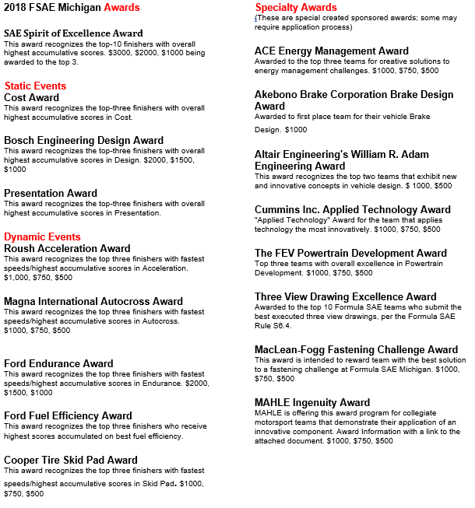
2018 FSAE AWARDS

Slide 30
AWARD CEREMONIES
AWARD CEREMONIES SPONSORED BY GENERAL MOTORS – Main Tent
There will be two award ceremonies in 2018
1ST AWARD CEREMONY: FRIDAY 7:00PM
The following Awards will be given:
ACE Energy Management Award
Akebono Brake Corporation Brake Design Award
Altair Systems Engineering Awards
Cost Awards
Cummins Applied Technology Award
MacLean-Fogg Fastening Challenge Award
Mahle Award
Presentation Awards
Three View Drawing Awards
Roush Acceleration Awards
There will also be a few prize drawings for the teams, must be present to win.
2ND AWARD CEREMONY: SATURDAY 8:00PM
The following Awards will be given:
Bosch Design Awards
Cooper Tire Skid Pad Awards
FEV Powertrain Development Award
Ford Endurance Awards
Ford Fuel Efficiency Awards
Magna International Autocross Awards
SAE Spirit of Excellence Awards
EZ-PASS PRIZE: This year General Motors is sponsoring the “EZ-Pass” prize drawing for a free 2019 FSAE Registration (teams must be present to win). Official results will be posted to SAE’s website ~May 15, 2018. Unofficial results will be available online through the mobile scoring website.

Slide 31
TECHNICAL INSPECTION
TECHNICAL INSPECTION EVENT DESCRIPTION
Officials:
Chief Technical Inspectors: Mark Muddiman, Jeff Lovell
Overall Procedure:
Technical Inspection will be broken down into three (3) parts:
1. Checks of the all the drivers’ safety gear, “rain” tires, fire extinguishers.
2. Vehicle Checks.
3. Driver Checks: helmet clearance, head restraint, seat belts and egress.
When:
1.Safety gear and rain tire checks:
-Wednesday, 119th May 10:00 a.m. – 12:00 pm
- Teams should NOT line up earlier than 9:45 a.m.
2.The Vehicle Checks portion of Tech Inspection will be open:
-Wednesday, 9th May 12:00 p.m. until 7:00 p.m.
(No new cars after 6:00 pm)
-Thursday, 10th May 9:00 a.m. until 5:00 p.m.
-Friday, 11th May By appointment*
-Saturday, 12th May By appointment*
Come to G2 for an appointment. If no one is present at G2, then please see the announcer.
3. Driver Checks:
One driver only per team may be checked Wednesday. Additional Driver Checks will begin on Thursday. If a driver is not at the track by Thursday, contact the Chief of Tech to arrange for an appointment prior to their dynamic event.
Where: Garage G2
-For the Safety Gear checks, enter at the southwest corner.
-For the Vehicle Checks, enter at the southwest corner.
-Beginning Thursday, the checks of the additional drivers will be at the east end.
Procedures:
1.Pre-assigned Tech Numbers
-All teams will be assigned a vehicle inspection Tech Number, according to the submission date of the version of their SES/SRCF document which was approved. Teams with the earliest dates will be first in line, so please submit your structural documentation in a timely and accurate manner.
-Teams will be informed of their Tech Number at competition, and can confirm their number during the Safety Gear check (below).

Slide 32
TECHNICAL INSPECTION

Slide 33
TECHNICAL INSPECTION
4. Re-inspection
If a vehicle did not receive a Tech sticker, the event staff will mark your Tech Form with the issues that must be fixed, and then the form will be returned to you.
After you have fixed the issues, on Wednesday, vehicles ready for re-inspection will be required to wait until no more teams are in need of first-time inspection. Event staff will designate a separate line for vehicles needing re-inspection to wait in. Keep the Tech Form with the vehicle when you return for re-inspection.
5. Additional Driver Checks: (not available Wednesday)
Enter the east end of garage G2.
With you, you must have:
    The car
    The push bar and fire extinguisher.
    The driver’s safety gear: helmet, arm restraints, gloves, long pants, long-sleeved shirt, and close-toed shoes must be worn for the egress, harness, and clearance checks. Driving suits, balaclavas, and race shoes are not required for this check.
Notes:
Only four (4) team members will be allowed into the actual Tech Inspection area. All other team members, the Faculty Advisor, and other spectators will be required to watch from outside the inspection area. The Dynamic Passes will be used as the “pass” into the inspection area. Team members may rotate in and out of the inspection area as required, as long as there are no more than four in the inspection area at any one time.
When you pass Tech, the first part of the Tech Form will be retained by the event staff, and you will be given the first of four (4) parts of the competition sticker. You should then proceed to the Fuel Station, and then Tilt Table. The second, third and fourth parts of the sticker will be given at the Tilt Table, the Brake Test and the Noise Test respectively. Only when you have all four parts of the competition sticker will you be allowed to compete in the dynamic events or run on the practice track.
If there are issues found that must be rectified, the Tech Form will be returned to you (the team,) and you will not receive a sticker. You must then correct the issues and present your car at Tech again for re-inspection.
No car will be allowed to run on the chassis dynamometer (if one is available) until it has passed all parts of Technical Inspection, and has been issued all four parts of the competition sticker.
If you (a team) expect to have a time conflict with a Static Event (Design, Cost, or Presentation,) please be aware that the Static Event has priority. If your vehicle is currently undergoing Technical Inspection, but you need to leave to attend a Static Event, simply inform your Inspector. You will be allowed to remove your vehicle from the Technical Inspection area, and can resume Technical Inspection later.
Best Regards from your Tech Inspection Team

Slide 34
SCALES
SCALES DESCRIPTION
Event Captains: Mike Thodoroff
Steve Balanecki
Dates/Times: Wednesday, May 9 3:00 p.m. - 6:00 p.m.
Thursday, May 10 8:00 a.m. - 4:00 p.m.
Friday, May 11 7:30 a.m. - Noon (for “cornering)
Location: Garage 1 Drive Through
All registered cars are required to weigh their cars at the designated Weigh Station. This must be done PRIOR to the Design judging. It is NOT required to weigh a car prior to Tech Inspection. It is the responsibility of every team to be aware of their scheduled Design appointment and plan their weigh-in accordingly.
Team members shall push their car on to the scales WITHOUT assistance from the Weigh Station personnel.
A team member must declare the level of fuel currently in the fuel tank by designating (a) NO FUEL, (b) HALF TANK, (c) FULL TANK. This designation will be recorded along with the final weight numbers.
Other than fuel, each car must be completely filled with all fluids required for the car’s operation (i.e., engine coolant, engine oil, brake fluid, etc.)
Any of the teams’ registered drivers may sit in the car during the scales process. That driver must be wearing a driver’s suit, helmet, all restraints, gloves, and shoes. (It is also acceptable to have the aforementioned driving equipment sit on the driver’s lap during the scales process).
Cars will be weighed in two segments:
(a) With driver: total weight, front/rear %, left/right %
(b) Without driver: total weight
The scales technician will declare all weights obtained and place a sticker containing the recorded weight information on the “nose” area of the car. This will ensure that the information will be in clear sight for the Design judges.
Team members will remove the car from the scales and push it out of the scales area.

Slide 35
COST
COST EVENT DESCRIPTION
Event Captain: Susan Zukowski
Date: Thursday, May 10, 2018
Location: Main Tent
Overview:
Each team will prepare a report of their car's cost to be evaluated by the cost judges. The concept of the cost event is to obtain an accurate estimate of cost of the car in a limited production. The report is in effect your cost proposal to the senior management of a company to get them to invest in your product line. The more information that you can supply to them, the more professional the look of your materials, the more likely the company may be willing to look at the product itself. This is the goal of the cost report itself. Additionally, the teams will also prepare an electronic Bill of Materials using a shared database with standard materials and processes and a detailed process description. This evaluates not only the cost of the car, but also the team's ability to prepare an accurate engineering cost estimate and know exactly how the vehicle would be built. The car with the lowest corrected cost and the best report will win the event. The event can be divided in to three separate sections - the cost report itself, visual inspection, and ‘real case scenario’ discussion.
The Cost Report:
The actual cost report is due into the judges approximately six to seven weeks prior to the event at the venue. Books must be mailed before the post mark deadline or the book will incur a penalty of 10 points per day after that date. The cost report is judged on the basis of the cost of the car and quality of the cost report. The cost of the car is determined by the cost of the parts and fabrication using established manufacturing practices and the application of “Lean Manufacturing” principles. The report will follow the guidelines set forth in the published rules. From this analysis, the judges (in 9 distinct areas of expertise) will determine if all parts and processes were included and if unreasonably low (determined by the experience of the judges) - the judges will add penalties if there are errors, items omitted, or have costs below reasonable estimates – at either standard point(s) deduction or at a rate equal to twice the cost error, whichever is greater. We have eight teams that review each and every book based on their expertise. The costs and penalties will then determine the cost score. The report score will be given based on the quality of the report and its overall presentation. The report score ranges from 0 to 40 points. The price score will be awarded based on the following formula:
NOTE: Pyour is the adjusted cost of your team’s car with penalties, Pmin is the adjusted cost of the lowest cost car in the competition, PMax is the adjusted cost of the highest cost car in the competition)
The Visual Inspection and “Real Case” Evaluation:
On the day of the event, the cost event judges will man ten bays with appointments in each bay every half-hour in order to see every competing car. This is to make sure that the parts that are on the vehicle are reported in the cost report and that nothing has been added since the cost report's publication.

Slide 36
COST CONT.
The focus of the cost event centers on the cost of the vehicle and the process of building the vehicle and the components contained therein. At the time of check-in at our event, the designated team representative will randomly draw to determine which of the nine random “real case” scenarios the team will be discussing in detail. These cases will encompass real issues that the team may encounter and how they would handle them in reference to their own team vehicle, systems or parts. The cost judges will also question the students regarding the report, process, and “real case”. This is a critical step in the cost event process. This discussion of the ‘real case’ and the visual inspection on the event day can only help the student’s team. If this appointment is missed the team will sacrifice the twenty points for this portion of the event. If the team feels that for some reason their appointment time needs to be changed they will need to contact the event captain to make necessary arrangements.
The time allotted for the appointment on event day is ½ hour per team at the designated time for that school. That time can then be broken down as follows.
Check-in: 1 or 2 minutes
Visual Inspection: 4 to 5 minutes
Real Case Scenario Discussion: 20 Minutes
Addenda to the report can be taken into consideration to cover any necessary changes made in the car. These addenda will only be accepted at the time of registration at the event and must be in the format proscribed by the rules (Appendix C-5).
In addition to the above, the cars with the lowest costs will be subject to a physical audit to make sure that they included all processes and materials on their vehicle in the cost report. The audits will be held on the same event day but by a separate team of auditors sometime after their initial appointment with the cost area. The adjustments that this team of auditor makes will be included in the final scores as well.
The final scores are tabulated and presented at the end of the judging day to the statisticians and are posted the next morning for the students viewing. Once posted, the scores may be protested for only 30 minutes, after which the scores become final.
Tips for a Good Cost Report:
Follow the rules - put the items and processes where the guidelines tell you to put them
Include an eBOM (Electronic Bill of Material) on CD in MS Excel that follows the format of the 2018 FSAE Rules.
Create the eBOM using the on-line FSAE Cost Event Database utilizing standard materials, processes and tools.
No receipts necessary any more
Include any photographs, pictures, drawings, blue prints, etc. in the appropriate sections of the book to help us understand the design processes used in manufacturing the parts
If you must - err on the high side rather than cut yourself short
Detail any processes or materials not already specified in the standard tables and submit AIR (add item request) to have them added to the standards table if needed.
Be careful to postmark by deadline, no need to throw away good points by slack timing.
Carefully consider Make/Buy decisions – these often result in dollars being spent more wisely.

Slide 37
REAL CASE COST SCENARIO
2018 FORMULA SAE MICHIGAN
Rule S4..3.3 states that the third part of the Cost Event will be a “real case” scenario where students will have to respond to a challenge related to cost or manufacturing of the student vehicle.”
The real case scenario for this event will be one of the following:
The Cost Judges have reviewed the Cost Report that you have submitted and they have determined that the cost of the _________ on your car is substantially higher than expected.
Your task at the event is to present the Cost Judges with your proposals to reduce the cost of the ________ on your car by 15%.
The presentation must fulfill the following requirements:
No longer than 5 minutes
Flip chart pages (optional !)
No handouts or use of electronic devices.
Must be based on the system on your car.
Your presentation will be evaluated on:
The process or methodology(ies) used to develop the proposal(s)
The alternatives presented
The credibility of the proposals
The team’s presentation skills will NOT be scored.
Teams competing at both events will discuss a different random choice at each event.
The blanks above will be randomly drawn choices of the following:
ECM/ECU
BRAKE BALANCE BAR
INTAKE MANIFOLD
Rules Committee,
FSAE.

Slide 38
DESIGN
FORMULA SAE DESIGN EVENT DESCRIPTION
Chief Design Judges: Anthony Lyscio, Steve Fox, Bill Riley
Event Captains: Anthony Lyscio, Steve Fox, Bill Riley
Date: Thursday, May 10th, 2018
Location: Garage G3
Design Judging Procedure:
Student competitors must submit a Design Report (DR), Design Spec Sheet (DSS), and Business Logic Case (BLC) prior to the competition. The DR and DSS provide judges with a ‘sneak peek’ at the designs. Teams that do not submit all documents will be disqualified from the Design event and receive zero points. As per the official FSAE rules, the DR cannot contain more than four text pages, must include three pages of vehicle drawings, and may include one page of optional content material for a total of eight pages. The DR will not be judged based on length. Content of the DR should highlight design goals, processes, and details in engineering terms. The intended audience is that of experienced engineers and while concise, the content should be technical and cover all major vehicle systems highlighting notable features. The DSS is based on a fixed template located on the official FSAE website and contains detailed system and component level specifications. The BLC is also based on a fixed template and is intended to define the team’s overall (including marketing and finance) goals for their design.
It is the student competitor’s responsibility to prove to the judges that their vehicle is a first year car as second year cars are not allowed at FSAE - Michigan. If the structure of the frame is not obviously a completely new design from previous years, then thorough photo documentation should be provided to prove that the car is new as defined by the rules. The judges may deduct up to 30 points if photographic documentation shows that the remaining parts of the vehicle have not been significantly altered or if sufficient new design work has not taken place.
Design judging will start promptly at 8:30am on Thursday (see schedule). Each time slot will be exactly one hour long with approximately 45 minutes for the judges to review the vehicle with the team members and the remaining time used by the judges to write notes and score the car. At the conclusion of First Round Design Judging, approximately 8-12 cars will be selected to advance to Design Finals.
Teams will need to arrive early in order to be weighed before Design judging. Again, cars must be weighed before Design Judging. It is recommended that you be weighed at least 30 minutes prior to your design judging time slot. Teams who are late or who miss their slots will receive less time with judges, and thus less opportunity to score points, and risk not being judged at all. Separate volunteers will be in charge of timing for the event and assisting with queueing of teams. In fairness to other student competitors, vehicles will be rolled in and out on schedule.
Design judging will consist of 15 groups (queues) of judges, each having six to eight design judges. This means 15 cars are being judged simultaneously. The judges in each queue will evaluate the following areas: Suspension; Frame / Body / Aero; Powertrain; Cockpit / Controls / Brakes / Safety; Systems Management / Integration; Manufacturability / Serviceability; Aesthetics / Style; & Creativity. Teams should make a point of reviewing the Design Judging Score Sheet on the official FSAE website. The score sheet gives the competitors insight into how they will be judged, as well as giving them a detailed breakdown of each judging category. Each judge has a different area of niche expertise, and will seek out the student team member responsible for that particular area of the car. There will also be roving judges who will be briefly assessing cars across judging groups while also making note of particularly interesting vehicle features and/or flaws.

Slide 39
DESIGN CONT.
Expanded definitions of each area have been provided on the Design Score Sheet, along with space for comments. Design judges from your queue will seek out teams on Friday and Saturday, in order to return score sheets, explain individual scores, as well as provide targeted feedback. Since the score sheet is used as a tool by the judges, the values written on the form will likely not add up to the team’s Official Score. The judges are strongly encouraged to make lots of notes and provide written feedback to the student competitors. Students are encouraged to approach Design Judges on the days following the Design Event to request additional feedback on their designs.
Teams may also call and request a specific design judge for feedback. There will be a phone number posted and announced which student competitors can call in order to schedule an appointment for a debrief session with your Design Judges. The post-event debrief sessions can be very informative and all teams are encouraged to participate. Note: Not all Design Judges can be available all days so it is best to make arrangements to meet with judges early. Further, ensure that your team provides your judges with a contact cell number.
During first round judging, each student team should have at least one representative who is prepared to discuss each major system individually. This means five or more students should be prepared to speak independently. If the judges have to split their time between a single student (ie. if one team member holds ALL the answers), lower scores could result based on total amount of information received. Students should bring any and all information they feel is relevant (charts, graphs, parts, photos, video, etc.) to support their design efforts. Data, data, data. A simple well organized binder or tablet with relevant data can work wonders. The judges will give higher Design scores to well-documented engineering than to word of mouth. Simply showing up with a great car is not good enough. A high emphasis is placed on the student team’s ability to Design, Build, Refine & Validate, and Understand your car.
At the conclusion of First Round Design Judging, each queue will pick approximately one car to send on to Design Finals. The Chief Design Judges, Design Event Captains, and roving judges work to assure consistency in this selection. The Design Finalists will be announced later that night. Scores and teams selected for the final Design review will be posted the following day, Friday, around mid-day. The scores and rank order of the top placing (Finalist) teams in Design shall be revealed during the Design Review.
Design Finals will take place Friday evening in Garage G3. (See schedule) Design Finalists shall assemble and be ready to be judged by the start time indicated on the schedule. Only four team members are allowed to be with the vehicle at any time to talk with the judges. Any remaining team members must be outside the immediate judging area. Teams with more than four team members that remain in the judging area will be penalized. Team members may switch places (tag in, tag out) to have the proper systems represented.
The overall Design Event Winner will be announced on Saturday while judges briefly review the designs of the top three Design Finalists for the audience. All student competitors are invited and encouraged to come and watch. This public design review clearly identifies what the Design Judges like (and dislike) about a FSAE car. Students, especially the less experienced teams, typically find the Design Review informative and very useful for improving next year’s Formula SAE efforts.

Slide 40
SALES PRESENTATION
Presentation Event Description
Event Captain: Adam Zemke
Co-Captain: David Roberts
Date: Thursday, May 10, 2018
Location: MIS Suites – Conference Rooms
Presentation Seminar: Friday, May 11, 2018 at 9:30 AM in Main Tent
Presentation Highlights: Saturday, May 12, 2018 at ~7:00 PM in Main Tent
Overview:
After a year of planning, fabricating, and testing a new, prototype vehicle, each team aspires to sell their vehicle design to a make-believe corporation. The competitors in this event will be judged on their ability to create and deliver a business case that convinces the judges that the team’s design best meets the demands of the amateur, weekend competition market, and that it can be profitably manufactured and marketed (see A1.2 in the 2018 Formula SAE rules for notes on Vehicle Design Objectives). The team that makes the best presentation will win the event and score 75 points.
The Presentation:
Competitors are to make a presentation to upper level executives of an imaginary corporation. The presentation should tie together all factors that would influence the marketability, manufacturing feasibility and profitability of their design. It should include an understanding of the marketplace and target customer, and show how their team’s design meets the requirements for each.
The Event:
Each competitor will be assigned a 30 minute window and location. This includes the time the judges need to score. Judges may allow a team to begin early, but the completion time (30 minutes) should be strictly enforced. The presentation itself is not to last any longer than ten minutes, at which point the judges will stop any presentations continuing. A question and answer period of up to five minutes will immediately follow, wherein only judges may ask questions and only presenters may answer. The audience (usually team members) may not ask questions or make comments. It is allowable for a presenter to only participate in the question and answer section, however he/she must be a member of the ‘presentation group,’ as defined by S5.3.2 of the 2018 Formula SAE rules.
A team of two to four judges will grade the competitors. The judges will use the form in Appendix S-6 of the Formula SAE rules for event scoring: “Presentation Judging”. This form breaks the scoring down into five equally weighted categories: Content, Organization, Visual Aids, Delivery, and Questions. A perfect score on the judges’ form will be 50 points. The judges’ combined score may be adjusted because some judging teams may grade, on an average, higher or lower than other judging teams. The competitor’s final score will be calculated using the equation defined in the PRESENTATION SCORE section.
In an attempt to encourage commonality amongst static events, the 2018 Formula SAE Rules contain Section S, Article 3; the Business Logic Case. Presentation Event Judges are asked to use the Business Logic Case to judge whether the given presentation is appropriate for the market and business strategy that the team has identified. See Article 3, Sections S3.1 through S3.3 for a detailed description of the Business Logic Case.

Slide 41
SALES PRESENTATION CONT.
Presentation Highlights:
The three top-scoring teams will be required to publicly reprise their presentations. For 2018, the Presentation Highlights remain a non-scored event, and will be held at ~7:00 PM before the Saturday Awards Ceremony. The expansion of this event is an effort on behalf of the organizers to inspire creativity amongst competitors in subject matter that is typically not engineering curriculum-inclusive.
PRESENTATION SCORE = 75 * Pteam /Pmax
If a team misses their allocated period, the team will receive zero (0) Presentation points.
Presentation Tips from Previous Experience:
Spell-check all visual aids, presentation tools, etc.
There is no dress code; however, bad first impressions are difficult to remedy.
Remember that equipment has been known to fail; copies can be ruined in transit, etc. Consider alternatives in case something should go wrong. Each team is responsible for bringing their own equipment. Remember, extension cords can be important and laptop speakers may not project sound very well.
Have a team member record your presentation and the judges' commentary for your team's future FSAE efforts. Teams are allowed to have as many spectators that will reasonably fit into the presentation room. People not associated with the presenting team are allowed to view presentations only if the presenting school gives their permission before the start of the presentation. This includes news reporters and photographers.
The most technically knowledgeable person on the team may not be the best person to lead the presentation team. A team may want to choose someone who is a charismatic public speaker.

Slide 42
FUEL & TILT TABLE EVENT
FUEL & TILT TABLE EVENT DESCRIPTION
Event Captains:Fuel - Herb Seubert, Rob Egenolf & Mike Thodoroff
Tilt – Alba Colon, Vince Bandurski & Mark Scott
Fuel Efficiency – Alba Colon & Mark Scott
Dates/Times: Fuel Station: Thurs. - 8:30 a.m. until 5:00 p.m.
Fri.- 8:00 a.m. until 5:00 p.m.
Sat.- 7:30 a.m. until 5:00 p.m.
Tilt Table: Thurs.- 9:00 a.m. until 5:00 p.m.
Friday- 9:00 a.m. to 5:30 p.m.
Location:
Fuel Station: Next to Tilt across from G3
Tilt Table:In between Fuel and Noise.
Description:
The required octane must be permanently identified on every vehicle, nearby the fuel filler cap, so that it is visible and legible at all times when filling the vehicle with fuel (octane stickers can be obtained at tech or the fuel station). Note: no vehicle will be provided with fuel until it has passed tech inspection. The first portion of a four-part sticker will be applied in a location near the front of the vehicle upon passing tech.
Follow specific safety guidelines while in the fueling area:
Engines and all electronics must be shut down and turned off; cars are to be pushed to and from fueling.
Only the vehicle push crew and the driver are allowed to enter the fueling station. All must have dynamic passes at each visit.
Only the driver, in the complete driving gear, with a full and completely functional fire extinguisher in hand, is permitted in the area as fuel is dispensed.
A Permanent line mark must be used to indicate the “full” level per Formula SAE rule IC2.6.6. NO TAPE
Tank is to be filled to this level each time fuel is received.
Fuel station must update the tech sheet before vehicle proceeds to tilt. Tilt will not accept vehicles with a tech sheet lacking fuel information.
The first time a vehicle is fueled, it must proceed directly (with engine off) to the tilt table. The vehicle will be placed on the table with the tallest driver aboard fully suited, helmet buckled, gloves and all safety restraints secured. The vehicle should be oriented on the tilt table where the fuel fill side is placed against the guard of the tilt table and is most likely to create spillage. The table will then be titled to an angle of 45 degrees. There must be no fuel (or any fluid) leakage at this angle. If the vehicle passes this test, the angle is increased to 60 degrees. This angle represents a cornering force of 1.5 G’s. The upper wheels must remain on in contact with the table in order for the vehicle to pass. The person in charge at the tilt table must sign off an inspection form, which travels with the car. A second sticker is applied (on the car) next to the first to indicate passing the tilt table test. The vehicle is now free to proceed to the Noise area. Should the vehicle fail at either of the two angles, the car must be repaired & re-tested.
Vehicles may be forced to return to tech inspection for re-certification at the discretion of the fuel station officials. This may be due to inability to provide a consistent fuel fill, or due to a safety concern with the functional operation of the fuel system.

Slide 43
FUEL & TILT TABLE EVENT
Safety guidelines for the tilt area
Engines off; push car on & off table. Take care to avoid damage to vehicle when pushed on and off tilt table.
Affix the safety strap to prevent vehicle from excessive lift while on table. Allow a little slack.
Be sure table is clear before raising and especially when lowering. Inform people in area when raising or lowering (e.g. “Coming Down”).
Use absorbent material to soak up leaks. (May be obtained at fuel station).
Keep a full and completely functional fire extinguisher handy.

Slide 44
BRAKE & NOISE TEST EVENT

Slide 45
BRAKE & NOISE TEST EVENT CONT.
Brake Test Event Description
When the vehicle passes noise it may go to the Brake Event and it is there the final tech sticker will be awarded if the vehicle meets the brake requirements. Provided no changes have been made to the muffler or exhaust system, teams that pass noise but do not pass brake don’t have to go through noise again if they work on the vehicle.
At the Brake Test Area, each driver WILL be instructed on the proper procedure. With the car at the start line of the station a green flag (or similar signal) should be used to signal the start of each run. The driver must accelerate to race speeds (typically getting into 2nd gear) until reaching the braking area, which is a box defined by water barriers. Once inside this box, the driver must apply the brakes with enough force to demonstrate full lock-up of all four wheels, the engine must remain running during the complete test. We are looking for the vehicle to brake from race speeds with all 4 wheels locking up and remain locked until the vehicle comes to a complete stop with the engine running.
If the vehicle passes, the person in charge will sign-off the approval form and provide the team with the final “tech” sticker. The vehicle is now free to proceed to the practice track or on to the dynamic events. (The approval forms shall be retained by the brake crew and turned in at the tech garage periodically.)
If the vehicle is unable to pass the brake tests in three attempts, the car must be repaired and then brought back for retest. The vehicle will not be allowed to compete without passing all tests. Note: The vehicle will not be permitted on the practice track without all 4 tech stickers; no exceptions. .
Noise level can be measured at any time during the dynamic events. Penalties may be assessed if the sound level exceeds the mandated maximum, and noise sticker can be removed by officials.
PLEASE NOTE – An official will conduct a functional test of the External Master Kill Switch with engine running up and under power as part of the Noise Test Event and / or Brake Test Event.
Also, Operation of Noise Event Area and Brake Testing Event Area in DAMP conditions is at the discretion of the Captain of the specific area. See FSAE rules for tire use at specific conditions, Rule #B6.4.1 Also see Part D “Dynamic Event Regulations” Article 2 Weather Conditions and Article 3 Running in Rain for further clarifications.
Vehicles may be forced to return to this station for re-certification should the officials deem it necessary. Re-certification may be required if work is performed on the vehicle’s braking system or exhaust system, or if the vehicle is involved in an incident that results in vehicle damage.
**At all times, drivers must be wearing complete and proper safety equipment and proper safety rules must be maintained in both areas.”

Slide 46
BRAKE & NOISE TEST EVENT CONT.
Safety guidelines for the Brake & Noise areas:
Only one car at a time in Brake or Noise area. Do not allow a second car into the area until the last one has completed its exit.
Only the vehicle push crew and the driver are allowed to enter the Noise and Brake areas. All must have dynamic passes at each visit.
Do not attempt certification of any vehicle without enough workers. Three (3) workers minimum, four (4) preferred at the Brake station. Three (3) workers recommended at Noise station.
Never place yourself in the line of travel of any car. Stay well away from the “hot” area.
Use hay bales for protection of workers and equipment.
Fire extinguisher must be with the car and crew at all times.
Use brooms and oil-dry as needed to keep braking area clean and dry.
Any vehicle damage or contact must be reported to the station manager(s).
No work will be allowed on the car inside the Brake or Noise areas. Car repairs and work must be performed outside of testing area. Specially marked areas will be set-up for this. Cars can then return to the test area at the discretion of the station manager.

Slide 47
PRACTICE TRACK
DYNAMIC PRACTICE TRACK DESCRIPTION
Event Captains: Frank Putman & Gary Godula
Dates/Times: Thursday- Noon until 5:00 p.m.
Friday- 9:00 a.m. until 5:30 p.m.
Saturday-8:00 a.m. until 3:00 p.m. (Note: Location change to Turn 4)
Location: The Dynamic Practice Track is adjacent to the Dynamic Autocross/Endurance Area just to the right at gate 12 (See site map in the Steward’s Manual and Registration Package).
Note: Location change for Saturday to Turn 4 Pit entrance to accommodate Endurance expansion.
Description:
The practice track is a relatively large (500’ x 180’ defined by water barriers and orange cones) open test area designated by the event organizers to provide teams with an opportunity to conduct brief dynamic tests of their vehicle during the available hours of the competition. The practice area will contain a 65 meter acceleration run with a 75 meter shut down area, a single 15 meter skid pad, elements of an autocross course which can be integrated with a slalom section, and an open track area which will be available for use at the driver’s discretion. No vehicle will be permitted to enter the Practice Track unless it has a) passed Tech Inspection, b) passed the Tilt Table Test, c) passed the Brake Test, and d) passed the Noise Test. The vehicle will not be permitted on the practice track without all four tech stickers; no exceptions.
Drivers and team members must adhere to all safety rules. Each driver must understand and follow proper driving procedures at this facility. In addition, it must be understood that the Practice Track volunteers and SCCA officials are in control of the facility and adherence to their direction is mandatory.
Only one car at a time will be allowed to enter the Practice Track. At all times, drivers must be wearing complete and proper safety equipment. Engines may only be started and warmed up in the designated “hot area” prior to entering the Practice Track. The officials will use green, red, and checkered flags to communicate session status with the on-track driver and team. Once signaled to begin testing (green flag), the driver is free to perform any test maneuvers he or she feels necessary to safely evaluate the vehicle (within the limits of the track surface conditions and within the limits of the practice area boundaries). In the event that a red flag is shown to a driver, that driver will immediately bring the vehicle to a complete stop and wait for further instructions from an official or course worker. The checkered flag shown to a driver indicates the test session is complete and the vehicle must be driven to the exit area. At least one SCCA-designated Practice Track Event Captain and one SCCA-licensed corner worker shall be present at all times to direct the activities of the assigned volunteers and to maintain the operation of the practice area in a safe and controlled manner in accordance with the Steward’s Manual and SCCA safety practices. Teams will be given an approximate 5-minute time period to conduct a practice session. Teams will be allowed to practice on a first come, first served basis. Multiple practice sessions are allowed, with teams returning to the back of the line to establish subsequent run order. Practice area officials reserve the right to adjust the allotted practice time for teams, based on a number of factors including the number of teams awaiting usage of the area.
A vehicle staging and repair area will be located next to the practice area within the boundary of the designated “dynamics” area. The “dynamics” area is defined by the track access gate at Gate 12 separating the infield from the MIS oval track surface. Teams are encouraged to stage their vehicles within the staging and repair area to minimize the number of teams and team members located on the access road due to the high vehicular/truck traffic utilizing the access road.
If during the course of dynamic testing the vehicle sustains damage or significant mechanical breakdown, the vehicle will be required to exit the track and make the necessary repairs. The Tech inspection sticker may be removed from the vehicle by a Practice Area Official thus requiring an additional Tech Inspection prior to participating in additional dynamic tests or events.

Slide 48
PRACTICE TRACK CONT
PLEASE NOTE – Operation of the Practice Event Area in DAMP conditions is at the discretion of the Captain of the specific area. See FSAE rules for tire use at specific conditions, Rule #B6.4.1. Also see Part D “Dynamic Event Regulations” Article 2 “Weather Conditions” and Article 3 “Running in Rain” for further clarifications.
Safety guidelines for the Dynamic Practice Area:
Only one car at a time in the Practice Track area. The next car will not be permitted to enter the area until the last one has completely exited. Vehicle engines may only be started in the “hot area” prior to entering the Practice Track and must be shut down immediately after exiting the Practice Track.
Three (3) volunteers (preferably four (4)) will be on hand to manage the operation of the Practice Track.
Never place yourself in the line of travel of any car. Stay well away from the “hot” areas, always at a safe distance behind the designated barriers.
SCCA Solo Radios and whistles are needed for worker communication.
Have 3-4 fire extinguishers, brooms, and oil-dry in the area.
Use brooms and oil-dry as needed to keep the Practice Track clean and dry.
Power sweep Practice Track at beginning of each day’s operation and during lunch break if necessary.
Use chalk/flour markers to designate the acceleration and braking lane, skid-pad, and autox sections as needed to easily identify the areas for the drivers.
Any vehicle damage or contact must be reported to the Dynamic Events Safety Steward. Additionally, remove the 1st tech sticker and report vehicle number to tech inspection so that it can be re-evaluated after repair. Tech Event Captain is to be notified, preferably by radio, of any vehicles/teams where the tech sticker has been removed for re-evaluation.
Do not permit spectators to sit or lean on the bike rack/barriers surrounding the practice track.
Radio communications with Emergency Response Team, Safety Stewards, and Event Control will be maintained at all times.

Slide 49
ACCELERATION
ACCELERATION EVENT DESCRIPTION
Event Captain: Bob Goppold
Asst. Captains: Steve Balanecki & Reid Collins
Date: Friday, May 11, 2018
Time: 10:00 a.m. - 5:00 p.m. (1 hour lunch break)
Location: FSAE Dynamic Area – Pit Road
Event Concept:
The objective of the Acceleration Event is to evaluate the vehicle’s demonstrated acceleration capability by measuring the elapsed time required for the vehicle to travel a distance of 75 m (246 ft) from a standing start. The event is designed to focus on engine performance and on the suspension's ability to maximize tire grip.
Event Format:
Up to four Acceleration Runs are permitted for each car. Two drivers are allowed per car. Each driver is permitted two Acceleration Runs. Elapsed Time will be recorded for each Acceleration Run. Any penalties will be assessed to the Acceleration Run during which the penalty occurred. The fastest corrected elapsed time (including penalties) of the completed Acceleration Runs will be used to calculate the score for each car.
All Acceleration runs must be completed by 5:00 p.m. However, the Event Captain may adjust the schedule based on event conditions
NO tools and/or spare parts are permitted in the staging lanes.
NO "traction enhancing" agents are permitted to be used on the tires or track surface.
NO "burnouts" are permitted.
Event Procedure:
Stage your car in the appropriate Staging Line for either Driver 1 or Driver 2. Cars in the Driver 1 Staging Line will be given priority. Drivers must be properly belted into the car with all required safety equipment properly installed, as directed by the Event Workers, before the car is first in line to start an Acceleration Run. An Event Worker will direct the driver to approach the Start Line. Cars will be staged approximately 0.3m (1 ft) behind the Start Line.
The driver is permitted to start an Acceleration Run only when the Event Worker waves the green flag. Timing will start when any part of the vehicle crosses the Start Line. The Acceleration Run is counted (one of the permitted Acceleration Runs) when any portion of the car crosses the Start Line.
Timing will end when the vehicle crosses the Finish Line located 75 m (246 ft) from the Start Line. The Finish Line is marked with a Checkered Flag.
After a driver's first run, the driver will have the option to immediately take a second run, or leave the staging area to complete his/her second run later during the event. Each car must exit the staging area before changing drivers.
Penalties:
A two second penalty will be assessed to the Acceleration Run per cone knocked down or out of position.
A DNF (Did Not Finish) penalty will be assessed to the Acceleration Run for cars that go off course.
A DNF penalty (forfeit of a permitted Acceleration run) may be assessed to the team for infractions committed in the staging area, start line or return lane.

Slide 50
SKID PAD
SKID PAD EVENT DESCRIPTION
Event Captain: Seth Goslawski
Assistant Captain: Avery Snyder
Date:Friday, May 11, 2018
Time:10:00 a.m. until 5:00 p.m. (no lunch break)
Location: FSAE Dynamic Area – Turn 3
Event Concept:
The goal of the Skid Pad event is to measure the vehicle’s maximum cornering capability by measuring the total time required for the vehicle to complete one left hand and one right hand circle. The event is designed to focus on the vehicles suspension design characteristics and tune-ability for maximum lateral grip, and minimize the effect of driver reflexes during transitional maneuvers.
Event Format:
Two drivers allowed per car; two runs per driver. Each run consists of a driver completing 2 Right-hand laps immediately followed by 2 Left-hand laps of the course. Lap times will be recorded for the 2nd lap of each the Right-hand and the Left-hand circle (the 1st lap of each is not timed).
Scoring:
Lap times will be recorded for the 2nd lap of each circle for a given run on the Skid Pad. These times will be averaged together and added to any penalties and used to calculate lateral acceleration for each run. The fastest average time (including penalties) from either driver during any of the 4 runs will be used to calculate a score for that vehicle.
Staging:
Stage your car in the appropriate Staging Line for either Driver 1 or Driver 2. Cars in the Driver 1 Staging Line will be given priority. The first 3 cars in line are permitted to run their engines provided the driver is wearing a helmet and securely fastened. A person holding a Green Flag will motion a car to approach the starting line, which is located approximately 20 m (65.62 feet) from the timing line used for scoring. When the starter waves the green flag, the driver will approach the Skid Pad and proceed onto the RIGHT-HAND circle. After completing 2 laps, the driver must continue onto the LEFT-HAND circle and complete 2 more laps. After completing the second Left-hand lap (the fourth lap in total) the driver will exit the Skid Pad. After a driver’s first run, they have the option of immediately taking a second run, or leaving the staging area and running later in the day. In order to keep the event running in a timely manner, other teams can run Skid Pad in between a team's first and immediately second run. Each car must exit the staging area before changing drivers.
Penalties:
0.25-second penalty per cone knocked down or out of position.
DNF penalty for cars that go off course.
DNF for cars that run an incorrect number of laps.
No toolboxes and/or spare parts will be allowed in the queue area or staging lanes unless deemed necessary for starting the vehicle’s engine.

Slide 51
AUTOCROSS
AUTOCROSS EVENT DESCRIPTION
Event Captain: Matt Kalmus
Event Co-Captain: Corry Johnson
Event Assistant Captain: Costi Shami
Date: Friday, May 11th 10:30 AM-5:00 PM (Lunch breaks 1:00pm-2:30pm)
Location: Dynamic Area – Back Straight
Track Length: Approx. 800 m (2600 ft)
The Event: The Autocross event is designed to test the car’s handling qualities without the hindrance of competing cars. The event has two heats. Each heat has a different driver. A heat is composed of one driver making two runs of the course. The fastest of the runs completed, including penalties, will be used to calculate the team score. Cars that are unable to complete the course with a time within 145% of the fastest car will only be awarded 7.5 points.
Penalties:
1) A 2-second penalty for each cone knocked down or out of position (indicated by a chalk square at the base of the cone).
2) A 20-second penalty for going off course and not re-entering at a point prior to the missed gate. Missing one or more gates of a given slalom counts as a single off-course penalty.
All cones in the dynamic area can be scored as penalties. This includes cones before the start line and after the finish line.
Staging:
Following the announcement of the start of the event, all cars should begin staging in the first heat line on a first come first served basis. Upon completion of the first heat driver’s two runs, a car may either go to the second heat line or back to the paddock for repair and/ or adjustments.
When there are no cars in the first heat line, cars in the second heat line will be allowed to run. Cars that have not run a first heat have precedence over second heat cars. The event may be cancelled or cut short due to weather or time, so it is important to be on time for the first heat. It is encouraged for teams to join the second heat line immediately after completing the first heat.
At 5:00 PM the Autocross Event is scheduled to close, and no additional runs may be made after the closing. Cars in line will not be allowed to run the course after 5:00. If there are delays in starting the event, rain delays, or extended track closures, the event captain has the discretion to extend the closing time if conditions permit. Please see the event captain or listen for announcements for any extensions.
A safety inspection (helmet, belts, kill switch) will be performed before entering the final staging area; each car will be staged 6.0 m (19.7 feet) behind the start timing lights and will accelerate from a standing start.
After a driver’s first run, the driver has the option of taking the second run immediately, or leaving the staging area and running later in the heat. A shortcut-turn, immediately following the finish line, will allow the driver to proceed directly to the start for a second run. This is called the re-run line. If a driver chooses to not take a re-run, he/she should proceed through the exit.
It is intended that the race be conducted without the hindrance of competing cars. If there is a stopped or slow vehicle ahead, the driver should proceed at a safe distance (3m) around the incident and/or follow the direction of the course workers, and then reenter the track to finish the run. Once past the finish line, the shortcut should be taken to go directly to the start line. At this time, the driver will be notified if another run will be allowed. If a slow or stopped vehicle ahead is judged by the track officials to not be a hindrance, a re-run will not be allowed.

Slide 52
AUTOCROSS CONT.
A driver’s run may be stopped by a track official (indicated by a waving red flag or hand gesture), your car may be directed to complete the track or directed to follow a straight route back to the starting line (with caution). This is common when a red flag is shown in the first half of the course. Caution – course workers may also signal your car due to a malfunction (broken suspension, muffler, leaking oil, etc.). If this occurs, the car should be driven off course and brought to a controlled stop as soon as possible. Avoid stopping directly on the course. This prevents potential incidents with following cars and limits the amount of oil/water spilled on to the racing surface, preventing long delays.
If a car fails during a driver’s first run, vehicle repairs can be made to the car, and the driver can return to complete the second run.
Notes:
-Once the car passes the start timing line, the run has been officially attempted and cannot be re-started. If the car stalls before triggering the timing lights, it can be pushed back for a re-start. This is only allowed once. If the car demonstrates difficultly in launching it will need to be pulled away and repaired.
-Timing will rely on a combination of timing lights and an RFID tag to identify vehicles. Properly affixing assigned RFID tags will be required to register times.
-Please be aware that several cars may be running the course at the same time. Once past the finish line, slow the vehicle and exit in a controlled manner. Do not park the car at the exit of the course; this can create an unsafe situation and will cause traffic to back up.
-If time allows, drivers will be allowed to walk the course – please check the schedule and listen for announcements regarding the timing of walks. Walking will be allowed (time and weather permitting) on Friday before the course opens.

Slide 53
ENDURANCE & FUEL EFFICIENCY
ENDURANCE TRACK AND FUEL EFFICIENCY EVENTDESCRIPTION
Event Captains: Laura Klauser & Matt Kalmus
Date: Saturday, May 12, 2018
Time: 9:00 am
Location: Dynamic Area – Back Straight
Purpose:
The goals of the endurance and fuel efficiency event are to test the durability and fuel efficiency of the vehicles. The dual nature of the event can lead to compromises in designing for its 22 km length. Note: No repairs or work may be performed on the vehicle during the event (with the exception of tire changes due to weather conditions and seat or pedal position adjustments to accommodate the second driver).
Description:
The event is approximately 22 km, with two drivers completing 11 km segments each. A completely filled Fuel Tank is required to be eligible to run this event. No refueling is allowed during the event. Each team is given three minutes to complete the driver change.
The run order for the event will be based primarily on the Autocross event. The run order will be slowest to fastest autocross times. If a team did NOT score in the Autocross event, the vehicle will run at the beginning of the Endurance event, with the order based first on the finishing order of the Acceleration event, and then on the finishing order of the Skid Pad event. Teams without a score in any event used to determine the run order will run in the order established by the event captains. Teams must run within the 20 cars after them in the run order. For example, the team with run order position 10 must run before the team with run order position 30. The out of order penalty will be applied to teams that are not able to run in their designated run order position. The last 20 teams scheduled must run before the last car is called. All teams will be provided a minimum 15-minute window to enter the track. If the last scheduled team of the heat is not able to run when called, they will receive the “out of order” penalty and will be given 15 minutes to enter the track before they are disqualified. Any team that does not comply with the run order rules as listed here will be disqualified.
The event captains reserve the right to adjust the run order as necessary during the event to maintain safe operations and the flow of the event.
If the weather conditions of the prior dynamic events have been variable, a team's Skid Pad or Acceleration result may be used as a substitute or supplement to the team's finish order in the Autocross event.
Endurance Procedures:
In order to compete in the Endurance event, teams must have their four-part tech sticker by 5:30 PM on Friday. Teams who have not successfully passed all parts of tech by 5:30 PM Friday will not be eligible to participate in Endurance on Saturday. Teams who have a sticker pulled have the opportunity to re-visit technical inspection on Saturday to regain the sticker; however, cars are only eligible to run Endurance within 20 cars or 15 minutes of their scheduled slot in the run order.
The team must have their fully fueled (see Fuel Efficiency Procedures) vehicle in the staging/prep area at the appointed time. Only two crewmembers and the two drivers assigned to the endurance event are allowed in the staging area for the vehicles. When the car is called to the staging line, the team must push the “race ready” car with driver completely belted in to the staging line. Once the car is pushed to the staging line it cannot be touched by any team member except the driver in the car. The only tools allowed in the possession of the team members at the staging line are those needed for driver seating adjustment during driver change. No laptops, pressure gauges, baffles, tire wraps, etc. will be allowed at the staging line. Nothing can be brought to the starting line that is not intended to stay on the car.

Slide 54
ENDURANCE & FUEL EFFICIENCY CONT.
When there is a space for the vehicle on the course and the timing/scoring system is set, the first driver will be motioned to the starting line. The person staging the vehicles is not obligated to give teams any advance notice prior to entering the track. An official will perform a safety check of the vehicle and the driver restraint system. The starter will stage the vehicle’s front tires at the beginning of the entrance to the track. When there is an opening on the track, the course marshal (starter) will wave the green flag, signaling the go-ahead for the driver to start. If the vehicle stalls, the driver must wait for another green flag before being allowed on the course. Note: If the vehicle cannot be restarted, the team members must move the car away from the staging area. The team will then have until 20 cars after them in the run order have attempted to start or 15 minutes to attempt to start endurance again (an out of order penalty will be incurred). If a team running out of order has a vehicle that stalls and cannot be restarted after entering the track, the car will be deemed disabled and will be disqualified from the event.
On the last lap of the first driver, a checkered flag will be displayed directing the vehicle to exit to the driver change area. It is the Driver’s responsibility to correctly exit the track; any person directing the car off the course is an additional aid only. Only three team members (including drivers) are allowed in the driver change area at once. After the vehicle arrives in the driver change area, the team has three minutes to get the second driver belted in and car started. Only adjustments to fit the second driver (or weather related tire changes) may be performed on the vehicle. No other work is allowed.
When the second driver is ready, the vehicle should be slowly driven to the starting line queue. An official will perform a safety check of the vehicle and the driver restraint system. The course marshal will stage the vehicle’s front tires at the beginning of the entrance to the track. When there is an opening on the track the course marshal will wave a green flag signaling the go-ahead for the driver to start. If the vehicle stalls, the driver must wait for another green flag before being allowed on the course. Note: If the vehicle cannot be restarted without external assistance, the car will be deemed disabled and will be disqualified from the event.
Upon completing the last lap with the second driver, the checkered flag will be displayed and the vehicle will exit the course and will be directed to the fueling station. It is the Driver’s responsibility to exit the track, any person directing the car off the course is an additional aid only. The vehicle must go directly to the fuel station after completing endurance in order to receive a fuel score.
If either first or second driver is shown a red flag during their driving session, they must come to a controlled stop within viewing distance of the nearest flagging station and turn off their vehicle. (If they see the red flag just before the driver change exit, they may coast into the driver change area and turn off their vehicle.) All cars on track during a red flag event will be towed to the driver change area where they will wait, with driver belted in vehicle, until the track is clear. The lap in which the red flag was shown will not count in time or fuel economy calculations. When the track is clear, the drivers will be told to start their vehicle and will be released on track to finish their laps. Teams involved with a red flagged track will not be permitted to add any fuel to their vehicle.
Weather Conditions:
Teams must fit rain tires to their vehicle if the course is declared Wet.
Teams have the option of dry or rain tires if the course is declared Damp.
Teams may change tires at any time while their car is in the staging area inside the "hot" area.
All tire changes after a car has received the green flag to start the event will take place in the driver change area.
Teams may not perform any work on the vehicle other than the tire change in the driver change area.
Teams are allowed 10 minutes to change their tires in the driver change area if a Dry track is declared Damp, or if a Dry or Damp track is declared Wet. If the tire change is happening at the same time as a scheduled driver change, the 10 minutes are in addition to the 3 minutes allowed for the driver change.

Slide 55
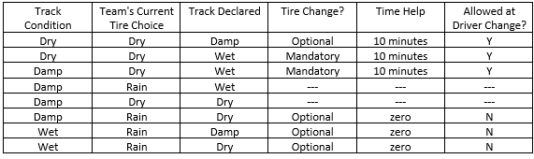
ENDURANCE & FUEL EFFICIENCY CONT.
If a track is damp, teams are allowed to pit to change their tires from dry tires to rain tires at any time (following notification of track marshal) and will be allotted 10 minutes to complete. If the team chooses to come in for a tire change mid-run, the car must be turned off for the change and restarted per driver change restart rules.
Teams are allowed to change their rain tires to dry tires at any time if the course is Dry or Damp. However, this change is not permitted during the driver change, and the time taken to change the tires is included in the team's total time for the event.
The following chart summarizes the possible track condition changes, the team's options, and the time allotted for changes:

Slide 56
ENDURANCE & FUEL EFFICIENCY CONT.
General Notes:
The vehicle will be expected to be ready for competition with the first driver at the team’s run order position. If the endurance event is running late, the vehicle is still expected to be ready when its run order position is reached. If the vehicle is not ready when the official starter motions the vehicle to the starting line a two minute “out of order” penalty will be assessed and the team will lose their time slot to run the event. Teams are only allowed to run within the 20 cars after them in the run order in their heat. For example, the team with run order position 10 must run before the team with run order position 30. The last 20 teams scheduled must run before the last car is called. All teams will be provided a minimum 15 minute window. If the last scheduled team of the heat is not able to run when called, they will receive the “out of order” penalty and will be given 15 minutes to enter the track before they are disqualified. Teams cannot run earlier than their scheduled run order.
The driver change will be scored as an extra-long lap. It will be assumed by scoring that the change was completed in the required time (less than 3 minutes) unless notified otherwise. An official will be in the driver change area timing each vehicle and monitoring that no work is done to the vehicle other than the driver change. The official will keep track of each team’s time and will notify scoring if a team has exceeded the three minute limit (from time vehicle arrives in driver change area to time vehicle leaves area). There is no competitive advantage to changing drivers in less than three minutes.
Tire changes from dry to rain tires will be scored as an extra-long lap. It will be assumed by scoring that the change was completed in the required time (less than 10 minutes) unless notified otherwise. An official will be in the driver change area timing each vehicle and monitoring that no work is done to the vehicle other than the tire change. The official will keep track of each team’s time and will notify scoring if a team has exceeded the ten minute limit (from time vehicle arrives in driver change area to time vehicle leaves area). There is no competitive advantage to changing tires in less than ten minutes.
Tire changes from rain to dry tires will have the time required to change tires added to the team's total time. The time taken to get to, and out of, the driver change area will NOT be added. An official will be in the driver change area timing each vehicle and monitoring that no work is done to the vehicle other than the tire change. The official will keep track of each team’s time and will notify scoring of the time required to change tires (from time vehicle arrives in driver change area to time vehicle leaves area).
No toolboxes will be allowed in the staging lanes or driver change area. (It is assumed only hand tools would be required to adjust the vehicle for the second driver.) In the event of tire changes due to weather conditions, tire changing equipment will also be allowed in the driver change area. Toolboxes will be allowed in the dynamic area along the wall separating the practice area. Teams may work on the car in this area only. Any work done on the vehicle must be approved by a tech inspector before the team will be allowed on the endurance course.
If the vehicle leaves the course because of a mechanical/electrical problem of any type, the event is considered over for that vehicle and scoring will be notified and record the team as DNF. The vehicle will NOT be allowed to return to the track.

Slide 57
ENDURANCE & FUEL EFFICIENCY CONT.
If the vehicle contacts a barrier on the course, the event is considered over for that vehicle and scoring will be notified. The vehicle will NOT be allowed to return to the track.
The vehicle may be restarted if it stalls on the track, but external assistance is not allowed.
The driver may pull in the driver change area to have belts re-tightened if necessary, though the additional time for this procedure will be counted.
The driver may also pull the vehicle off course to remove any cones that may become trapped; though the additional time will count against the team.
The lap times for the vehicle will be monitored. If the vehicle is not running within 145% of the fastest lap time run on the course (by the fastest car) the vehicle may be black-flagged and removed from the event. If this occurs with the first driver, the second driver will NOT be allowed to run, as the event will be considered over.
Course Preparation:
Course walking times (weather permitting) for the teams will be listed on the schedule.
NO MOTORIZED VEHICLES ARE ALLOWED ON THE COURSE WALK. VIOLATORS OF THIS POLICY MAY BE DISQUALIFIED FROM THE EVENT.
Fuel Efficiency Procedures:
Calculation of fuel consumption will be made by the fueling officials and will be based upon the weight of the fuel consumed. Consumption calculation is determined by the following procedure:
The vehicle visits the fuel station prior to the endurance event to have the fuel system filled to the ‘full’ mark.
The vehicle returns to the fuel station immediately upon the completion of the endurance event and is refueled by this cadence:
  The full fuel can to refuel the vehicle is first measured for weight.
  The vehicle is refilled to the ‘full’ mark.
  The fuel can is then measured a 2nd time for weight.
  The fuel used for the endurance event is then identified by the differences of the two weight values.
  The driver will be required to observe the entire fuel scoring process and initial the results, identifying approval.
The ‘full’ mark is a clearly defined scribe line in the filler neck or sight tube as defined by Rule IC2.6.6. The vehicle will be filled to this mark before starting the heat and again upon completion of the endurance event heat.
At the fueling station it is critical that visibility of the scribe line in the fuel filler neck is very clear.
Also, no shaking of the vehicle will be permitted at any time.
Note: All Vehicles must return for re-fueling to enable the calculation of the efficiency score.

Slide 58
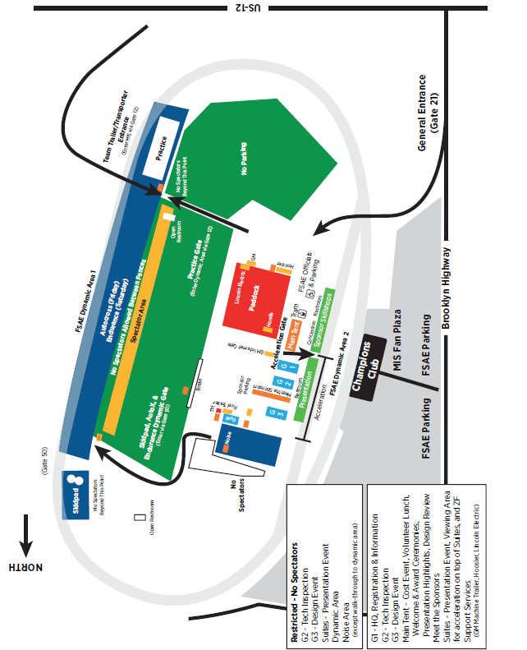
MIS SITE MAP

Slide 59
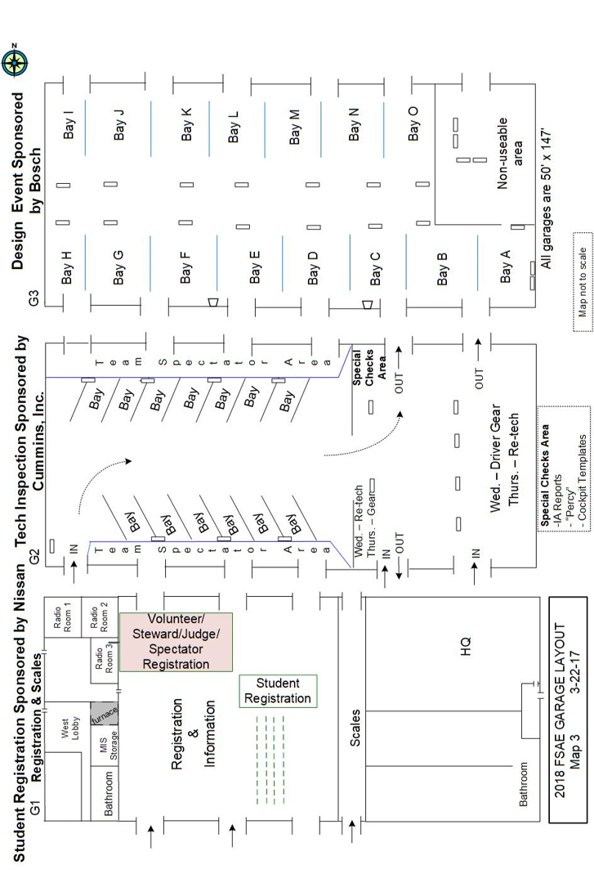
GARAGE LAYOUT

Slide 60
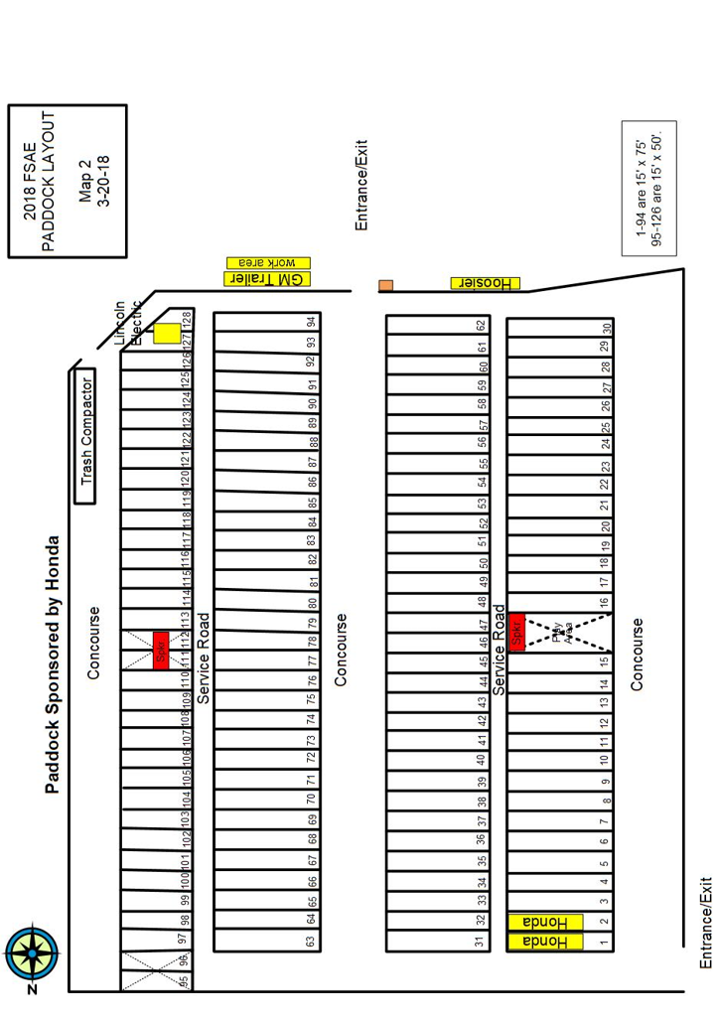
HONDA PADDOCK LAYOUT

Slide 61
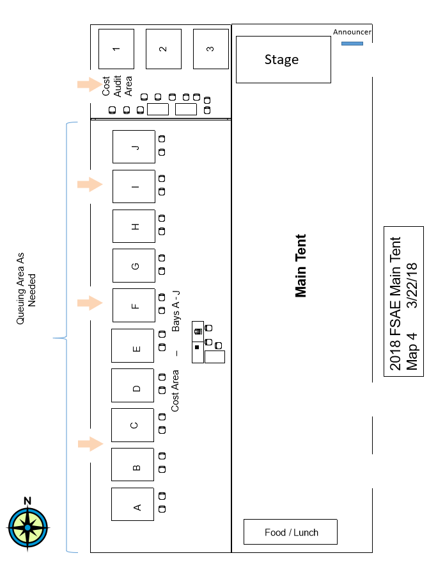
COST LOCATION

Slide 62
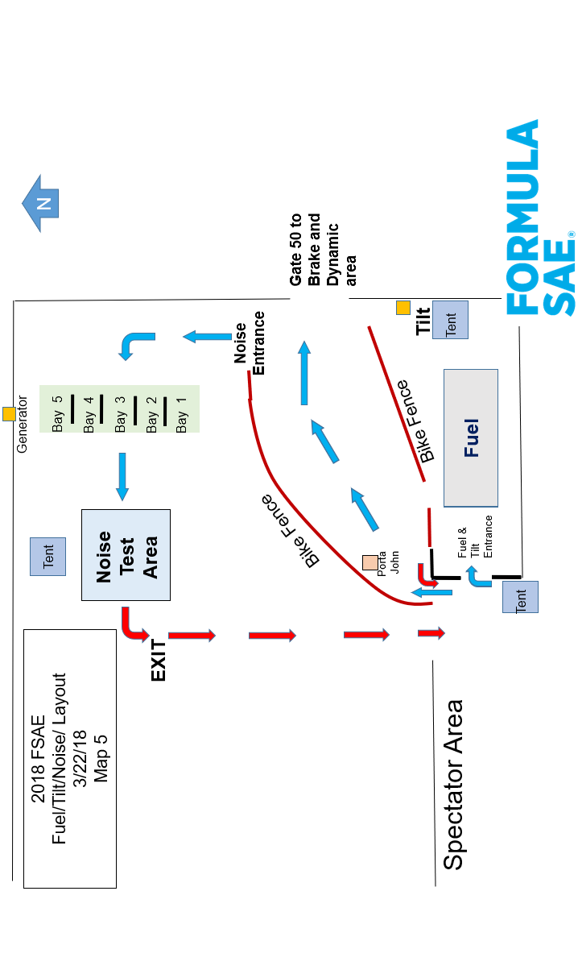
FUEL/TILT/NOISE LAYOUT

Slide 63
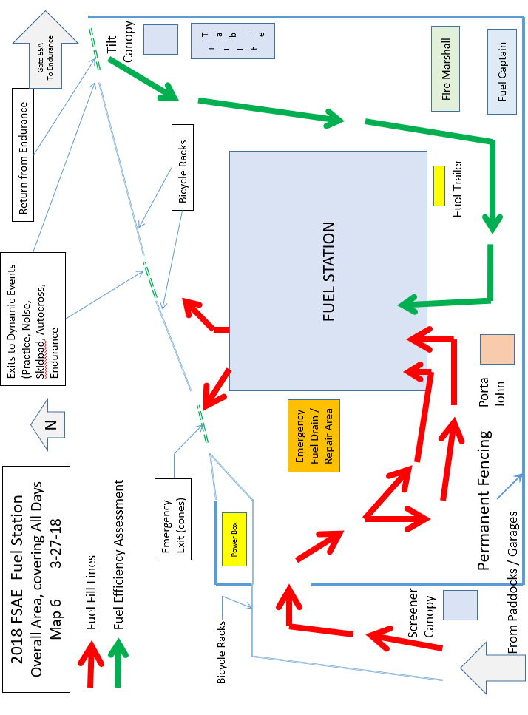
FUEL STATION LAYOUT

Slide 64
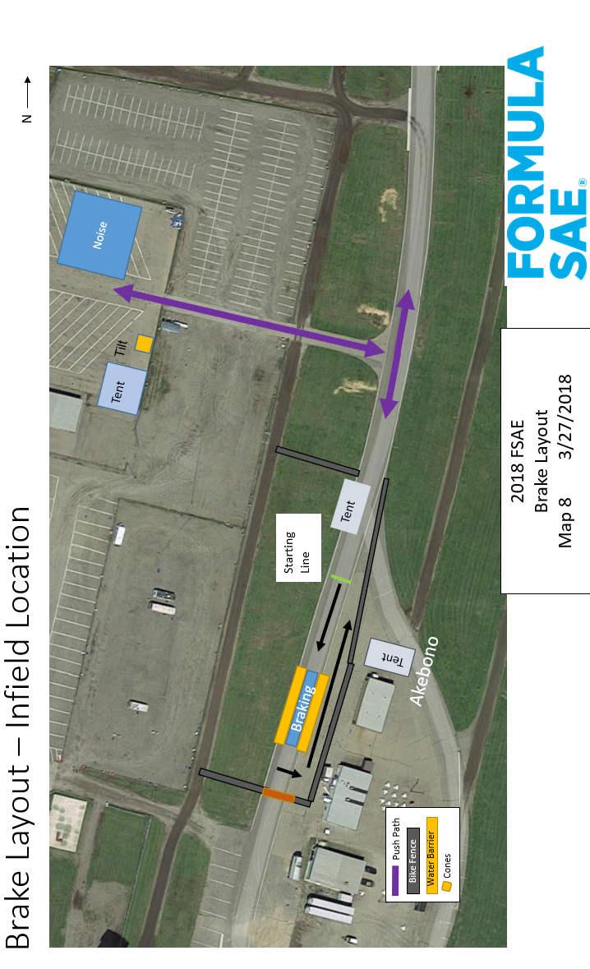
BRAKE LAYOUT

Slide 65
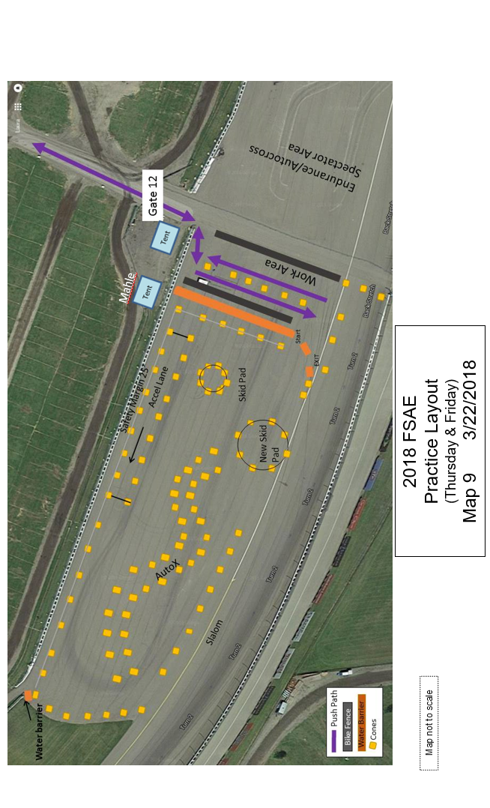
PRACTICE TRACK

Slide 66
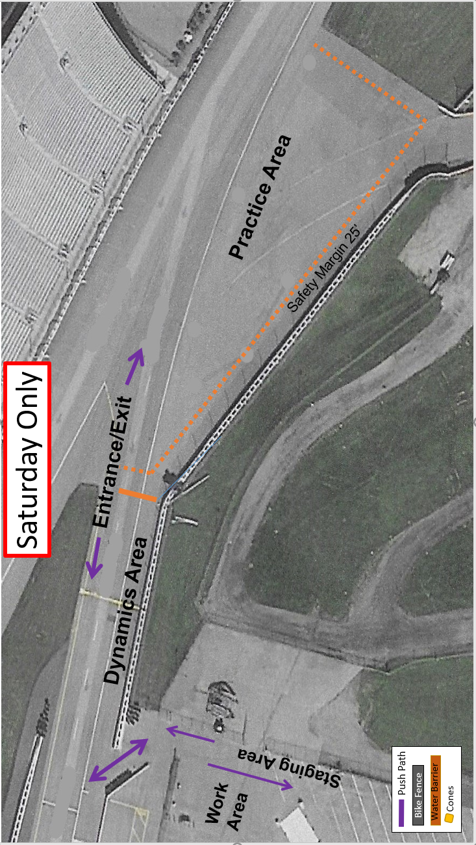
PRACTICE TRACK

Slide 67
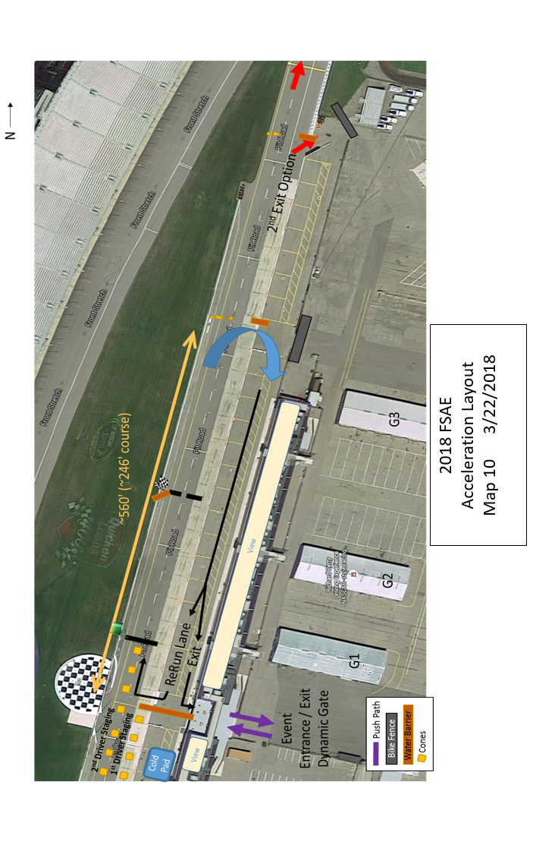
ACCELERATION LAYOUT

Slide 68
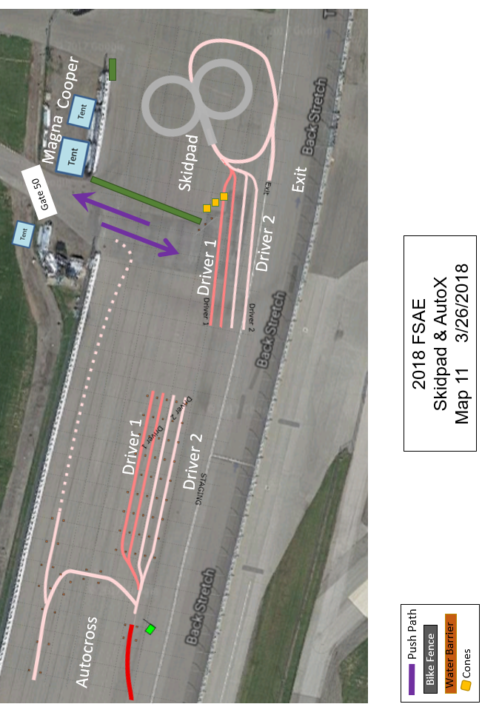
SKID PAD & AUTOX LAYOUT

Slide 69
AUTOCROSS LAYOUT

Slide 70
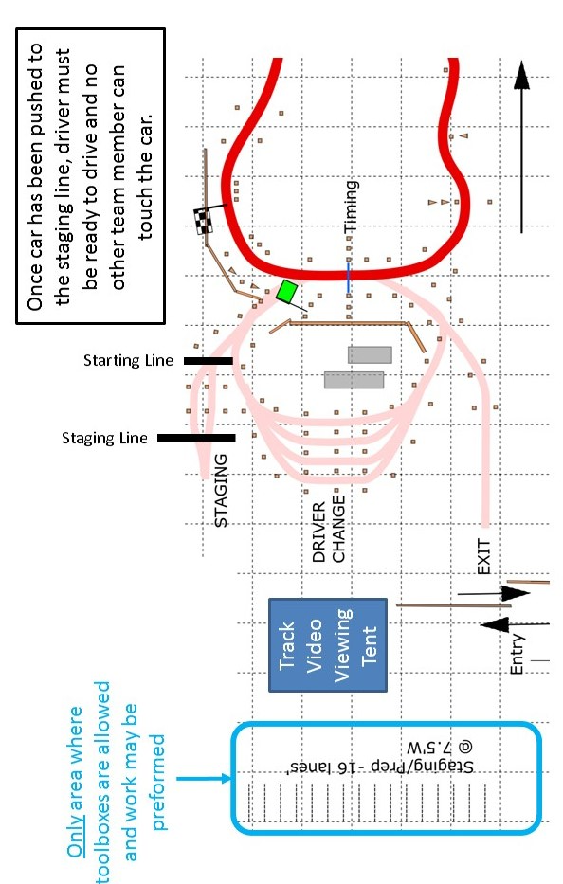
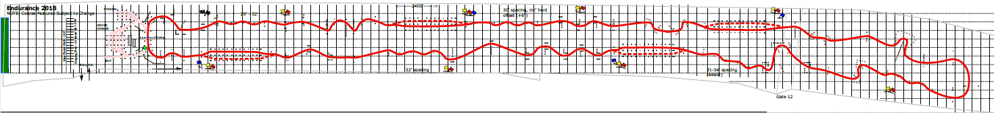
ENDURANCE & FUEL EFFICIENCY LAYOUT

Slide 71
PLACES TO EAT

Slide 72
PLACES TO EAT CONT.

Slide 73
PLACES TO EAT CONT.

Slide 74
MOTORCYCLE SHOPS
FIRE EXTINGUISHER SUPPLIERS

Slide 75
RACING SUPPLIES

Slide 76
ADDITIONAL RACE SHOPS

Slide 77
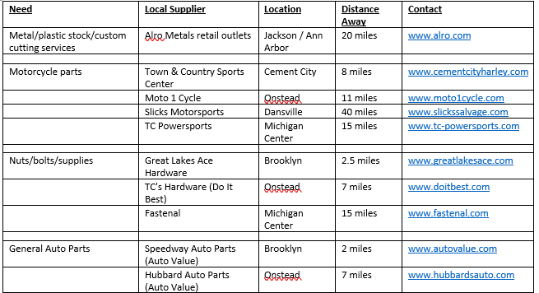
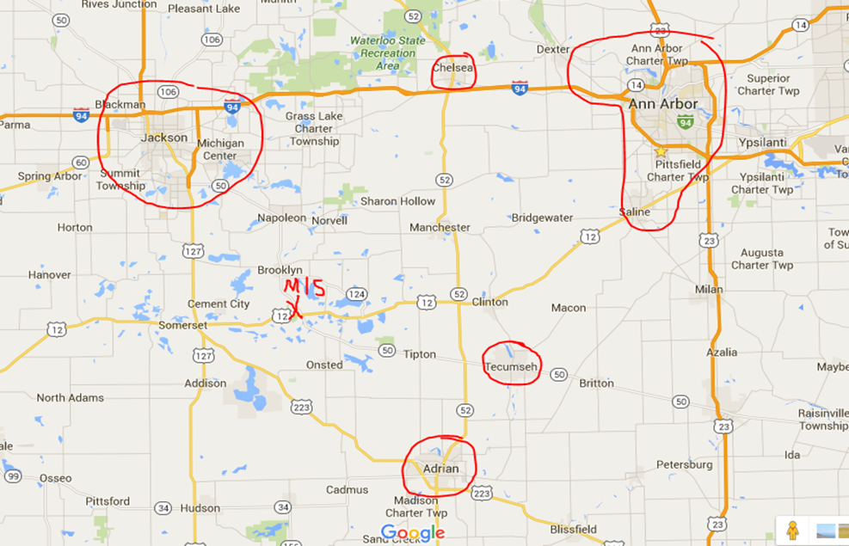
LOCAL BUSINESS GUIDE

Slide 78
SURVIVAL LIST
We suggest you bring (or wear, as appropriate) the following to ensure that you are comfortable and prepared for just about anything. (Temperatures were in the low 40s in 2006 & 2007. In 2016, we had rain, snow and sleet as well as very cold and windy weather during the Endurance event)
Long pants
Comfortable, close-toed shoes (absolutely no sandals)
Heavy jacket
Rain slicker (please do not wear red or yellow)
An umbrella
Extra sweatshirt(s). Dressing in layers is very highly recommended.
Gloves
Thermal under layer(s)
Hat (we suggest both a cap and a winter hat)
Ear muffs
Spare pair of dry shoes and socks
Hand warmers/toe warmers
Sunscreen
Lip Balm with SPF
Insect Repellant
Anti-bacterial waterless hand sanitizer
Sunglasses
Tissues
Aspirin / Ibuprofen
Allergy medication
Band Aids
Ace Bandages
Antacids
Water bottle
Small cooler with snacks / plastic bottles of drink
Pen & paper
Business cards
Cell phone
Ear plugs
Lawn chair
Stadium Blanket
Camera (may not be used in some areas/assignments)
Backpack to contain your belongings
Large clear plastic bag (labeled with your name) to protect your belongings if it rains
Anything else you think you might need to be comfortable!

Slide 79
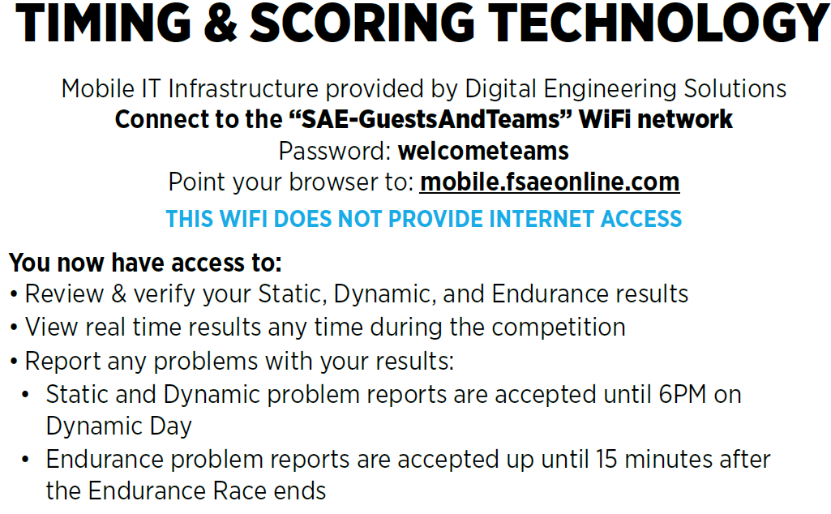
TIMING AND SCORING TECHNOLOGY

Slide 80
DESIGN JUDGE BIOGRAPHIES
Steven (Steve) Fox: Chief Design Judge & Design Event Captain Alma Mater: Iowa State Law Enforcement Academy, U.S. Army Military Police Academy. Employment History: PowerTrain Technology, President / Director of Engineering, ‘01+. Quarter Master Industries, Design Engineer, 20 years, new product development, manufacturing, testing. Expertise: Skilled Mechanic, Journeyman Machinist, Power transmission design over a broad spectrum of applications, Engine Development, Materials Selection & (Lean) Manufacturing Engineering. Over 40 years motorsports / engineering career. Past Chief Design Judge- Formula Student Germany, Formula Student Austria, Formula Student India. Design Captain- FSAE-Virginia ’08 & ’09. SAE Industrial Lecturer. Currently resides in: IL First car: ’70 Camaro Z-28, (no power steering, power brakes, or AC) Favorite Racecars: Porsche 917-30 & McLaren M8. Sadly, today’s liability concerns will never let that much power to weight ratio loose on a racetrack again… Design Judge since: 1999 when recruited by Carroll Smith
Anthony (Tony) Lyscio: Chief Design Judge & Design Event Captain Alma Mater: University of Minnesota: B.M.E.- Mechanical Engineering; Purdue University: M.S.E. - Design Engineering; Indiana University: M.B.A. Employment History: SpaceX - ‘15+; GM - Adv. Technologies, Camaro Lead Suspension Design Engineer, Vehicle Dynamics Adv. Development- Vehicle Dynamics Dev., Vehicle Handling Lab- Analysis/Test Engineer, Concept / Advanced Vehicle Integration-Design Engineer. Race Engineer Consultant Expertise: Suspension /Steering / Chassis Design and Development, Data Acquisition, Race Engineering. Currently resides in: CA First love: ‘69 Camaro 327/4-speed. Favorite racecar: Ford GT40. Proof that revenge can be a very productive emotion. Design Judge since: 2001
William (Bill) Riley: Chief Design Judge & Design Event Captain Alma Mater: Cornell University: BS and MEng Mechanical Engineering. Employment History: Cornell Formula SAE (3 Years), Chassis Team Leader (1 Year). FSAE Rules Committee (9 Years), Ford Motorsports (including assignment with Jaguar Formula 1) and Advanced Engine Engineering (7 Years). General Motors: Combustion and Cylinder Head Design (4 Years). Space Exploration Technologies: Senior Director of Structures Engineer ‘10 +. Expertise: Chassis Structures, design & analysis. Composites, Composites FEA, Engine Component Design, Combustion. Currently resides in: CA First car: '84 Mercury Topaz 2-Door GS that went to 230,000 miles. Favorite racecar: I like them all! Design Judge since: 2008
Shiva Aher: Alma Mater: Pune University: MS in Mechanical Engineering – Mechanical Design Employment History: ‘05+: Ricardo, Inc: Senior Project Engineer – Engines: Expertise: Powertrain Design and Development Currently Resides in: MI Favorite Race Car: Bugatti with 16 cylinder engine Design Judge since: 2017

Slide 81
DESIGN JUDGE BIO CONTINUED
Ryan Arens: Alma Mater: Northern Illinois University: BS and MS in Mechanical Engineering. Employment History: Honda R&D Americas Expertise: Suspension Design, Tire Development, Overall Vehicle dynamics, Component Design, 5 yrs. Formula SAE experience Currently resides in: OH First car(s): ’91 Honda CRX Favorite racecar: Lotus 99T, Red Bull RB7 Design Judge since: 2012
William Attard: Alma Mater: University of Melbourne - Australia. BE, BSc, PhD in Mechanical Engineering. Employment History: Chrysler, MAHLE Powertrain; Perkins Engineering; Bishop Rotary Valve Expertise: Powertrain R&D (combustion, fuels, turbocharging, engine design). Currently resides in: MI First Car: ‘80 Holden Commodore. Favorite racecar: VL Commodore Group A Touring Car Design Judge since: 2008: FS-UK, 2009-FSAE-MI
Siddarth ‘Sid’ Attravanam: Alma Mater: University of Texas at Arlington: BS (Hons.) in Mechanical Engineering (minor in Electrical Engineering) Employment History: ‘14 – present: Cooper Tire & Rubber Company: Manager-Tire & Vehicle Dynamics, Vehicle Modeling, Simulation and Track Testing; ‘13 – ‘14 OptimumG: Vehicle Dynamics Intern; Jan ’13 – June ’13: Fixrim Racing: Track Engineer, data acquisition setup, vehicle setup, tuning, driver coach. Expertise: Vehicle handling modeling, simulation and testing, data acquisition setup, driver metrics. Currently Resides in: OH First car: ‘01 Toyota Celica GTS Favorite Race Car: Ferrari F2004 driven by Michael Schumacher. Judge since: 2015
Robert Bailey, P.E.: Alma Mater: US Air Force Academy: BS in Mechanical Engineering; University of Dayton: MS in Mechanical Engineering. Employment History: Engineering Systems, Inc. ‘13+: Engineering Consultant. US Air Force ‘03 – ’13: Mechanical Engineer, Assistant Professor at the US Air Force Academy, Operations Director of the Applied Mechanics Lab. Expertise: Manufacturing technologies, machine design, failure analysis, powertrain development, vehicle dynamics, program management. Currently resides in: CO First Car: ’83 Dodge Shelby Charger. Favorite racecar: Toss-up between the Mazda 787B or the Lotus 38. Design Judge since: 2013
Ryan Baldi: Alma Mater: Rochester Institute of Technology: Mechanical Engineering. Employment History: ’15-Present: Pratt & Miller Engineering – IndyCar Simulation Engineer; ‘12-‘15: Richard Childress Racing – Lead Vehicle Performance Engineer, NSCS Race Engineer; ‘10-‘12: Tesla Motors, Brake System Design Engineer Expertise: Vehicle dynamic simulation, race engineering, circuit & rig testing, brake system design and testing Currently Resides in: MI First car: ‘98 Saturn SW2 Wagon Favorite Race Car: Porsche 956 Design Judge since: 2014

Slide 82
DESIGN JUDGE BIO CONTINUED
John Barrick: Alma Mater: Rensselear Polytechnic University, MS Mechanical Engineering Employment History: General Motors Engineering, Chassis, Suspension, and Program Engineering Management for Cadillac V Series. Expertise: Suspension, Chassis, Kinematics FSAE Experience: 4 years as a Presentation Judge Currently resides in: MI First Car: ‘68 Pontiac Catalina Favorite Race Car: ‘67 STP-Paxton 4 Wheel Drive Turbine Car #40 Design Judge since: 2017
Martin Belley: Alma Mater: École de Technologie Supérieure (ETS): BS in Electrical Engineering Employment History: ‘06 – Present: Electrical Design Engineer at Robert Bosch LLC (USA) and Robert Bosch GmbH (Germany) Expertise: Electronic controls for Diesel and gasoline powertrains, design validation, combustion engines Currently Resides in: MI First Car: ’87 Ford Escort GT Favorite Race Car: Mercedes Benz 190E 2.3-16 Design Judge since: 2016
Jude Berthault: Alma Mater: Ecole de Technologie Superieure (ETS): FSAE Fellowship 03’-09’
Employment History: 2010: Joe Gibbs Racing: NASCAR Chassis Design Engineer; 2011-13: Essex Parts Services / AP Racing: Created Dynamometer for high performance brake system testing; 2013-15: Chip Ganassi Racing: NASCAR Design Engineer. 2015-Current: Ford Motor Company: Product Development Engineer, Engine Systems & Components for Hybrid Electric Vehicles. Currently Resides in: MI First Car: Rust lightened ‘89 Toyota Corolla Station Wagon Favorite Race Car: My CCM “Jet Speed” Hockey Skates! Design Judge since: 2014
Michael Black: Alma Mater: Rutgers Mechanical Engineering ‘90, Licensed Professional Engineer. Employment History: Ford Motor Company, 15+ Years Automotive Body and Body Structure Product Design. Military Contractor, Machine Design. Initiated Rutgers FSAE Team '89. FSAE Volunteer since 1995. Expertise: Automotive Structures, Metallic Materials, Threaded Fasteners, Chassis Design. Currently resides in: MI First car: '72 Merc Colony Park Wagon w/ 429 engine & simulated wood grain side panels. Favorite racecar: McLaren MP4 F1 driven by Ayrton Senna or any car driven by Senna. Design judge since: 2000
Hugh Blaxill: Alma Mater: University of Bath, UK: Mechanical Engineering & MPhil in Automotive Engineering. Employment History: MAHLE Powertrain LLC, General Manager. Previously MAHLE Powertrain Ltd, Chief Engineer, R&D. Expertise: Combustion Engines, High Performance Engine Engineering, Fuel Economy Technologies, Production programs for Niche applications. Currently resides in: MI. First car: BMW 635CSi, Golf GTi Favorite Car: Audi R8 V10, Nissan Skyline GT-R Favorite racecar: Lotus 49, BMW E9 Batmobile Design Judge since: 2014.

Slide 83
DESIGN JUDGE BIO CONTINUED
Ben Bosworth: Alma Mater: Michigan State University: BS in Mechanical Engineering. Employment History: 2018-Present: Guerrilla Gravity: Senior Engineer, 2013-2018: Pratt and Miller Engineering: Design and Analyst Engineer, 2015-Present: Type2Cycles: Co-Founder. Expertise: Composites testing and analysis, composites manufacturing, FEA optimization methods, and non-linear crash simulation (LS-Dyna). Currently Resides in: Morrison CO. First Car: Focus ST. Favorite Race Car: C7R. Design Judge since: 2016
Ben Brooke: Alma Mater: University of Maryland College Park: BS in Mechanical Engineering Employment History: ’14 – present: Pratt & Miller Engineering; Defense Design Engineer; ’11-’13; Petroleum Institute, Abu Dhabi, UAE; Baja SAE Program Mentor. Expertise: Chassis and Suspension Design, Kinematics and Compliance Testing, Fabrication Currently Resides in: MI First car: ’80 Jeep CJ-7 Golden Eagle Favorite Race Car: Audi R10 TDI Judge since: 2016
John Burford: Alma Mater: University of Texas – Arlington Employment History: Altair Engineering ‘98 – ‘04; Contractor ‘04 – ‘15: experienced in multiple fields: Military, Automotive, Heavy Duty Trucks, and Aerospace. Currently works for Aurora Flight Sciences Expertise: CAE analyst focusing on Multi-Body Dynamics and Structural Optimization Currently resides in: VA First Car: ‘84 Pontiac Firebird Favorite racecar: Group C/IMSA GTP Mazda 787 Design Judge Since: 2011
David Caples: Alma Mater: Michigan State University: BS in Mechanical Engineering. Employment History: ’14-Present: General Motors – Corvette Aerodynamics CFD Engineer. Expertise: Performance Vehicle Aerodynamics, Computational Fluid Dynamics, Wind Tunnel Testing Currently Resides in: MI First Car: ’02 Mitsubishi Lancer Favorite Racecar: Corvette C7.R Design Judge since: 2017
Sebastian Castro: Alma Mater: Cornell University: MS in Mechanical Engineering with a concentration in Systems, Dynamics, and Control. Employment History: '17 - present: MathWorks: Education Technical Evangelist, Robotics Student Competitions; '16 - '17: Aurora Flight Sciences: Software Engineer; '13 - '16: MathWorks: Training Content Developer, Modeling and Simulation. Expertise: Robotics, system-level simulation, control, and algorithm design, software, education. Currently Resides in: MA. First car: 2013 Mazda3 Grand Touring. Favorite Race Car: "Grimsel" from AMZ racing -- current record holder for 0-100 km/h acceleration with an electric car. Judge since: 2018

Slide 84
DESIGN JUDGE BIO CONTINUED
Gerry Clark: Alma Mater: THE Ohio State University: BS in Mechanical Engineering. Employment History: ‘89 – present: General Motors; ’97-Present: GM Powertrain Synthesis and Analysis; ’89-’96: GM Crashworthiness Test and Non-linear FEA Analysis. Expertise: Engine performance simulation and valvetrain mechanical dynamic simulation. Engine architecture for performance and fuel economy. Camshaft profile design. Currently resides in: MI First car: ’72 SAAB Model 96 Favorite racecar: Summer Bros, Goldenrod. Design Judge since: 2010
Michael Collenberg: Alma Mater: TU Munich. BS, MS Electrical Engineering. Employment History: 2012 Kinexon, 2014-now Tesla. Expertise: Embedded SW+HW, chassis controls. Currently resides in: San Francisco, CA. First car: Golf IV. Design judge since: 2016 at FSG, 2018 in US.
Ian Dahl: Alma Mater: University of Washington: BS in Mechanical Engineering Employment History: ‘12+ - SpaceX: Manager – F9 Stage 1 Structures Expertise: Composites, Structural design, Brakes Currently Resides in: CA First Car: 92’ EG Civic Favorite Race Car: Benetton B194 – Schumacher’s 1st Championship Design Judge since: 2016
Bill Davidson: Alma Mater: Brunel University, London, England: BSc Mechanical Engineering Employment History: Ford Motor Co / Visteon (UK & US) 20 yrs., MAHLE Powertrain 8 yrs., Chrysler (FCA) current Expertise: Powertrain mechanical design, calibration and control systems. Currently resides in: MI First Car: ‘69 Ford Capri Favorite racecar: ‘72-‘74 Ford Capri RS2600 / RS3100 Design Judge Since: 1995
Mike DeRonne: Alma Mater: GMI Engineering Management Institute Employment History: ‘86 - '99 & '01 – present: General Motors. Plant, body structure, motorsports, engine control systems. '99 - '01 Cosworth Technology. Engine calibration. Driveline controls Expertise: Powertrain calibration with many years focused on diagnostics. A few years as data acquisition expert for GM in the years of growth from Indy cars into all racing. Currently Resides in: MI First car: '70 Impala that dad got for us as a beater high school car First (real) car (I picked): '75 V-8 Monza Favorite Race Car: Chevy Intrepid GTP - great era in GTP Design Judge since: 1999
Karan Desai: Alma Mater: University of Pennsylvania: BS in Mechanical Engineering and Applied Mathematics, MS in Robotics. Employment History: ’13 – ‘14: The Goodyear Tire & Rubber Company: Life Cycle Mechanics Engineer. ’14 – present: The Goodyear Tire & Rubber Company: Vehicle Dynamics Engineer. FSAE Volunteer and tech inspector since 2014. Expertise: Tires. Experienced with tire testing and modeling, vehicle dynamics, and vehicle dynamic simulations. Currently resides in: OH First Car: 2006 Honda S2000. Favorite Race Car: 2000 Audi R8 (LMP). Design Judge since: 2018

Slide 85
DESIGN JUDGE BIO CONTINUED
Drake DeVore: Alma Mater: Northern Illinois University: BS Mechanical Engineering. Employment History: International Truck and Engine (NVH Engineer) – ’04-’05, MoTeC Systems East ’05 - present. Expertise: Electronic fuel injection, data acquisition, engine calibration. Currently resides in: NC First Car: Pro Street ’65 Plymouth Barracuda my father and I built. Favorite racecar: My first FSAE car. Design Judge Since: 2011
Steven Dietz: Alma Mater: University of Michigan-Dearborn: BS, MS in Mechanical Engineering. Employment History: FSAE (4yrs), DENSO Component Failure Analysis (2yrs), General Motors since ’08: Transmission Calibration 6/8 RWD (6yrs), Powertrain Integration Small Block current. Expertise: Powertrain Integration, packaging, calibration, FSAE chassis design Currently resides in: MI First car: ’94 F-150 Ext cab w/ 5.0L EFI. Favorite racecar: C6.R Design Judge since: 2015
Justin Dolane: Alma Mater: SVSU - BS in Electrical engineering. Employment History: 2011-2016 Walbro Engine Management, project engineer developing electronic fuel injection systems. 2016-present General Motors, Calibration engineer for small diesel applications. Expertise: Embedded hardware and software design, electronic controls and modeling, engine calibration and diagnostics. Currently Reside in: Milford MI. Favorite vehicles: Aprilia RSV4, BMW S1000RR, Ducati SuperSport, C5, S2000. Design Judge since: 2017
Paul Dovi: Alma Mater: Embry Riddle Aeronautical University: ‘11 BS in Mechanical Engineering Employment History: SpaceX ‘11+ Manager, Falcon Structural Test Expertise: System Level Structural Testing Currently resides in: TX Favorite Race Car: 2011 ERAU Formula Hybrid car Design Judge since: 2016
Murilo Duarte: Alma Mater: EESC-USP 2003 Employment History: ‘12+ Ford Motor Company; ’11-’12 Honda Research Americas; ’04-’10 Ford Motor Company Brasil Expertise: Vehicle Dynamics, suspension design, structural design. Currently resides in: MI First car: ‘92 Fiat Uno Mille (simple, lightweight, reliable, surprising huh?). Favorite racecar: Brabham BT52 (how to exploit big rules changes). Design Judge since: 2011
Ash Dudding: Alma Mater: Virginia Tech, BSME. One of the founding members of VT FSAE team. Employment History: '89+ Volvo Truck, Ride and handling development engineer, validation engineering for structures and fatigue. '96+ Hendrickson Commercial Vehicle Systems. Working in product development for Truck, Bus and Military vehicle suspension and chassis. Heavily focused in structures, fatigue and vehicle dynamics. Currently Global Director of Engineering. Expertise: Truck chassis, ride, handling and structural development. Truck suspension component and system development. Currently resides in: IL First Car: ‘72 Fastback Mustang. Favorite racecar: Ford GT 40 (original), Porsche 917, Porsche 962. Design Judge since: 2010

Slide 86
DESIGN JUDGE BIO CONTINUED
Tom DuPree: Alma Mater: University of Pittsburgh: BS in Mechanical Engineering. Employment History: '16 - Present: Joe Gibbs Racing - Race Team Support and Vehicle Dynamics Engineer. '15 - '16: Northeast Tool and Manufacturing Co. - Manufacturing/Process Engineer. Expertise: Data Analysis, Vehicle Dynamics/Tire simulation support, Race Engineering Tools. Currently Resides in: Mooresville, NC. First Car: 1999 BMW 328i. Favorite Race Car: 2011 spec. Audi R18 TDI Ultra. Design Judge since: 2018
Dylan Edmiston: Alma Mater: University of Florida. Employment History: 2015 - Present: Pratt & Miller Engineering: Cadillac Racing Electronics Engineer, prototype customer generic support, test & development. Expertise: Electronics and data acquisition. Currently Resides in: MI. First Car: '98 Honda Civic LX. Favorite Race Car: Subaru Impreza WRC2005. Design Judge since: 2018
Gabriel Eduardo PhD: Alma Mater: University Sao Paulo: BS and PhD in Mechanical Engineering Employment History: ’08 Renault F1 Team, ’10+ General Motors Expertise: Vehicle Dynamics, ride and handling, suspension, steering and tire development, simulation and testing Currently Resides in: MI First Car: VW Polo Favorite Race Car: Harsheys Design Judge since: 2014 (in Brasil!)
Colin C. Engebretsen, MS: Alma Mater: University of North Dakota, BS in Mechanical Engineering; Air Force Institute of Technology, MS in Aeronautical Engineering Employment History: US Air Force: ‘08-Present; Structural Engineer, KC-135; Battle Damage Engineer, Tankers & Bombers; Assistant Professor, Engineering Mechanics, US Air Force Academy Expertise: Suspension, Vehicle Dynamics, Tires, Chassis, Data Acquisition, Power Train, Aero, & Brakes (Jack of all, master of some) Currently Resides in: OH First Car: '06 Civic Si Favorite Race Car: Mazda 787B Design Judge since: 2016
Greg Fadler: Alma Maters: University of Michigan BS in Aerospace Engineering; University of Illinois MS in Aerospace Engineering; Indiana University MBA. Employment History: ’85-‘89 McDonnell Douglas, Fighter Plane Flight Test Engineer. ’89-’98: General Motors (GM), Senior Corvette Body Design Engineer and Aerodynamicist. ’98-’01: GM Aerodynamics Technical Integration Engineer. ’01-’03: GM Aerodynamics Engineering Group Manager. ’03-’05: GM Cadillac DTS Performance Manager. ’05-’07: GM Racing Vehicle Engineering Team Manager. ’07-’11: GM Aerodynamics Engineering Group Manager. ’11-’14: Navistar Director of Performance Integration, Certification & Compliance. ’14 – present: Fiat Chrysler Automotive Group, Wind Tunnel Manager and Aero Technical Specialist. Expertise: Aerodynamics, Body Design, Composites, Chassis, Instrumentation, & Complete vehicle design, development, testing & integration. Currently Resides in: MI Favorite Race Car: ‘69 L-88 Corvette. Design Judge since: 2010

Slide 87
DESIGN JUDGE BIO CONTINUED
Kevin Finney: Alma Mater: University of Central Florida (UCF): BS and MS in Mechanical Engineering, Summa Cum Laude and Founder's Day Scholar. Employment History: 2013-present: Gray Motorsports: General Manager, NHRA Pro Stock Drag Racing, 2010-2013: Chip Ganassi Racing, Design Engineer, NASCAR Cup Series. 2005-2010: Excelleration, LLC, Project Engineer for The Revolution Inertia Engine Dynamometer. 2003: NASCAR, Field Investigator-Safety Inspector, Cup Series. Expertise: Design Engineering with an emphasis on chassis and suspension components. Extensive research on engine testing methods and procedures while developing the inertia dyno for the racing industry. Currently Resides: Concord, NC. Design Judge since: 2018
Nick Fishbein: Alma Mater: Cornell University, BS in Mechanical Engineering. Employment History: ’08 – present, Chip Ganassi Racing NASCAR Program Vehicle Dynamics Engineer; ’07, Rahal Letterman Racing ALMS Program Data Engineer; ’06, Milliken Research Associates. Expertise: Vehicle dynamics testing and modeling including development of full vehicle simulation models, 7-post rig testing and performance metric correlation. Currently resides in: NC First Car: ’59 Austin Healey Bugeye Sprite. Favorite racecar: Cornell FASE ARG06 Design Judge since: 2014
John Fratello: Alma Mater: Virginia Tech: BS and MS in Mechanical Engineering. Employment History: ’13 – present, Tesla Motors: Chassis Controls Development, ’11 – ’13, Bosch: Traction/Stability Control Calibration. Expertise: Chassis controls design and practical robust application, applied vehicle dynamics, test planning and execution. Currently resides in: CA First car: ’94 Ford Taurus. Favorite racecar: Lancia Stratos. Judge since: 2013
Matthew Gesch: Alma Mater: University of Minnesota-Duluth: Mathematics and Statistics and Actuarial Sciences Employment History: DENSO International America, Inc.: Application Engineer; Modern Automotive Performance: Turbocharger Operations Expertise: Advanced Driver Assistance Systems, Prototype System Installation, and Data-logging, Machining Currently Resides in: MI First car: Mitsubishi 3000gt VR-4 Favorite Race Car: Audi R10 TDI Design Judge since: 2016
Peter Gibbons: Alma Mater: Worcester Polytechnic Institute, Mechanical Engineering Employment History: ‘11+: Multimatic: Technical Director Vehicle Dynamics. ‘04-‘10: Andretti Autosport, Technical Director. ‘91-‘04: Newman Haas Racing, Race Engineer / Technical Director. ‘88-‘91: Penske Racing, Race Engineer. ‘86-‘88 Kraco Racing. ‘84: MARCH Engineering. ‘81-‘86 Patrick Racing. Expertise: Vehicle Dynamics, Design, Simulation, Simulators Currently resides in: Toronto First Car: ‘72 Ford Pinto Favorite racecars: Lotus 78-79 (A Paradigm Shift in Motor Racing!) Design Judge since: 2013

Slide 88
DESIGN JUDGE BIO CONTINUED
Billy Godbold: Alma Mater: Florida State University: MS in Physics. Employment History: COMP Performance Group (COMP Cams): 20+ Years, Camshaft Design / Valvetrain Engineering Manager. Expertise: Engine Systems Theory, Design and Development, Metallurgy, Motorsports. Currently resides in: TN First car: ‘86 Jeep CJ7 (V8 engine swap) Favorite racecar: Panoz Esperante GTR-1, but I have never seen a racecar I did not like. Design Judge since: 2014
Graham Gott: Alma Mater: GMI Engineering & Management Institute, BS in Mechanical Engineering (Automotive Specialty). Employment History: 2017-Present: Engineer, Joe Gibbs Racing; 2003-2017: Sr. Development Engineer, Stackpole Engineering Services, Inc.; 2002-2003: Development Engineer, Goodyear Racing. Expertise: Vehicle dynamics, multibody simulation, sim optimization and validation, programming. Currently Resides in: NC. First Car: 1986 Ford F-150. Favorite Race Car: 1981 AAR Eagle "Pepsi Challenger". Design Judge since: 2018
David Gould: Alma Mater: Newbury Grammar School. Employment History: Gould Engineering since ’94. Expertise: Chassis and suspension design, composite & traditional manufacture. Currently resides in: UK First Car: Austin Mini. Favorite racecar: Williams FW07 and Red Bull from 2009 on. Design Judge since: 1996
Jerry Grandov: Alma Mater: Rutgers University: BS in Applied Physics Employment History: 1996 Co-Founder of Shadow Racing Products 15+ years experience in Telecom R&D with Bell Labs Lucent Technologies / Alcatel-Lucent / Nokia Expertise: Cockpit adjustable suspension products. Vehicle Dynamics. Trackside racecar setup. Metal fabrication and manufacturing. CAD & FEA. Racing experience covers such diverse classes as IndyCar, NASCAR Busch Series, Silver Crown, Formula Ford, NEMA Midget, Formula Mazda, Super Stock, Pro Stock, Dirt Modified, Dirt Late Model, Super Modified, TQ Midget, Shifter Kart, Quarter Midget and of course FSAE. 1994 FSAE Best Prototype Fabrication Award Currently Resides in: NJ First car: ‘79 Chrysler Cordoba (With rich Corinthian leather seats) Favorite Race Car: McLaren MP4/4 Design Judge since: 2005 FSAE Volunteer since: 1996
Mirza Grebovic: Alma Mater: UofM Ann Arbor/Dearborn: BS in Mechanical Engineering and MSE in Automotive Systems. Employment History: 2010-present: General Motors Performance Variant Engineering Manager, including lead brake systems engineer performance brakes, including brake chassis controls release engineer. 2005-2010: TRW Automotive brake/chassis controls engineer. Expertise: Chassis (brake/suspension) design and development, full vehicle project management and systems integration. Currently Resides in: MI First car: 2005 Subaru STi Favorite Race Car: Seriously? I need 10 pages but Cadillac ATS-V.R, who knew a Caddy can wipe the floor with the world’s best. Design Judge since: 2018

Slide 89
DESIGN JUDGE BIO CONTINUED
Edwin Ho: Alma Mater: University of Waterloo, Bachelor of Applied Science – Mechanical Engineering Employment History: ’95-’16: Chrysler – Vehicle Development, Chassis Design, Vehicle Dynamics. ’16-’17: Ford – Ford Performance Vehicle Engineering/Vehicle Integration Expertise: Vehicle dynamics, vehicle integration, and chassis design Currently Resides in: MI First car: ‘89 Honda Civic Si Favorite Race Car: Williams FW11 Judge since: 2017
Spencer Jackson: Alma Mater: Rose-Hulman Institute of Technology. Employment History: '16 - present: SpaceX Structures Engineer. Expertise: Chassis design and analysis. Currently Resides in: CA First car: '13 Ford Focus ST Design Judge Assistant since: 2018
Jeremy Keller: Alma Mater: University of Windsor Mechanical Engineering ’04 Employment History: Roush Industries: Powertrain Development Engineer ‘04+ Expertise: Exhaust Aftertreatment, Prototype and Production Engine Development Currently Resides in: Ontario First Car: 1981 Buick Regal Favorite Race Car: Ford GT40 Design Judge since: 2016 Tech Inspector since: 2005
Rachel Kendall: Alma Mater: University of Manitoba: BS in Mechanical Engineering. Employment History: '17 - present: Polaris Industries Inc: Test Engineer - Powertrain Validation. Expertise: Powertrain development and validation. Dyno testing, data acquisition. Currently Resides in: MN. First Car: '88 Ford Ranger, an old farm truck I fixed up to drive in high school (this is how I fell in love with standard vehicles). Favorite Race Car: Ferrari 312 T - Driven by Niki Lauda in 1975 when he won his first world title. Design Judge since: 2018.
Will Kerley: Alma Mater: McGill University: BEng - Mechanical Engineering. Employment History: ‘12-Present: Multimatic: Design Engineer; ‘11: Newman/Haas Racing: Data Engineer. Expertise: Design and development of vehicle suspension/structures, data acquisition and on-track testing of road/race vehicles. Currently Resides in: Toronto, ON. First car(s): 1990 300ZX (turbos added soon after). Favorite Race Car: Williams FW14B/FW15 Design Judge Since: 2016
Ryan Koch: Alma Mater: Western Michigan University 2009: BS in Mechanical Engineering. Employment History: AM General - Engine Product Engineer 6 years; Chrysler - Powertrain Synthesis Engineer 3 years; Pierburg EGR Engineer/Project Manager 3.5 years. Expertise: actuation equipment for intake/exhaust air flow, throttle body, EGR systems, intake/exhaust design, serviceability. Currently resides in: Clarkston, MI. Favorite Race Car: Maserati 250F Design Judge since: 2016

Slide 90
DESIGN JUDGE BIO CONTINUED
George Konstantinopoulos: Alma Mater: Western University, MEng in Composite Materials Employment History: Structural design for defense industry, Hexion Expertise: Structural design; Composites design and processing for low and high volumes Currently Reside in: ON, Canada First Car: ‘03 VW GTI Favorite Race Car: Lunar Roving Vehicle Design Judge Since: 2017
Ryan Kraft: Alma Mater: University of Michigan: BS Mechanical Engineering, Mathematics. Employment History: Director, Engineering at Arrivo, previously Faraday Future, SpaceX, Tesla Motors, and Kaz Technologies. Expertise: Dynamics (vehicle and structural), vehicle architecture, chassis systems, dampers. Currently resides in: CA First Car: '04 Nissan Sentra (RIP). Favorite racecar: Brabham BT46B. Design Judge since: 2010
Philip LaPointe: Alma Matter: Wentworth Institute of Technology: BS in Mechanical Engineering Technology. Employment History:..’91-‘07 Honda R&D Americas, Inc.; Suspension Design Engineer, Chassis Design Manager and Technical Leader ‘07-‘15 Honda Performance Development, Inc.; Chassis Design and Development Manager as Principal Engineer then Chief Engineer including aerodynamics, transmission, bodywork ‘07,-‘11 LMP2. ‘09 LMP1, ‘12-‘15 IndyCar DW12 including Engine installation, HPD Aerokit composite design. Wind tunnel program management; HPD Performance Engineering Chief Engineer. ‘15+: Honda R&D Americas, Inc.; Manager of Technical Information Management. Expertise: Suspension, Brakes, Wheels, Axle, Mounts, Exhaust, Brakes, Steering, Cooling, and Aerodynamics. Currently Resides in: OH First Car: VW Super Beetle Favorite Race Car: ‘09 Acura LMP1 ALMS Champion Design Judge since: 2010
Luke Legatt: Alma Mater: University of North Dakota: BS in Mechanical Engineering Employment History: Honda R&D Americas ’09+ Expertise: Automotive closure design. Including experience in white body and assembly part design Currently Resides in: OH First car: ’87 Toyota 4-Runner Favorite Race Car: McLaren Honda MP4/4 Design Judge since: 2011
Kim Lind: Alma Mater: University of Michigan Ann Arbor: BS Mechanical Engineering. Employment History: General Motors - 25 years; Previously: Michigan Automotive Research Corp - 7 years. Expertise: Dyno testing and development; by-wire systems; active suspension systems; AWD systems; vehicle concept development demonstrating turbocharging, supercharging, AWD and DCT technologies; and pre-production vehicle architectures. Raced 9 years in SCCA & was a driving instructor for SCCA driving schools. Currently resides in: MI First car: ‘68 Pontiac Bonneville (small aircraft carrier). Favorite racecar: My SCCA F-Production MG Midget. Design Judge since: 2010

Slide 91
DESIGN JUDGE BIO CONTINUED
Gene Lukianov: Alma Mater: Worcester Polytechnic Institute, Lawrence Technological University: BS Mechanical Engineering, MS Automotive Engineering. Employment History: Currently Owner and Principal of VRAD Engineering LLC, a vehicle design, consulting and service company. Chrysler: 22 years in vehicle dynamics tuning, development and analysis. Gabriel Shocks: 7 yrs. shock absorber design, manufacturing and tuning, also automotive brake design and weapons. Expertise: Specialist in all aspects of Chassis design, vehicle dynamics, calculations, development, tuning and subsystem/component manufacturing and performance. Currently resides in: MI First car: ‘61 Volvo 544. Favorite racecar: Ford GT40 (THE Original One). Design Judge since: 1999
Kim Lyon: Alma Mater: University of Minnesota / Minneapolis: BS Mechanical Engineering, BA Chinese. Employment History: ‘84 – ‘08 Chrysler Powertrain Engineering, Advanced Engine Systems Senior Specialist, VVT engine development – I4, V6, V8, V10;LeMans LMP 900 engine and chassis systems development; hybrid electric Le Mans racecar (Patriot Project); Formula One engine, chassis systems, and calibration development-Lamborghini Engineering. Expertise: Calibration, data acquisition, software design & coding, engine and chassis dyno testing, turbocharger and auto-manual transmissions development, modeling and simulation. Currently resides in: MI First car: ‘66 Chevy Impala SS (327c.i. 4-speed). Favorite racecar: Lola T70 coupe, Porsche 962, Nissan GTP, ‘93 F1 McLaren MP4/8. Design Judge since: 2003
Rich Mandle: Alma Mater: Cal Poly San Luis Obispo: BS in Electronic Engineering. Employment History: Hewlett Packard, Nissan Performance Technology, Budweiser King Racing, Chip Ganassi Racing, Penske Racing, Detroit Diesel/Daimler AG. Expertise: powertrain control, testing/DAQ, electronic system integration. Currently Resides in: MI. First car: 1972 Volkswagen Super Beetle. Favorite Race Car: 1991 Nissan NPT-90 GTP and 1996 Penske PC-25 Indycar. Judge since: 2018
Greg Massey: Alma Mater: The Ohio State University: BS in Mechanical Engineering Employment History: ’15-‘16 Bosch Chassis Controls Traction & Stability Control Calibration. ’16+ Tesla Chassis Controls. Expertise: Vehicle Dynamics, Brakes, Data Acquisition & Analysis Currently Resides in: MI First car: Honda Civic Favorite Racecar: Brawn GP 001 Design Judge since: 2017
Kyle McArver: Alma Mater: North Carolina State University: BS in Mechanical Engineering. Employment History: ‘06 – present: Roush Fenway Racing: Junior Aero Engineer ’06-’08; R&D Team Engineer ’09-’10; Race Engineer + Simulation Engineer ’11-’14; #17 Team Race Engineer, ’15-’16; Race Support Group Engineer, ’17 Expertise: Overall vehicle dynamics, vehicle simulations, suspension, aerodynamics / wind tunnel testing Currently Resides in: NC First Car: ‘83 Mercedes Benz 300D Favorite Racecar: ‘67 Lotus 49 Design Judge since: 2017

Slide 92
DESIGN JUDGE BIO CONTINUED
Luke Morrow: Alma Mater:..University of Newcastle, Australia; BS in Mechanical Engineering Employment History: ’07-'08 Prodigy Motorsport (Australian V8 Supercars, Development Series), Data Engineer; ‘08 General Motors Holden, Chassis Design Release Engineer; ‘08-'14 Toyota Technical Center Australasia, Senior Customer Quality Engineer; ‘14+ Tesla, Staff Product Support Engineer Expertise: Chassis and Mechanical Structure, Data Acquisition, implementation, and analysis, Electric Vehicle Powertrain architecture / design / safety / performance and Mechanical Systems Integration packaging / manufacturing / serviceability Currently Resides in: CA First car: ‘76 Volvo 244DL Favorite Racecar: Ferrari F2002 - beautiful and effective (see Pomeroy Index) Design Judge since: 2009 (at FSAE-A)
Anthony Musci: Alma Mater: Michigan Ross School of Business MBA, Rutgers BS Mechanical and Aerospace Engineering Employment History: current - JetHeat LLC, VP of Product and Business Development. Team Leader for Design and Development – Aston Martin V12 engine program. Mechanical Design Leader for Honeywell line of home-standby and portable generators. Ford Motor Company Advanced Powertrain Engineering. Expertise: Powertrain Design and Development. Jet Engine Design and Development. Aerodynamics. Electronic control systems, simulation, and Data Acquisition Currently Resides in: MI Favorite Vehicle: actually an aircraft – North American X-15 Judge since: 1998
Marc Musial: Alma Mater: Western Michigan University: B.S. Automotive Engineering. Employment History: Started at Chrysler in ‘91. Moved to Saleen for 1.5 years in ‘08 and returned to Chrysler in ‘09. Expertise: Engine systems (combustion, Air Flow, Calibration, Controls and dynamometer testing). Latest development project: Hellcat. Technical lecturer and driving instructor. Worked on Chrysler’s North American Touring Car Race Team. Currently resides in: MI First car/coolest car: ‘68 Chrysler Newport that I got from my grandfather. 2002 Dodge Viper GTS Coupe Favorite Racecar: North American touring cars or touring cars in general. (door slammer race cars like NASCAR used to be) Design Judge since: intermittently since 1996
Dick Myers: Alma Mater: University of Vermont: Mechanical Engineering Employment History: Chrysler Corp (33 yrs.), Ford (4yrs). Expertise: Design/development engineer, program manager, engineering supervisor and manager, racecar engineer. Currently resides in: MI First Vehicle: ‘56 Chevy 3/4 ton pickup (461,000 miles, honest) from my dad. Favorite Racecar: Winged 410 sprint car. Design Judge since: 1999
Jacob Oberlin: Alma Mater: U. of Michigan: Computer Engineering. Employment History: ‘11 – present: Tesla Motors: Manager Firmware Engineering. ‘10: MRacing Chief Powertrain Engineer. Expertise: Automotive firmware and electronics, powertrain and HVAC thermal systems, Data acquisition, 12V battery system charging and wiring harness design, lithium ion battery modeling. Currently resides in: CA First car: ‘96 Ford Thunderbird LX Favorite Racecar: Williams FW15C – From a time when engineers did the racing Design Judge since: 2014

Slide 93
DESIGN JUDGE BIO CONTINUED
Erich Ohlde: Alma Mater: University of Kansas – Lawrence: Mechanical Engineering FSAE ‘04-‘09. Employment History: Fiber Dynamics ’09-’10, Tool and die designer for USF1 projects; Pratt & Miller Engineering ’11-'14, Systems/Data Acquisition Engineer; GM R&D projects & Corvette Racing. Robert Bosch ’14 +, Motorsport Engineer. Expertise: Data Acquisition/Control Systems, Wiring harness design and manufacture Powertrain design and calibration. Currently resides in: MI First truck: ’96 Mazda B-Series Pickup. Favorite Racecar: Chaparral 2J Design Judge Since: 2014
Dan Olson: Alma Mater: Penn State, BS Mechanical Engineering. Employment History: '06 - Present: Joe Gibbs Racing, Expertise: Automotive design, Exotic materials, Physical testing and data acquisition, Hydraulic systems, CFD & aerodynamic R&D, Vehicle simulation, Experimental aircraft design and testing. Currently Resides in: NC First car: '89 Porsche 944 Turbo. Favorite Racecar: 1938 Mercedes W154. Design Judge since: 2018
Henning Olsson: Alma Mater:..Dartmouth College, Mechanical Engineering Employment History: ‘07-‘09: Ohlins Racing; '09-’14: Optimum G; ’15+ Calspan Expertise: Tire performance testing and analysis, tire and vehicle dynamics simulation, motorsports performance engineering, numerical methods Currently Resides in: CO First Car: ‘77 Opel Kadett 1.2, 52 hp and RWD Favorite Racecar: Toyota TF110 Design Judge since: 2017
Brett Oltmans: Alma Mater: Rochester Institute of Technology: Mechanical Engineering with Automotive Focus. Employment History: '00 - '05 Ford Motor Company, '05 - Present Polaris Industries Inc. Expertise: Dyno calibration, Alternative fuels engine design and calibration, Alternative fuels engine design and calibration, Induction system design, boosted and N.A. Currently resides in: MN First car: A rusty ‘71 Datsun 240Z. Favorite Racecar: Tyrell P34 6-wheeler Design Judge since: 2008
Mike O’Neil: Alma Mater: University of Akron, BS and MS Mechanical Engineering, competed in FSAE the first four years of their program Employment history: Technical Director for Tilton Engineering, Inc. for 14 years, Technical Director at Essex Parts Services, Inc. since 2010, works with a wide variety of teams in professional sportscar, NASCAR, Indycar, and other forms of racing Expertise: Racing brake, clutch, and driver control systems, dynamometer testing of brake systems, holds a patent related to his work developing a machine and process for bedding brake discs and pads, wide experience with most areas of a racing vehicle, testing, and manufacturing processes. 2009 AMA flat track motorcycle amateur national champion. Currently resides in: NC First car: ‘73 Chevy Nova Favorite racecar: Ford GT40 Design Judge since: 1998 Served as Chief Design Judge for FSAE West from formation through 2012 and in Lincoln, Nebraska before stepping down to work more with the students and focus on training new judges.

Slide 94
DESIGN JUDGE BIO CONTINUED
Sriram Pakkam: Alma Mater: North Carolina State University, MS in Aerospace Engineering. Employment History: ‘11-‘14 General Motors Racing. ’14-present: Chrysler SRT. Expertise: Racecar aerodynamics, Aerodynamic design leveraging wind tunnel testing and CFD. Currently resides in: MI First Car: ’04 Mazda RX-8. Favorite Racecar: Porsche 917K and 917/30. Design Judge since: 2014
Chris Patton Ph.D.: Alma Mater: Oregon State University: BS, MS and PhD inMechanical Engineering Employment History: ‘13-’14: Caterham F1; ‘14-’15: Nissan LMP1, ‘16+: SpaceX Expertise:..Dynamics, numerical methods and simulation: Tire modeling, vehicle modeling, lap simulation Currently Resides in:..CA First Car:..’73 BMW 2002 Favorite Racecar: 1928 Bentley Speed Six (200 hp 6.5 liter 6 cyl. w/ 6.1:1 comp.) 1929 Le Mans winner, & (at the time) THE most powerful car in the world. Design Judge since:..2015
Andrew Pautsch: Alma Mater: South Dakota School of Mines and Technology, BS Mechanical Engineering Employment History: '11-'15 Bosch Diesel Systems - SCR Aftertreatment Calibration; '15+ Bosch Motorsport - Diesel Projects and Motorsport Hardware Development Expertise: Powertrain calibration, hydraulic systems, motorsport electronic systems. Currently Resides in: MI First car: ‘92 Pontiac Grand Am (w/ a 5 speed and custom side pipes) Favorite Racecar: Lancia Delta S4, who doesn't love a twin charged engine? Design Judge since: 2014
Matthias Peeters: Alma Mater: KU Leuven (Belgium), MS in Mechanical Engineering: Delft University of Technology: MS in Aerospace Engineering. 1 year member of the KU Leuven FSAE Team '10, 2 years FS Team Delft '11-'12 Employment History: '2012 Intern BMW Group: R&D Engineer, Munich: '13-'16 BMW Group: Preliminary Concepts and Innovation Projects, Munich: '17-Present OptimumG: Expertise in Vehicle Dynamics. Currently Resides in: CO Favorite Racecar: Ferrari 488 GT3. Design Judge since: 2018
Joseph Penniman: Alma Mater: San Jose State University, Mechanical Engineering. Employment History: Tesla since 2012, FSAE volunteer since 2011, Founding member of SJSU FSAE in 2008 as suspension lead and chief engineer. Expertise: Automotive sensing system development. Mechanical system testing and characterization. Suspension and chassis design. Currently Resides in: CA First car: 1976 Datsun 280z. Favorite Racecar: Bob Sharp CP 280zx. Design Judge since: 2015

Slide 95
DESIGN JUDGE BIO CONTINUED
Aratz Pinter: Alma Mater: Tecnun, University of Navarra, Industrial Engineering, MS Mechanical Engineering 2013. University of Sheffield MS Aerospace Engineering 2012. Employment History: Nissan Technical Center Europe 1+ years Drivability and Acceleration Performance Engineer.Gearbox and IC calibration. 2016+ Rivian Automotive Aerodynamic Design Lead. Expertise: Mechanical Design, IC Powertrain, Aerodynamics. Currently Resides in: MI First car: 05 Toyota Aygo. Favorite Racecar: Mazda 787b. Design Judge since: 2014 (Spain)
Chai Pocknett: Alma Mater: University of Michigan: Studied Mechanical Engineering. Employment History: 2016-Present: Leidos: Structural Design Engineer; 2010– 2016 Gurit USA: Composite Design Engineer. 2006-2010 University of Michigan FSAE: Brakes, Unsprung, Manufacturing and 2010 team lead. We were fast. Expertise: Grew up building racecars with a strong fabrication background. Professional experience is weighted towards the analysis and fabrication of composite structures. Currently Resides in: MA. First Car: 2000 Nissan Maxima. Favorite Racecar: Ferrari 330 P3. Honorary Favorite Race Car: University of Michigan Rental Minivans. Design Judge since: 2018
Benjamin Pohl: Alma Mater: University of Florida Mechanical BSME. Employment History: Brembo North America, Program Manager 15 years. Expertise: Chassis Design, Vehicle Dynamics, emphasis on Brake Systems. FSAE Competitor 4 years. Currently resides in: MI First Car: ‘95 Acura Integra GS-R. Favorite Racecar: Ferrari 333SP Design Judge since: 2014
David Redszus Ph.D.: Alma Mater: Northwestern University: BS Industrial Engineering and Economics, MS Systems Management and Operations Research, PhD Product Development Processes. Employment History: Precision AutoResearch (founder, 25 yrs), Over 35 years total (research, engineering services, and specialty products for the motorsports industry). Expertise: Technical consultant, engineer, coach, and racer, advanced driving techniques, vehicle design, and engine development. Data analysis techniques and ability to translate complex issues into racer-understandable language. Currently resides in: IL First car: ‘70 Porsche 911S Targa. Favorite Racecar: What other than the Porsche 917-30? Or any other car which causes rules-changes ex-post should be a favorite! Design Judge since: 2004
Richard Reichenbach: Alma Mater: Michigan State University: BS Computational Mathematics. Employment History: ‘11 – present: Pratt and Miller: Analyst / Tire Modeling Engineer: ‘9 – ‘11 Roush Fenway Racing – Design Engineer: Expertise: Mechanical Simulation, Chassis Design, Tire Modeling: Currently Resides in: MI First car: Fiat X1/9 Favorite Racecar: Lancia Stratos Design Judge since: 2012

Slide 96
DESIGN JUDGE BIO CONTINUED
Rusty Richards: Alma Mater: Virginia Tech: BS, MS in Mechanical Engineering. Employment History: 2007-2017: General Motors; 2015-2017: Technical Lead for Suspension Components General Motors; 2017-current President, QAS Solutions. Expertise: Suspension component design and vehicle dynamics. Currently Resides in: MI First Car: 1988 Pontiac Firebird. Favorite Racecar: Swift 007i Design Judge since: 2014
Conor Riordan: Alma Mater: Western Michigan University: BS Mechanical Engineering; University of Notre Dame: ME Mechanical Engineering. Employment History: ’09 - '12: Hamilton Sundstrand, Aircraft Emergency Power Systems, Mechanical Design Engineer; '12+: Woodward, Inc., Aircraft Turbine Combustion Systems, Senior Research and Development Engineer Expertise: Primary and secondary turbine engine combustion (fuel nozzles and after burners), Aircraft emergency power systems, Topology optimization, High temperature superalloys, Additive Manufacturing, Abrasive flow machining Currently Resides in: MI First car: 1996 Buick Regal Custom Favorite Racecar: Aston Martin DB9R Design Judge Since: 2012
Tony Roma: Alma Mater: LTU (BSME) / Purdue (MSE) Employment History: General Motors since ‘93: Transmission Calibration (4L60e) / Engine Development (Small Block) / Powertrain Integration (Corvette) / Powertrain Program Manager (Cadillac World Challenge Program) / Engineering Group Manager for Vehicle Integration (Cadillac V Series) / Sr Engineering Group Manager for High Performance Vehicle Operations / Camaro Performance Variant Manager (responsible for the ZL1) Expertise: Powertrain Integration and Chassis Engineering Currently resides in: MI First Car: ‘83 VW Rabbit GTI Favorite Racecar: Chaparral 2E Design Judge Since: 1998
Claude Rouelle: Alma Mater: Institute Gramme, Belgium: Industrial Engineering MSc. Master Thesis on the design and manufacture of a wind tunnel and racecar. Employment History: Including, but not limited to: Racing a Formula Ford designed & built while completing his Master Thesis. Race Engineer for Volvo, Toyota and Alfa Romeo (European Touring Car Championship / European Rally Championship). Race Engineer for French Formula 3 Team Oreca. Development Engineer for AGS Formula One team. Technical Representative for Reynard in Japan. Technical Advisor for Apomatox Formula 3000 team, various Indy Lite Series Teams, CART Teams, Endurance Teams, and Le Mans series cars. Founder of Optimum G (racecar engineering consulting) ‘97-current. Expertise: High performance and racecar designer, research and development engineer with over 35 years of experience in design, simulation, data analysis and data base management. Hundreds of 3 to 12 day Vehicle Dynamics Training Seminars (presented to automotive manufacturers (OEMs), motorsports engineers and university students). Over 11,000 professionals taught since ’97… and counting. Consulting services for passenger cars and race teams on all continents, and almost all countries in the world. Design and support kinematics, tire modeling. Vehicle dynamics and lap time simulation software. Currently resides in: CO First car: 15 yo Renault-4 Station Wagon with a heavy CNG reservoir on the roof. (It helped to understand the influence of CG height on weight transfer!) Favorite racecar: The next one we are designing. Design Judge since: Cars have had wheels

Slide 97
DESIGN JUDGE BIO CONTINUED
Dev Saberwal: Alma Mater: University of Manitoba (BS, Physics), Wayne State University (MS, Mech Eng). Employment History: '94 - present: Ford Motor Company - Ford Performance Motorsports Engineering ('14-present), Ford Racing Performance Parts Engineering ('05-'14), Cosworth Formula 1 V10 Engine Calibration ('00-'02), Mustang Powertrain Calibration ('96-'99, '03-'04), Ford FCG Program ('94-'95). Expertise: Powertrain Controls and Calibration. Currently resides in: MI. First car: '84 Dodge Colt. Favorite Racecar: 2016 Ford GT #68. Design Judge since: 2012.
Luke Sagur: Alma Mater: Kettering University: BSc Mechanical Engineering. Employment History: TRD since ‘04 working on vehicle dynamics and simulation projects for Toyota’s NASCAR program. Previous work at Pi Research developing and supporting Pi’s simulation products. Expertise: Vehicle dynamics simulation, data acquisition. Currently resides in: NC First car: ‘72 MGB. Favorite race car: Porsche ‘96 GT1 (first “true” race car I worked on). Design Judge since: 2008
Gen Sasaki: Alma Mater: Cornell, UW Madison: BS and MS in Mechanical Engineering. Employment History: ‘94 – ‘05: Delphi: Systems Engineer; ’05 – ‘08 Eagle RTEC: Senior Program Manager; ’08 – ’15: MathWorks: Sr. Technical Consultant; ’15 – present: ITK Engineering: Sr. Technical Manager. Expertise: Powertrain Controls, Model-Based Engineering, and Embedded Software Development. Currently Resides in: IL First car: ’88 Accord 4-dr with stick. Favorite Racecar: no true “favorite,” but the Williams Renault FW18 (1996) certainly is the most memorable. Design Judge since: 2018
Jeff Scheurer: Alma Mater: The University of Alabama: BS in Mechanical Engineering Employment History: '09-present: Honda R&D Americas, Inc Expertise: Seat design, safety, and comfort. Currently Resides in: OH First Car: 1990 Nissan 300ZX Favorite Racecar: 2017 Acura NSX GT3 Design Judge since: 2011
Eric Schieb: Alma Mater: Georgia Institute of Technology, BS in Mechanical Engineering, ‘92. Employment History: Electron Speed '06 to present, GM, CMI, Kelsey-Hayes, TRW Automotive, Elan Power Products, specializing in: System-level, data-driven development of chassis and powertrain controls. Expertise: Data-based, System-level development. Currently resides in: GA First car: Mini 1000 Favorite Racecar: The one that is making me think. (FSAE car, various Road Racing Karts, Elan DP02) Design Judge since: 2003
Preston Schipper: Alma Mater: University of Colorado at Boulder: BS in Computer and Electrical Engineering Employment History: Pi Innovo – 4 years semi active suspension controls and brake based chassis controls, Bosch – 3 years gasoline powertrain calibration and motorsport software/systems engineering. Expertise: Powertrain controls, chassis controls, embedded software, Simulink rapid code prototyping, motorsport electronics. Currently resides in: MI First car: 1990 Ford Thunderbird. Favorite Racecar: 2000 Audi R8, first GDI racecar. Design Judge since: 2014

Slide 98
DESIGN JUDGE BIO CONTINUED
Jason Schwanke: Alma Mater: University of Wisconsin – Madison; BS in Mechanical Engineering. Employment History: 2009-present: Robert Bosch LLC; Sr. System Engineer responsible for advanced combustion controls and micro/mild-hybrid system development. Expertise: Powertrain controls and combustion development. Embedded software system development. Powertrain cooling design. Currently resides in: MI. First Car: ’82 DeLorean DMC-12 with a twin turbo Chevy 350 V-8 Favorite Racecar: McLaren MP4-4. Design Judge Since: 2009.
James Shaw: Alma Mater: University of Pittsburgh, ‘02 Employment History: Managing Director of Fastway Engineering; Teaching CAD/CAE classes and consulting based on experience from Aerospace, Automotive, Manufacturing, & Electronics Industries. Expertise: CAD/CAE software, Electronics Packaging, Chassis and Suspension design. Currently resides in: MA First car: ‘85 Oldsmobile Cutlass Supreme Favorite Racecar: Audi R18 Design Judge since: 2015
Ana Sopalovic: Alma Mater: Tecnun, University of Navarra, Industrial Engineering, MS Mechanical Engineering 2012. Employment History: GKN Driveline, 5+ Years Electric Powertrain Design, Development and Integration. Initiated Tecnun FSE Team 2010. Expertise: Mechanical Design, Electric Powertrain, System Integration. Currently Resides in: MI First car: ’98 Rover 623GSi Favorite Racecar: Shelby Cobra 427 Design Judge since: 2014 (Formula Student Spain)
Garrett Stockburger: Alma Mater: University of Minnesota – Twin Cities: BS and MS in Mechanical Engineering. Employment History: ’04-‘07: Honda R&D Americas, ’07-’09: Honda Performance Development, ‘09: Honda R&D Americas, ’09-’11 Honda R&D (in Japan), ‘12+: Honda R&D Americas. Expertise: Powertrain Design and Development. Practical experience is biased towards engine performance specification setting, testing, dyno automation and 1D engine simulation Currently Resides in:..OH First Car:..Rusted out ’80 Chevy Suburban Favorite Racecar: I would go with favorite race car type, which would be GT Design Judge Since:..2007
Clifford (Cliff) Stover: Alma Mater: BSME, MSE, MBA. Cal Poly San Luis Obispo, Cal State Fullerton, Cal Poly Pomona. PE (CA, OR, MA, FL, PA). NCEES Model Law Engineer.
Employment History: Professor and Director of the Engineering Project Development Facility at Cal Poly Pomona, Engineering Consultant, Design Engineer, Moldmaker, Tool and Die Maker, Auto Mechanic. Expertise: 30+ years design, manufacture, analysis, testing, and inspection of mechanical systems. Expert witness in accident reconstruction, failure analysis, patent infringement, and product liability. Competitive background includes AMA motorcycle racing (district 37), 750cc supersport roadracing and IKF Region 7 kart racing as well as numerous club racing seasons. 22 years SAE Faculty Advisor SAE-Baja and Formula SAE, 72 national and international competitions. Currently resides in: OR First car: ’72 Ford Pinto/302 V8 Favorite Racecar: Ford GT40 Design Judge since: 2018

Slide 99
DESIGN JUDGE BIO CONTINUED
Trent Strunk: Alma Mater: University of Kansas: BS in Mechanical Engineering. Employment History: 2010-2014 Formula SAE, 2013 Continental Tire Sports Car Series Race Engineer in GS, 2014-Present Joe Gibbs Racing. Expertise: Race engineer for 2 seasons, vehicle dynamics, dynamic simulation development, driver-in-the-loop simulation development, tire analysis, driver coaching, data analysis, suspension kinematics analysis, vehicle-driver integration. Currently Resides in: NC. First Car: 1985 Nissan 300Zx Favorite Racecar: 1973 Porsche 917-30 Design Judge Since: 2018
Mike Tam: Alma Mater: Virginia Tech ’06 Employment History: ‘08+ Roush Fenway Racing; ’07-’08 Brewco Motorsports Expertise: Vehicle Dynamics; Computer Simulation; Track Testing & Data Acquisition Currently resides in: NC First car: ‘87 Mazda Rx-7 Turbo II Favorite Racecar: Ford Focus RS WRC Design Judge since: 2015
Salvador Toledo: Alma Mater: University of Puerto Rico-Mayaguez, BS Mechanical Engineering; University of Michigan: MS Mechanical Engineering. Employment History: Ford Motor Company since 2000, Chassis PD Supervisor and Recruiter. 1 year: DaimlerChrysler. 3 years: Drag Racing Pit Man. 3 years: Mechanic assistant. Expertise: Chassis Engineering. Currently resides in: Michigan. First Car: ‘00 Ford Explorer. Favorite Racecar: ‘09 F1 Brawn GP Car Design Judge since: 2004
Pierce Umberger, PhD: Alma Mater: Virginia Tech: BS Mechanical Engineering, MS and PhD Engineering Mechanics Employment History: Virginia Tech Materials Response Group and US Army Research Lab; Engineering Systems, Inc., Applied Mechanics / Polymers / Composites Consultant Expertise: Composite Materials, Finite Element Analysis, Applied Mechanics. Currently resides in: GA First car: Ford Escort Favorite Racecar: ’89/90 McLaren MP4/5 and 4/5B Design Judge since: 2015
Wm Joe Vitous: Alma Matter: Western Michigan University: BS Mechanical Engineering Employment History: ‘83-present: FCA (Chrysler): Body Structure Engineering ‘83-‘99. CAE Manager ‘00-‘07 Motorsports Aero/Thermal & Body Manager ‘08-‘11. Production Car Aero-‘12-‘14: Advance Development Engineering. ‘15-present Expertise: Structures, Aero, Project Management & Team Leadership Currently resides in: MI. First car: ‘71 Chevy C-10 Favorite Racecar: Pro Stock Dragsters Design Judge since: 2016
Andy Vrenko: Alma Mater: University of Akron: BS Mechanical Engineering Employment History: Ford Motor Company 17 years – Vehicle Dynamics and Race Development Engineer
Expertise: Vehicle dynamics and production based race car development. Currently Resides in: MI Favorite Racecar: McLaren MP4/4 Judge Since: 2014

Slide 100
DESIGN JUDGE BIO CONTINUED
Chris Warren: Alma Mater: UMASS Lowell BSME 2008, MSME 2010 Employment History: ‘15-Present: Amalgamated Titanium International Corporation: Engineering Manager ‘10-‘15: Naval Surface Warfare Center, Carderock Division: Mechanical Engineer, Submarine Acoustics. Expertise: Modal analysis and vibrations; experimental mechanics. Currently resides in: MA Favorite Racecar: 1966 Ford GT40 Design Judge since: 2016
Hannah Westbrook: Alma Mater: University of Pittsburgh: Electrical Engineering, Mechanical Engineering minor. Employment History: MoTeC Systems East. : Applications Engineer, Electronics Lead, FSAE. Expertise: Motorsports Industry, Data Acquisition systems, Electronics Integration, Powertrain, employed since 2013. Currently Resides in: NC First Car: Honda Civic 2003 Favorite Racecar: Budweiser Rocket Car. First car to go supersonic… way back in 1979! Design Judge since: 2014
James Whisler: Alma Mater: Iowa State University: Mechanical Engineering. Employment History: ‘17+ Polaris Industries Inc.: Development Engineer, Calibration, ’11-‘17 MoTeC Systems East: Applications Engineer, FSAE: Engine Lead. Expertise: Powersports (powertrain and calibration), motorsports industry, data acquisition, electronics integration, signals. Currently Resides In: MN. First Car: ’76 Datsun 280z. Favorite Racecar: Mazda 787B. Design Judge Since: 2013.
Craig Wood: Alma Mater: University of New Brunswick, BS in Mechanical Engineering, University of Windsor, MS in Mechanical Engineering. Employment History: '05+: Roush Industries: Advanced Engineering; FSAE Volunteer since 2005. Expertise: Program management, powertrain design and development, combustion analysis, engine controls and calibration, vehicle electrification, kinematics and dynamics modelling. Currently resides in: ON, Canada First Car: '69 Camaro RS/SS. Favorite Racecar: Ford GT40 Mk II. Design Judge since: 2015
Dwight Woodbridge: Alma Mater: Rensellear Polytechnic Institute, University of Illinois: MS Engineering Science (Engineering Management), BS General Engineering (Automotive Engineering/Design). Employment History: General Motors – ‘85 to present, 17 years with GM Racing. Expertise: Program Management, vehicle test and development, aerodynamics. Currently resides in: MI First car: Triumph TR-4. Favorite Racecar: Dakar Hummer H3. ‘10 GS Camaro. ‘96 Aurora GTS. Design Judge since: 2000
Christian (Skitter) Yaeger, PE: Alma Mater: Georgia Tech, Mechanical Engineering. Employment History: John Deere Sugarcane Harvesters, Flying Sheep Engineering, Deltawing Racing Cars, Green4U Garage 56. Expertise: Differentials, Torque Vectoring, Transmission Layout, Patent Process, Lift And Coast. Currently Resides In: GA First Car: '92 Accord, RIP 315k Favorite Racecar: Oldsmobile Aerotech. Design Judge Since: 2012

Slide 101
DESIGN JUDGE BIO CONTINUED
Paulo Yamagata: Alma Matter: University of São Paulo, Brazil. BS in Mechanical Engineering. Employment History: 2015 – present: OptimumG, USA; 2013 – 2014: JL Racing Products, Brazil. Expertise: Vehicle Dynamics, Suspension, Tires, Simulation and Software development. Currently resides in: CO. Design Judge Since: 2018
Katie Zielezinski: Alma Mater: Northern Illinois University: BS and MS in Mechanical Engineering. Employment History: ‘14 – present: Hendrickson Truck: Vocational Segment Manager; ‘13 – ‘14 Affinia Global Chassis: Product Engineer. Expertise: Brakes, Suspension Design and Development. Currently Resides in: IL First car: ‘03 Saturn L200 in Powder Blue. Favorite Racecar: Audi R8 LMS. Design Judge since: 2015
Kevin Zielezinski: Alma Mater: Northern Illinois University: BS in Mechanical Engineering. Employment History: ‘17+: Hendrickson Truck, New Products Rear Suspension Project Engineer; ‘13 – ‘17: Auto Truck Group: Engineer, Body and Rail Gear; ‘10+: Lorz Motorsports: Team Engineer and Driver; ’10 – ’13: Northern Illinois University FSAE Co-Team Captain, Suspension Team Captain, and Driver Expertise: Suspension Design and Tuning Currently Resides in: IL First car: ‘98 Ford Contour SVT Favorite Racecar: Oreca Viper GTS-R. Design Judge since: 2015

Slide 102
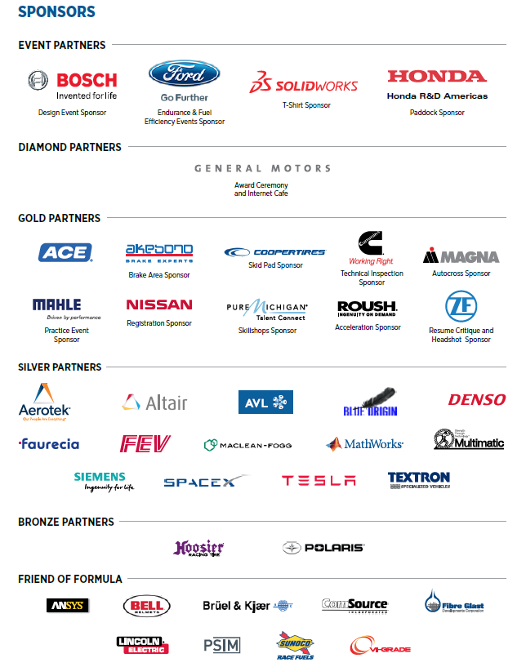
FSAE MICHIGAN SPONSORS

