Slide 1
2013 Formula SAE Rule Clarifications and Examples
29-Jan-2013
Version 1.1
This document is subject to change and update. Please check the SAE website for the latest version.

Slide 2
Introduction
This document is intended to address common questions about the rules and clarify with additional pictures, illustrations and examples.
This document is reference only and any conflicts between this document and the rules the rules prevail. This is simply a clarification and expansion of the intent of the rules.
These drawings are only provided to give you examples of some possible configurations of certain frame structures that are and are not acceptable. These drawings are not fully inclusive and there are many other solutions possible. This document is published only as a starting point and we are not recommending any particular bracing configuration.
As always the acceptability of a given design depends on both design and fabrication. All vehicles are subject to final approval at technical inspection.

Slide 3
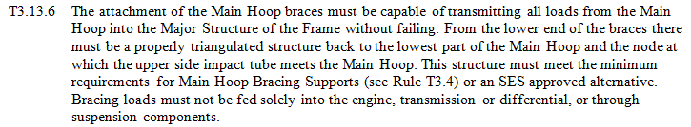

T3.13.6 Main Roll Hoop Brace Bar Support Options
Fig 1
Fig 2
Fig 3

Slide 4
T3.13 Main Roll Hoop Brace Bar Support Options
Fig 4
Fig 5
Fig 6
Fig 7
Fig 8

Slide 5
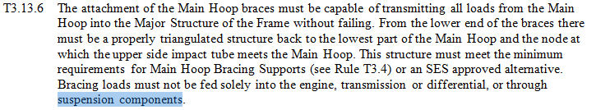
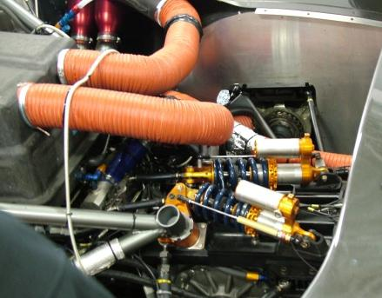
T3.13 Main Roll Hoop Brace Bar Support Options
Question: I have a question concerning rule T3.13.6, specifically the last sentence that states,
"Bracing loads must not be fed solely into the engine, transmission or differential, or through suspension components"
This year we want to attach our rear supports to the posts that fixture our rockers to our car and were wondering if this would be considered a "suspension component“. A structural equivalency will be submitted for proof of the rear supports and post.
The design mentioned above has been utilized in the GT series as shown.
Answer: The picture shows exactly what the rule was written to prevent. This arrangement is not allowed. It would be acceptable if there was additional tubing providing triangulation and a redundant load path before the attachment to the rocker post, if the tubes are properly sized and follow the rules.

Slide 6

T3.18.1 Frontal Impact Structure
Feet outside major structure of the frame

Slide 7
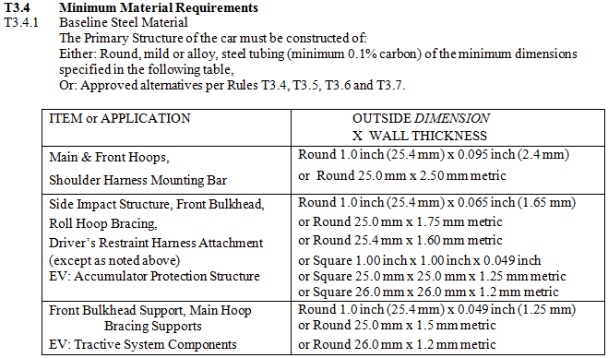
T3.18.1 Frontal Impact Structure
Feet within major structure of the frame
New tube must meet minimum for primary structure (1.0 x 0.049 in – see B3.3)
Other configurations possible but intent is to shown that when viewed in side, driver must be below 1.0 x 0.049 tube.

Slide 8
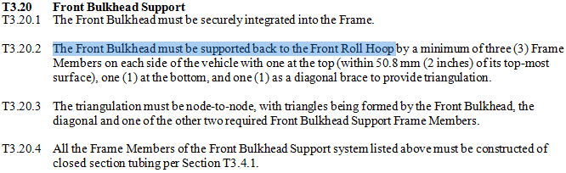
T3.20 Front Bulkhead Support
For 2013 the front bulkhead support must extend to the front roll hoop. This is different than 2009 but the same as 2010, 2011 and 2012
Examples
Or navigate to:
http://www.fsaeonline.com/content/FSAE_Front_Bulkhead_Support.xls

Slide 9
T3.20 Front Bulkhead Support
T3.20 Front Bulkhead Support
T3.20.1 The Front Bulkhead must be securely integrated into the Frame.
T3.20.2 The Front Bulkhead must be supported back to the Front Roll Hoop by a minimum of three (3) Frame Members on each side of the vehicle with one at the top (within 50.8 mm (2 inches) of its top-most surface), one (1) at the bottom, and one (1) as a diagonal brace to provide triangulation.
T3.20.3 The triangulation must be node-to-node, with triangles being formed by the Front Bulkhead, the diagonal and one of the other two required Front Bulkhead Support Frame Members.
T3.20.4 All the Frame Members of the Front Bulkhead Support system listed above must be constructed of closed section tubing per Section T3.4.1.
Question: Is it permitted to use multiple tubes to make up each of the required front bulkhead support members if they are not in a straight line? What about bent tubes?
Answer: Yes, but the minimum sizes given in the rules are for single straight tubes. Having non straight tubes (either multiple mitered tubes or bent tubes) reduces the strength. A 3rd tube is required in this case per B3.4.5 to carry the additional load, and it must meet the minimum structural requirements (1.0” x 0.049”). Other arrangements and configurations may be submitted for review through an SEF. Increasing the tube size for non-straight tubes may also be submitted as an SEF to avoid additional tubes.

Slide 10
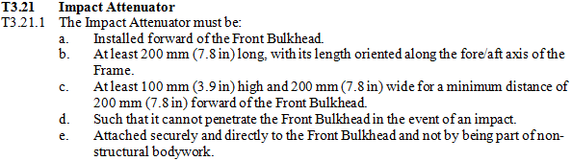
T3.21 Impact Attenuator
Question: This rule states that the impact attenuator must be at least 7.8 inches long and
wide and at least 3.9 inches high. These dimensions make up a rectangle, but is the required shape of the impact attenuator required to be rectangular? For instance, I am planning to make more of a cone shaped impact attenuator and wanted to know if this would be okay?
Answer: Per rule B3.20.1, the Impact Attenuator must have the minimum rectangular dimensions of 200mm (7.8 inch) long by 100mm (3.9 inch) high by 200mm (7.8 inch) wide. The IA can be bigger than the minimum dimensions but the specified minimum “box” must be present within the design. Essentially, a rectangle of those dimensions must be fully contained within the impact attenuator volume for it to comply with the rules. Any shape other than rectangle must consist of additional volume of material in addition to the rectangle. Please be sure the additional material will still allow the IA to meet the energy absorption requirements of rule T3.22.1.

Slide 11
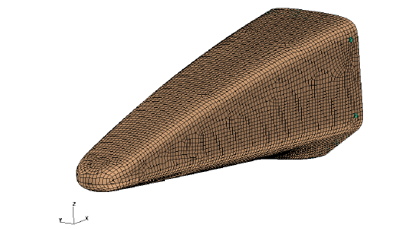
T3.21 Impact Attenuator
Fig 1
Fig 2
Rectangle of minimum dimensions fits within envelope of actual impact attenuator.
While length, width and height meet the minimum sizes in the rules the rectangular volume does not fit within the surface of the attenuator.

Slide 12
T3.22 Impact Attenuator Data Requirement
Question # 1: According to the rule T.3.22.1, the team must submit test data to show that their Impact Attenuator, when mounted on the front of a vehicle with a total mass of 300 kg (661 lbs) and run into a solid, non-yielding impact barrier with a velocity of impact of 7.0 meters/second (23.0 ft/sec), would give an average deceleration of the vehicle not to exceed 20 g’s with a peak deceleration less or equal to 40 g’s. To simulate such a scenario, I would need to attach a 300kg mass to my impact attenuator and raise it to a height that is derived from the conservation of energy. Due to the lack of facilities, I am unable to raise it to this required height. To overcome this, I would like to drop a heavier mass from a lower height. Is this acceptable?
Answer # 1: We purposely do not specify how a team must test their Impact Attenuator because different universities have different levels of facilities and capabilities. How you test your Impact Attenuator is up to you.
Question # 2: I have a question regarding the Impact Attenuator Testing method. Does the test have to be a 661lb object striking a solid barrier or can it be a smaller weight with a higher velocity?
Answer # 2: The Rules do not specify how the test data should or should not be acquired. They do not even require that the test be a dynamic test. That is up to the teams to decide. However, a strong case could be made for stating that energy is energy, and that for a dynamic test, a smaller mass at a higher velocity is equivalent!
Question # 3: Can we use a press to simulate the impact attenuator test?
Answer # 3: Yes, a steady state crush test with a press can be used for your impact attenuator testing. The Rules do not specify what form of test you must use. We left it open because of the different levels of equipment that universities have. There are many test methods available to you and it is up to each team to select one appropriate to your test equipment and resources. Just make sure you clearly explain your test method and supporting calculations to relate it back to the design requirements.

Slide 13
T3.22 Impact Attenuator Data Requirement
Question # 4: Rule T3.22.1 states the impact attenuator has to be designed for a total mass of 300 kg (661 lbs). Can we scale down the test for the actual test we perform? In other words, can we test half the mass with half of the crush area? We feel this would be safer and more practical, especially if we have to go through many iterations of design if our current one fails.
Answer # 4: The mass and velocity specified in the rules are to set the design requirements for the impact attenuator. They are not intended to specify the only test method for evaluating your design. You are free to modify the mass and velocity as long as you achieve the required energy level. Also, you are not required to conduct a dynamic impact test. A steady state crush test could be conducted on your impact attenuator. There are many test methods available to you and it is up to each team to select one appropriate to their test equipment and resources. Just make sure you clearly explain your test method and supporting calculations to relate it back to the design requirements.
However, although the Rules do not specify that the tests for the IA Data Report MUST be done on full size test pieces, the Rules Committee intended that to be the case, and Rules B.3.21.3 and B.3.21.4 imply that tests on full size pieces are required. Also, the consensus of those who review the Impact Attenuator Reports is that scaling down the size of systems such as Impact Attenuators is extremely difficult to obtain accurate results. This is because there are many factors involved that cannot be scaled correctly. It is especially so with composites.
To quote one of the reviewers: “Scaled model testing is too complicated, and with composites even more so to capture the right failure modes in scale.”
And from another reviewer: “In my experience, it is very difficult to relate results from a scaled assembly test to full size assemblies unless EVERY aspect of the design is scaled (fasteners, bond lines, etc.) due to complicated failure modes in an assembly.
Therefore, as we have not been specific in the Rules, scaled-down testing of the Impact Attenuator is not prohibited. However, teams that do not run tests on full scale IA’s will need to justify in their report, that the scaling has been done correctly, and will be graded accordingly.”

Slide 14
T3.22 Impact Attenuator Data Requirement
Question #5: Rule T.3.22.1 states that “The team must submit test data to show that their Impact Attenuator, when mounted on the front of a vehicle with a total mass of 300 kgs (661 lbs) and run into a solid, non-yielding impact barrier with a velocity of impact of 7.0 metres/second (23.0 ft/sec), would give an average deceleration of the vehicle not to exceed 20 g’s, with a peak deceleration less than or equal to 40 g’s.”
- What is the intent of this rule? To protect the driver? To protect the vehicle? To challenge the design students?
- At what time does the "average deceleration" begin to be averaged?
- When is the test considered "complete" (i.e. when do you stop averaging the deceleration)?
- Can the energy dissipation of the material used for the impact attenuator can be assumed to be independent of the rate at which it is crushed for calculation purposes?
Answer #5: The answer to your first question is “Yes to all of the above.” The impact attenuator data requirement is intended to make the front impact attenuator effective at absorbing energy in a collision. We are trying to add specific functional targets to insure all attenuators will operate and will safely decelerate the car in the event of a collision. The specifics parameters were chosen to maximize energy adsorption while insuring the “g” loadings would be at safe levels for the driver. Most of your specific questions we cannot answer directly, as the rule is purposely open ended to encourage students to think through the design challenge.
Here are a few general guidelines:
- At what time does the "average deceleration" begin to be averaged? One logical point would be when the attenuator begins to carry load.
- When is the test considered "complete" (i.e. when do you stop averaging the deceleration)? Again, one place to consider the test complete is when the vehicle achieves zero velocity.
- With respect to the rate of energy dissipation of the material, we cannot answer your question. So much depends on the material and other factors.
One component of your submission will be to clearly state the assumptions of your calculations, and why you made them.
Question # 6: What do the officials or the judges do with the Impact Attenuator Reports?
Answer # 6: Every Impact Attenuator Report is reviewed and judged to meet the rules requirements. The decision is passed back to teams and any reports that do not meet the requirements for performance, data gathering or data analysis are required to be redone and resubmitted before the car will be allowed to pass technical inspection at the competition.
Question # 7: Can dynamic simulation results, such as finite element analysis, be submitted instead of actual physical testing?
Answer # 7: No, actual test data must be submitted. Even in Formula 1 where teams have access to sophisticated crash modeling software physical tests are always performed to certify the impact structures to the FIA.

Slide 15
T3.34 Monocoque Front Hoop
T3.36 Monocoque Front Hoop
T3.36.1 Composite materials are not allowed for the front hoop. See Rule T.3.28 for general requirements that apply to all aspects of the monocoque.
T3.36.2 Attachment of the Front Hoop to the monocoque must comply with Rule T3.40.
T3.40 Monocoque Attachments
T3.40.1 In any direction, each attachment point between the monocoque and the other primary structure must be able to carry a load of 30kN.
Question: Does the new rule T3.36 and T3.40 mean that integrally bonded in front roll hoops are no longer permitted?
Answer: No, it simply means the SEF needs to show the equivalency calculations for the integral front hoop as having the required attachment strength.

Slide 16
IC2.4.5 Fuel Tank Emptying
Question: Rule IC2.4.5 states "The fuel system must have a provision for emptying the fuel tank if required." What should this provision look like? Must it take the form of a drain plug (emptied by the force of gravity), or can the fuel line be disconnected such that the fuel pump can pump the fuel out (forced out)?
Answer: You may use the fuel pump to siphon out the fuel from the tank. If you choose to design a drain in the tank, we would urge you to use sound engineering practices when designing the location, method of sealing and robustness of the drain plug. For this reason, a petcock-type valve that protrudes from the bottom of the tank would not be acceptable, as it may be susceptible to damage from the road surface. If the drain plug is flush mounted, locating it on the bottom surface of the tank should be acceptable or you can mount a drain on the lowest portion of the side of the tank. Just make sure you can fully drain the tank. If you use a drain plug, make sure you understand how to design the sealing method and factor in all the potential noise factors (heat, fluid exposure, etc.) and failure modes (compression set of elastomeric seals, thermal limits, fluid comparability, etc.). The Tech Inspectors are very sensitive when it comes to potential fuel leaks at the event.

Slide 17
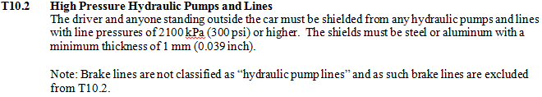
B13.2 High Pressure Hydraulic Pumps and Lines
Question: Can you explain more about T10.2?
Answer: The rule has two criteria to evaluate whether a certain line must be shielded:
1) The line must operate at pressures above 2100 kPa (300 psi) gauge
2) The line must be connected to a pump or large reservoir of hydraulic fluid such that if a line failed it could result in a significant volume of fluid flowing out of the line.
Using this clarification here are some examples:
Brake lines: Not regulated by T10.2. While containing high pressure hydraulic fluid they are not connected to a pump or large reservoir so no flow would result from a failure.
Engine oil lines: Not regulated by T10.2. While connected to the engine oil pump and meeting the requirement of flow they are not at a high enough pressure to require shielding by T10.2. So any lines driven off an engine oil pump or external pressure/scavenge pump with engine oil are not regulated by T10.2.
Active Suspension Hydraulic Lines: Regulated by T10.2. Lines connecting the actuator to the hydraulic pump running at 17 MPa (2500 psi) would require shielding.
Note: Rule T4.5 Firewall applies to all the examples above including engine oil lines.

Slide 18
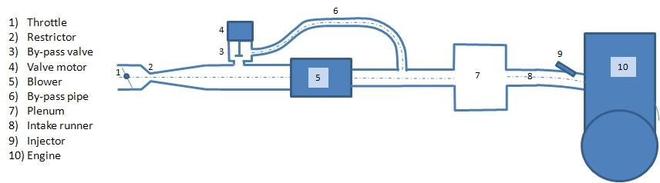
Supercharger Bypass
Question: The sketch below shows the by-pass system we would like to install. As Please note that the by-pass is installed downstream of the restrictor and the throttle, so it is neither affecting the maximum airflow rate, nor interfering with the load control.
Answer: The proposed system is allowed because it is all downstream of the restrictor.

Slide 19
IC1.1.1
Question: What sort of engine has “a primary heat cycle”?
Answer: The idea here is that the primary heat cycle is the 4-stroke cycle we all know and love. Previously you were only allowed to have a primary heat cycle, except for turbo chargers which have a secondary heat cycle which is extracting thermal energy from the exhaust to drive the compressor wheel. The idea is now if you want to use the exhaust gas that was burned in the 4-stroke cycle you can do something with it to generate more power. The idea is not to build a hybrid where you store the energy, but you could mechanically extract and use it immediately. For example, you could run the exhaust through a heat exchanger to heat up water to steam and use the steam to power a piston-cylinder. That’s not the best example but we’re trying to allow advanced powertrain technologies along the lines of waste heat recovery.

Slide 20
Idle Air Control
Question: I would like to know if it is legal to use the ecu to control the idle speed. The rule in question is:
IC1.5.2 Throttle Actuation
The throttle must be actutated mechanically, i.e. via a cable or a rod system. The use of electronic throttle control (ETC)
or "throttle-by-wire" is prohibited.
Answer: Electronic Idle air control is not allowed per the current rules but is under study for inclusion in the 2015 rules update

Slide 21
EV5.6 Brake System Plausibility
Device Reset
Question:
Can there be a driver switch to reset the Brake System Plausibility Device?
Answer:
The Brake System Plausibility Device may only be reset by power cycling the Grounded Low Voltage Master Switch

Slide 22
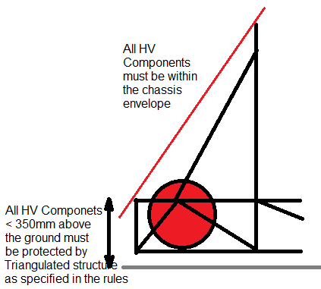
EV4.2 Positioning of the Tractive System
Question:
Please can you clarify where the tractive system components can be placed
Answer:
See the figure. Below 350mm above the ground, the tractive system components must be protected from impacts from the side and rear by a triangulated structure with the specified tubing sizes.
Above 350mm above the ground, the tractive system components must be within the frame envelope such that they are protected from rollover (within the red line)
Note: the tractive system components including the accumulator container must be inside the structure and therefore cannot also be the equivalent structure

